Slide 1
IITB Techfest Researcher Discovery Platform Challenge
TEAM ID : RD-215318
TEAMMATES : HARSH GANDHI
ADITYA DHAWARE
REUBEN COUTINHO

Slide 2
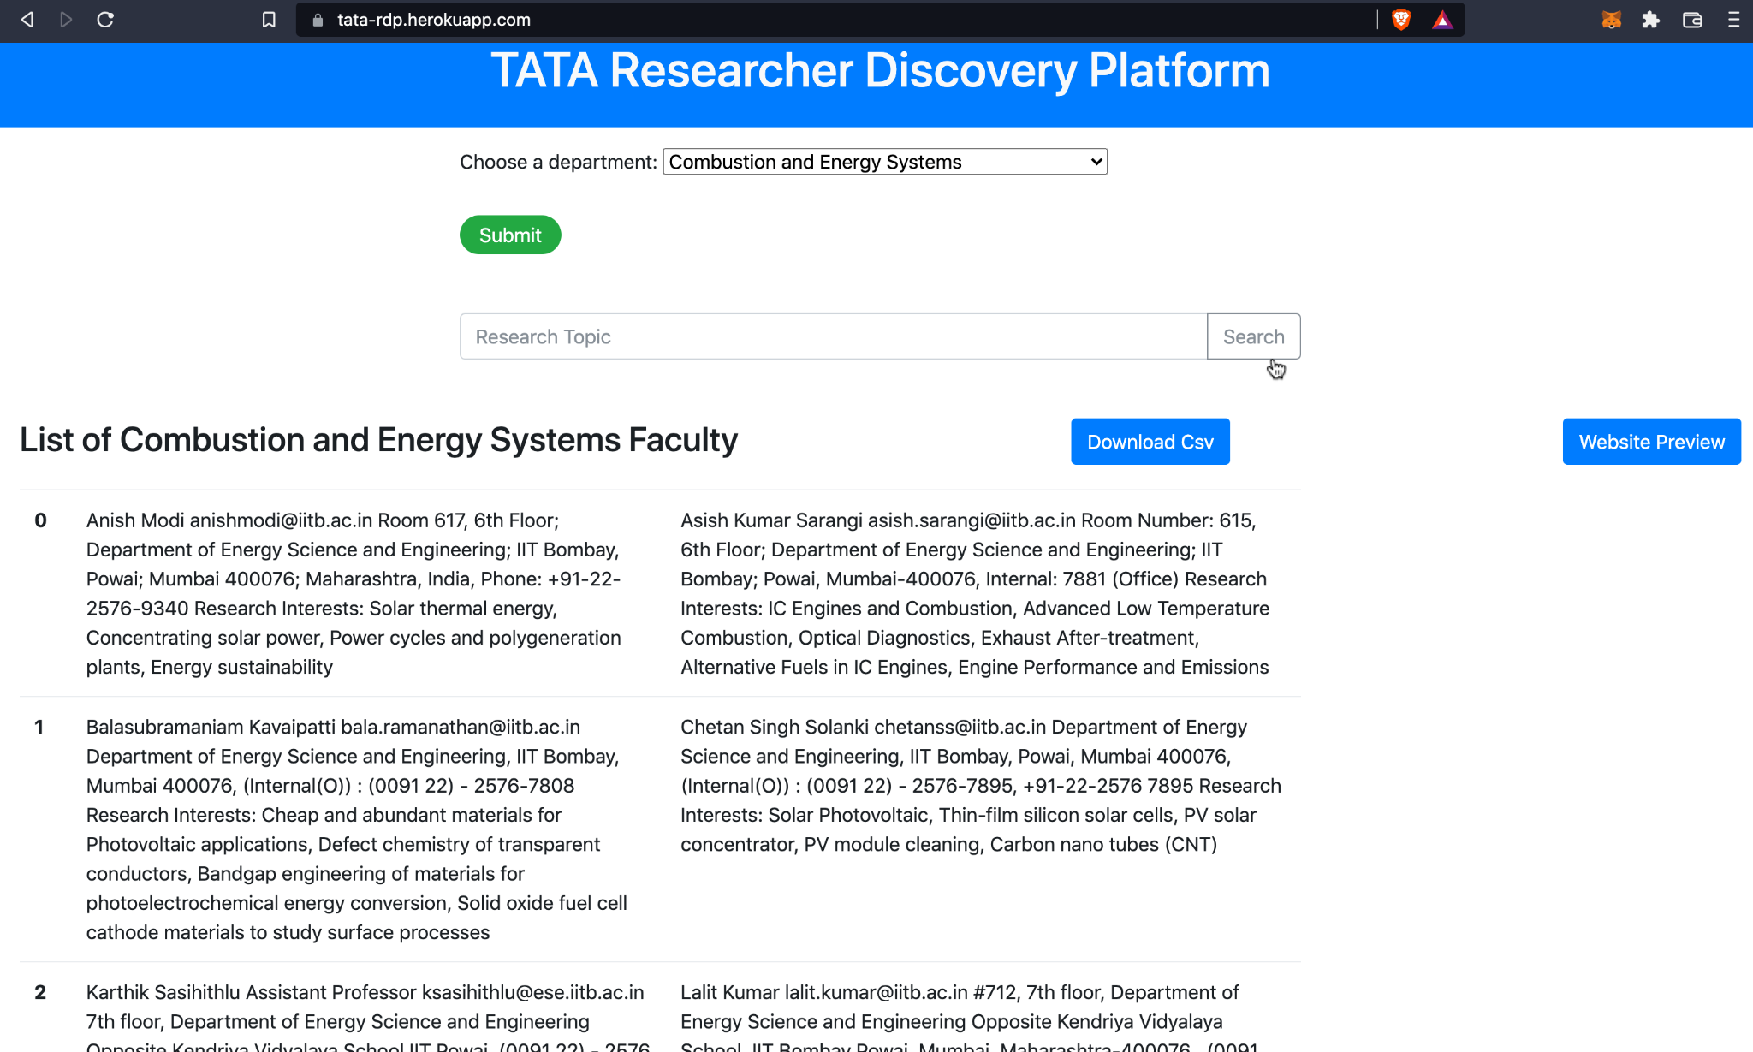
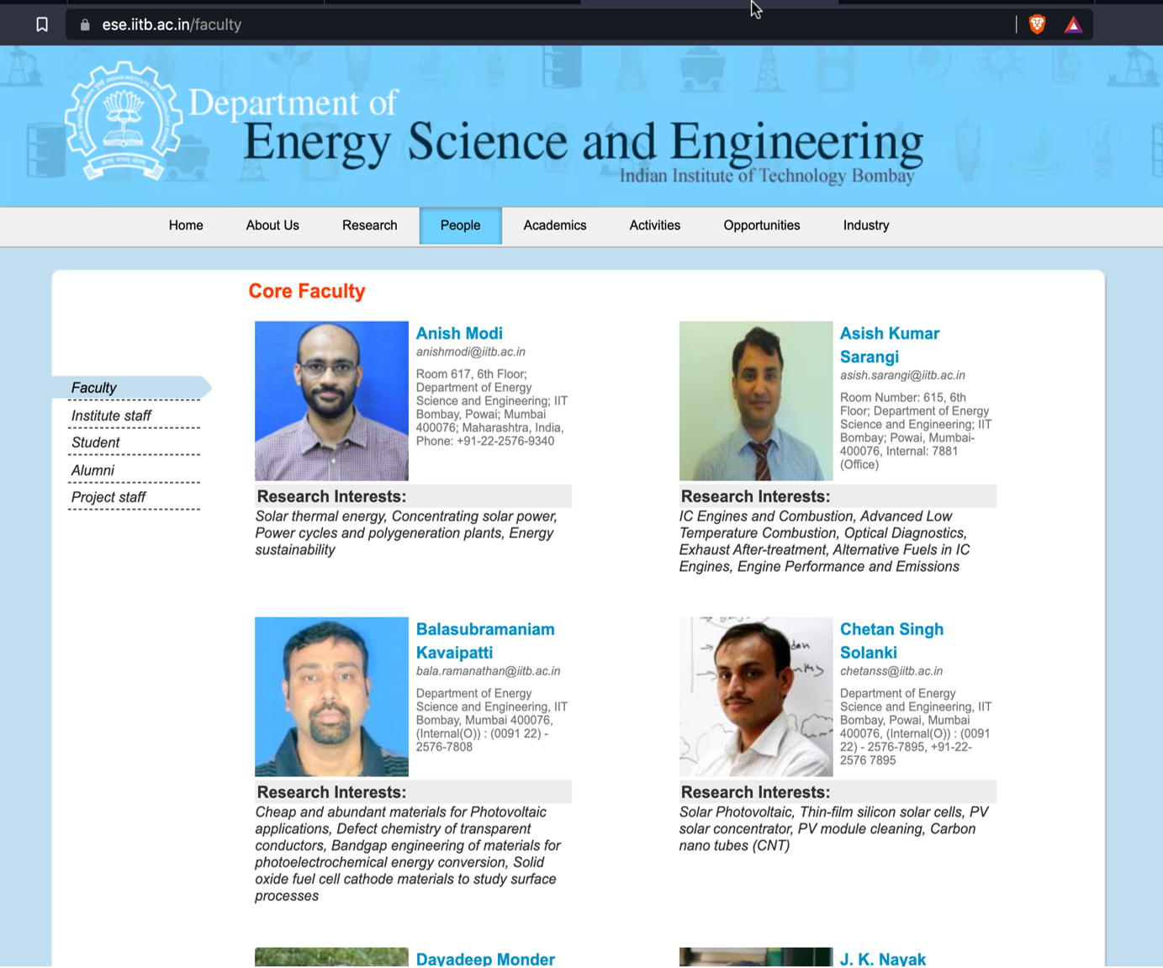
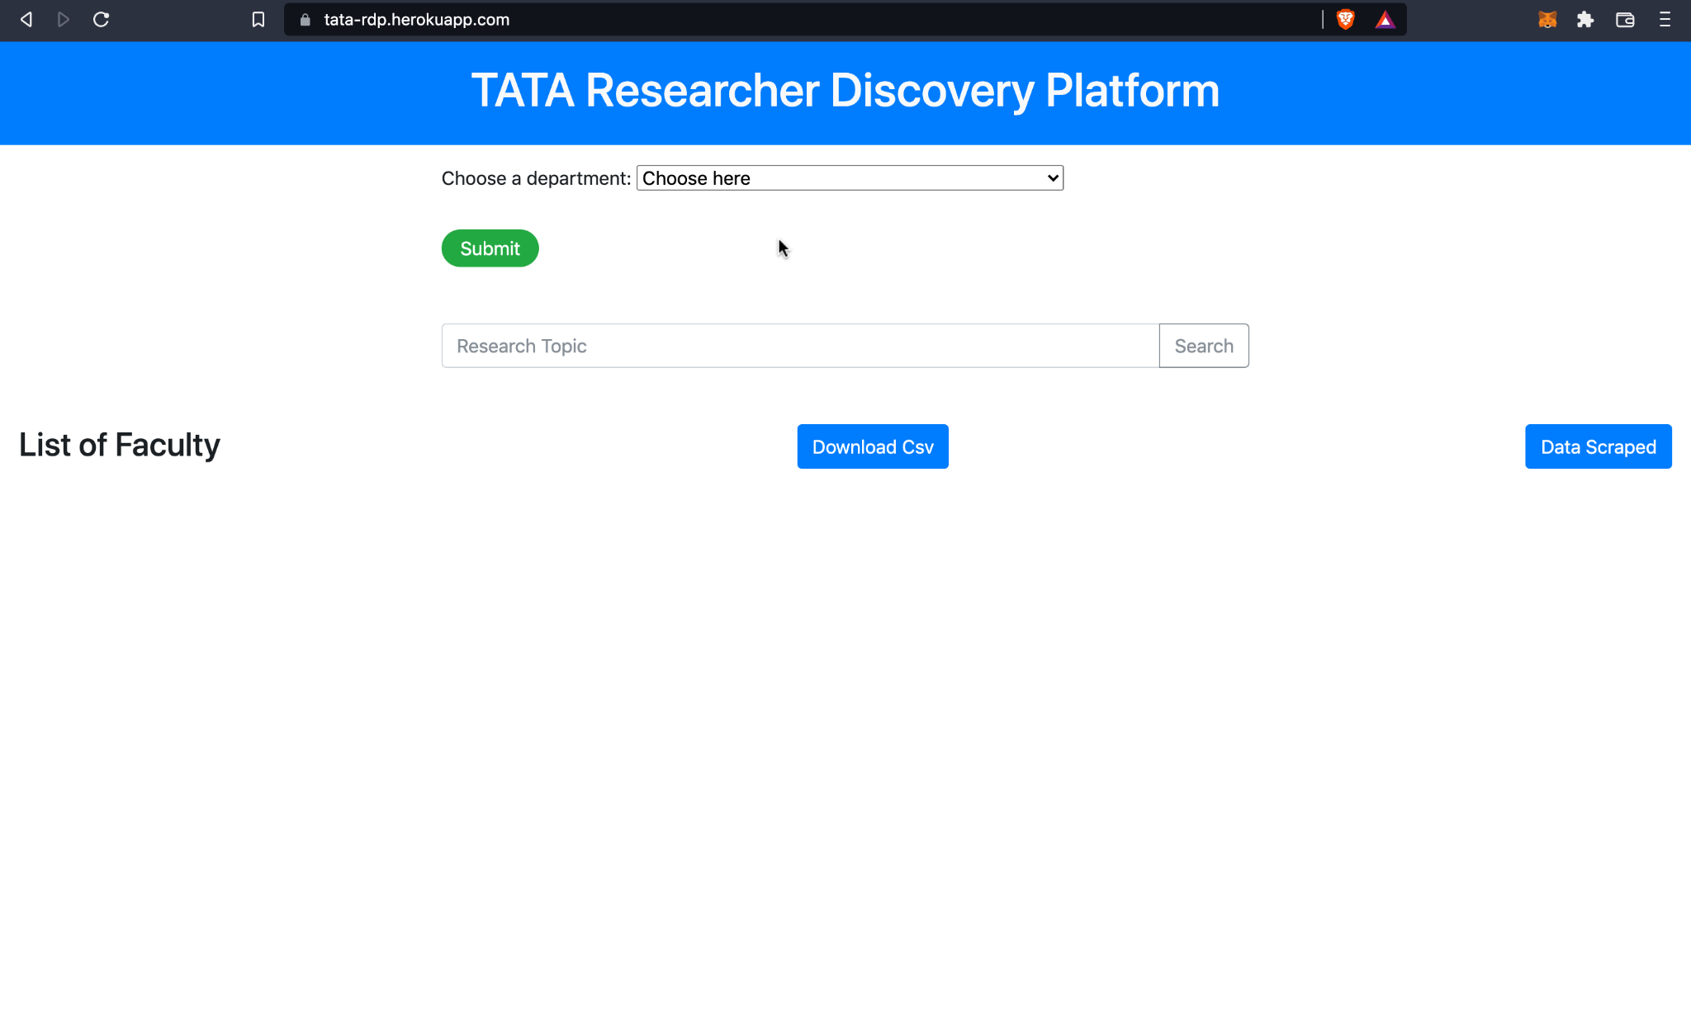
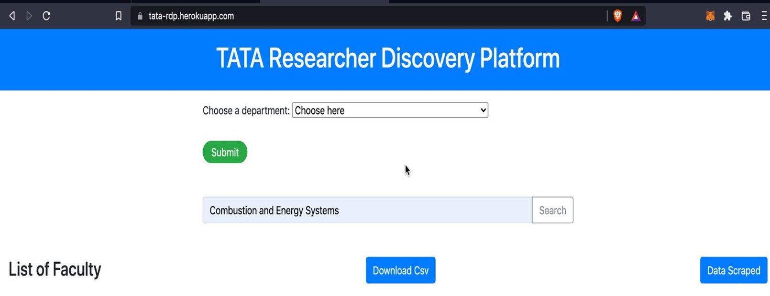
FLOWCHART
USER’S INPUT
' INDIAN ENGINEERING FACULTY NAMES '​
START
Run the flask app
SCRAPED DATA
USER INPUT
Take input from the user from dropdown or input textbox from website.
FACULTY DETAILS STORED IN TABULAR FORMAT
‘ Combustion and Energy Systems ’
' INDIAN ENGINEERING FACULTY NAMES '​
CRAWLING
Web crawling is done based on the user’s input, a query is created and passed as parameter to google module.
Googlesearch Module
Using google SEO, it returns top Institute websites links containing research faculty​.
NLP
SCRAPING
The websites obtained after crawling is scraped to extract research faculty details.
FACULTY DETAILS STORED IN <div> FORMAT
( MAXIMUM OCCURING <div> FREQUENCY METHOD )
NLP
Using NLP, we filter out the unwanted data.
Result
We display the then obtained data on our website in tabular format

Slide 3
Unique Value Proposition?
Pros and cons of approach?
Dropdown feature to search faculty department wise​.
Input textbox where user can search any research topic if he/she does not know which department his search query will belong to
Googlesearch module helps integrate SEO and helps in crawling thousands of websites and obtain the top 10 links for research faculty institute website.
Exporting to CSV.​
NLP (Spacy) to increase the accuracy ​​
Adequate amount of research faculty data for any given research topic.
NLP to eliminate negative true’s.
Fetching of the link depends upon the college SEO.
Time complexity.
Design choices made?
User-friendly web application.
Easily scalable model.

Slide 4
What elements are present in the solution?
2. How far solution reached?
3. What challenge we faced?
4. Next steps?
We are getting faculty name, phone no, email address, research interest specialization.
Currently, we have achieved 70% of the solution.​
It was challenging for us to dynamically fetch the links of different institute website to scrape the data.
Improvement in NLP/ML model to increase the accuracy and reduce irrelevancy of data.
More efficient technique to scrape institute website scraping technique.
Decrease Time complexity

