Slide 1
Quark - High Performance Secure Container
#ossummit
Notes:
Hello Every one, welcome again to OSS and hope you enjoyed the conference. And thank you for coming to our talk
My name is YX, I am from FW. My team mate Yulin is also here
We will present and talk about Quark container, a new high performance and secure container.

Slide 2
Agenda
Introduction & Background
Quark Architecture & Design
Preliminary Performance Test Results
Other Built-In Performance Features
Q&A
Notes:
Here is the agenda we have prepare for this talk
I will get started with introduction & background. Who are we and some background why we built a new container.
Then Yulin will take over and talk about detail of Quark design and its architecture
He will also talk about preliminary test results, to compare Quark with RunC, gVisor and Kata
Hopefully in the end we have time to answer questions you may have.

Slide 3
Introduction & Background – Why Quark
Secure container for Serverless with low startup latency
Lightweight container for edge applications
High performance container communication for AI & other network sensitive applications
Notes:
So YOU MAY ASK WHY WE BUILD ANOTHER CONTAINER WHILE WE HAVE Kata, gVisor, now WebAssembly.

Slide 4
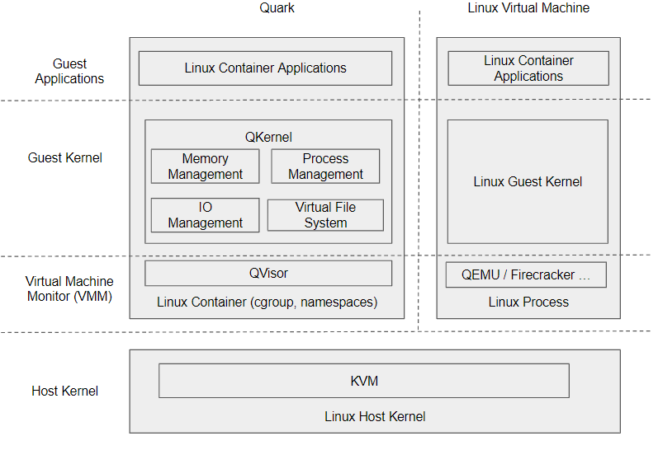
Quark Design #1 - System Call Virtualization

Slide 5
Quark Design #2 – IO Optimization
HCall (Hyper Call) :
QCall (Quark Call) :
Submit Queue ( Share memory)
Task manager integration: No Complete Queue
No guest/host context switch
UCall (IO-Uring Call):
Submit Queue: IO-Uring
Complete Queue: IO-Uring
Bypass QVisor
RCall (RDMA Call):
Zero memory copy from QKernel
Bypass Linux kernel
Dedicated control plan service
Linux Container Application
Quark Runtime
QKernel
Guest
Memory Manager
Task Manager
HCall
QCall
UCall
RCall
Host
File System
IO System
QVisor
Linux Container
Linux Host Kernel
RDMA NIC

Slide 6
Preliminary Test Results - Memory Overhead
The numbers are from the tests with an old version of Quark
Memory were measured after container startup with no traffic

Slide 7
Preliminary Test Results - Startup Latency
The numbers are also from the tests with an old version of Quark
A simple container app (check system date/time) was used for the tests

Slide 8
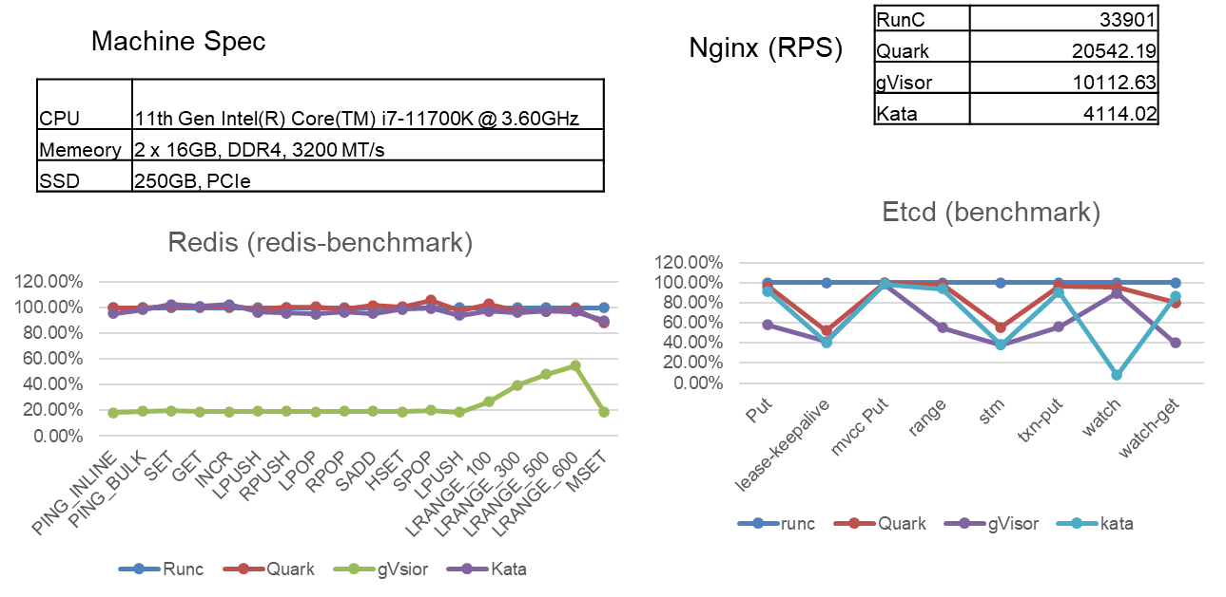
Preliminary Test Results - Request Per Seconds (RPS)

Slide 9
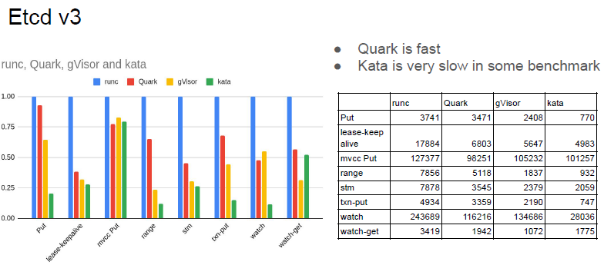
Preliminary Test Results - Transaction Performance

Slide 10
Other Built-In Performance Features
TCP Socket Over RDMA
Hibernate Container

Slide 11
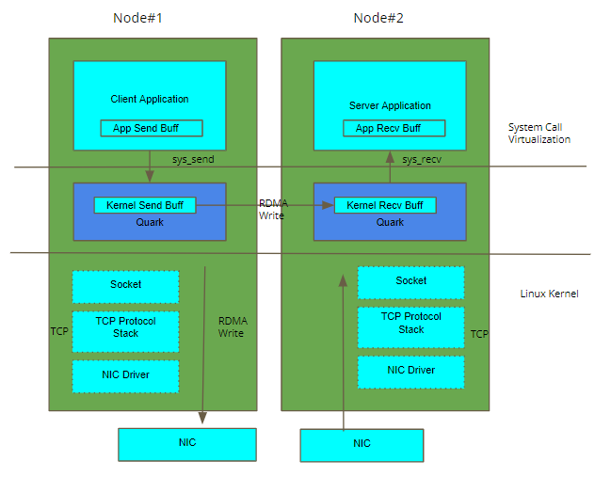
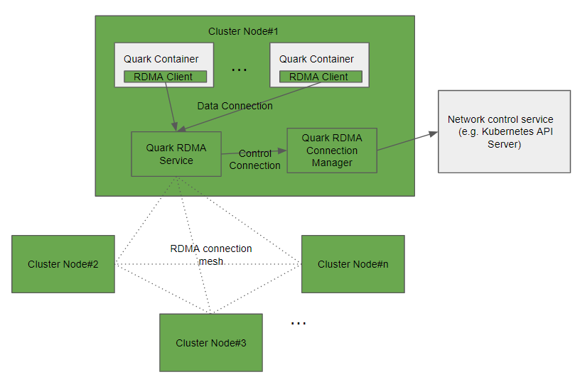
TCP Socket Over RDMA - Design
1. TCP Socket Virtualization
2. Container Network Integration

Slide 12
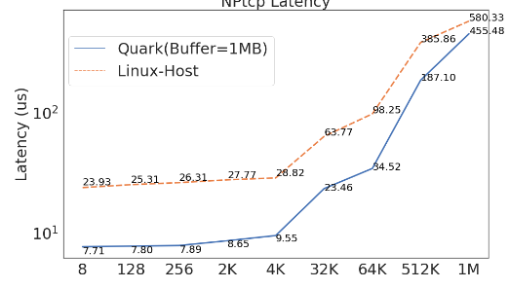
Test Result

Slide 13
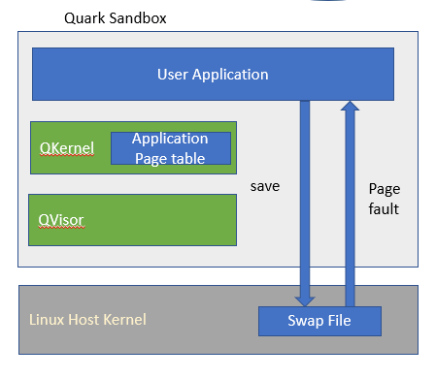
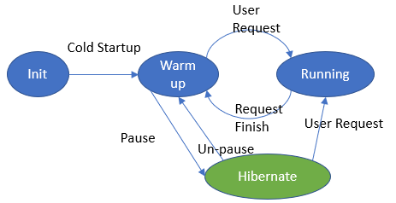
Hibernate Container

Slide 14
Q & A
Quark https://github.com/QuarkContainer/Quark
Perf test result https://github.com/QuarkContainer/Quark/blob/main/doc/perf_test_result.xlsx
Centaurus https://www.centauruscloud.io/

Slide 15
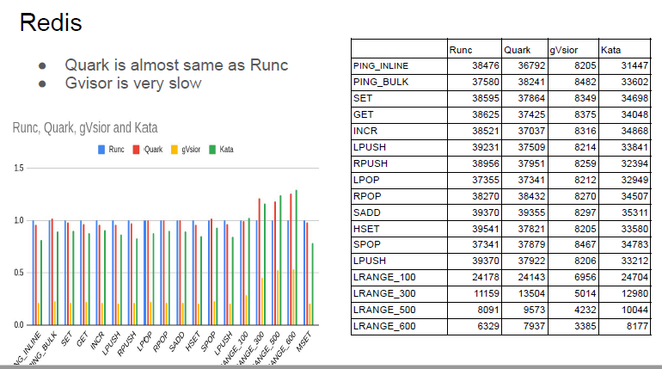
Preliminary Test Results - Transaction Performance

Slide 16
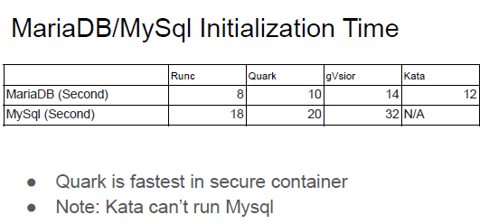
Preliminary Test Results - DB Initialization Time

