Slide 1
Cloud Lab Open-Source Projects & Planning
Through open source & open collaboration, research and design advanced technologies & solutions to solve big technical challenges and improve competitive advantages in cloud computing
Projects & Planning
2022-2023 focus and Goals
Centaurus Compute
Centaurus Network
Centaurus AI
Cloud Storage
Region less Platform
Cloud Native SDN & U-VPC
GPU Profiling & Model Analysis
OpenGauss on Chogori
Edge Serverless Computing
Programmable Data Plane
Data Efficiency for AI Platform
Tiered Memory - DRAM/SCM/NVMe
Container Runtime & Virtualization
Large Scale Network Simulation
I/O & RDMA Acceleration for AI
Push-Down Computation
Distributed Scheduling
Smart NIC
Acceleration
AI Model optimized for Platform
Geo-distributed Transaction
SLO Cloud
AI Based Network Data Analysis
Intelligent/Optimized scheduling
Scalable, Fault Tolerant Clock
Arktos Compute
Mizar/eBPF
Elastic Training Framework
Distributed PostgreSQL
Edge Cluster & Edge-to-Edge Gateway
Alcor SDN
GPU Sharing
Global Clock & Transaction Protocol

Slide 2
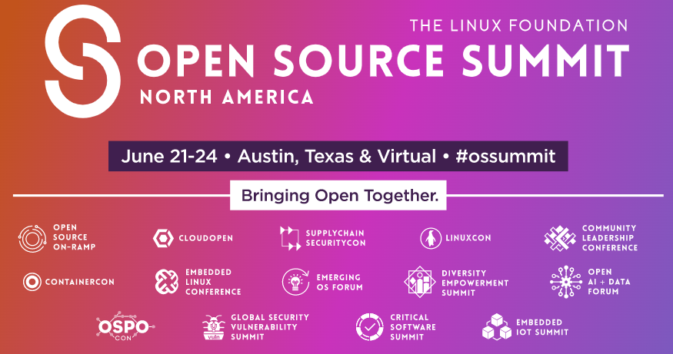
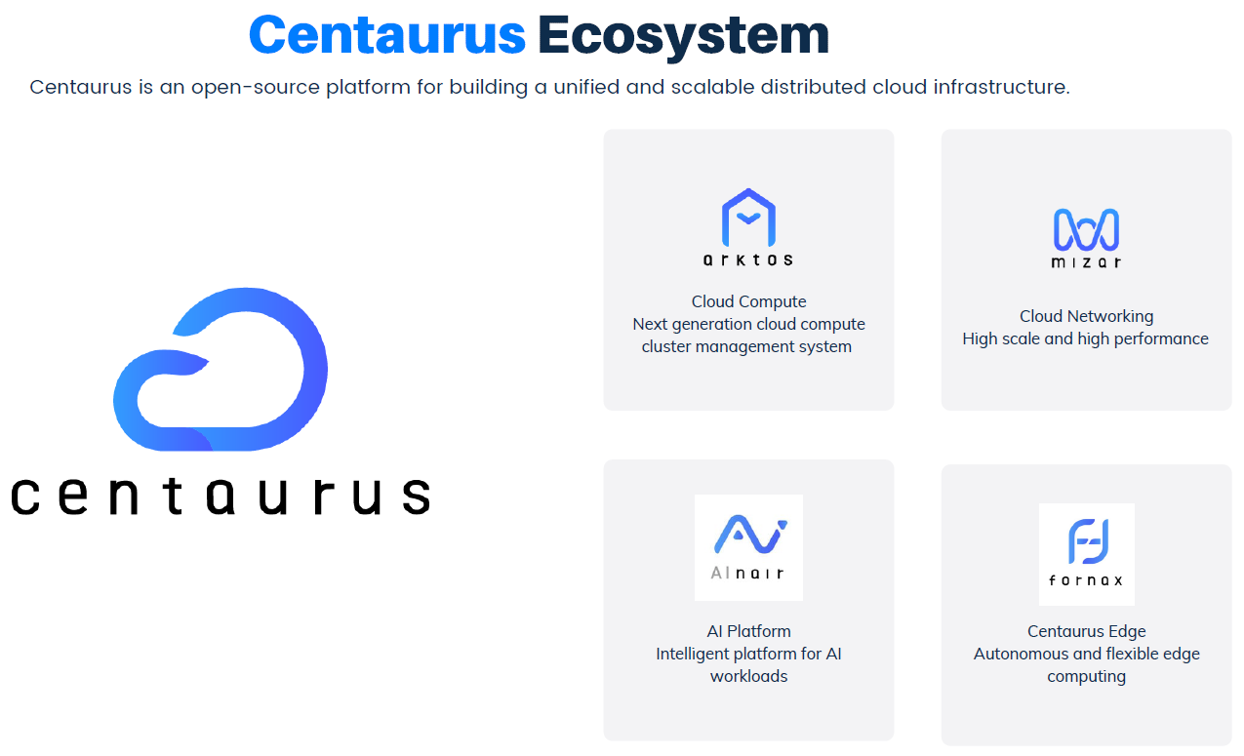
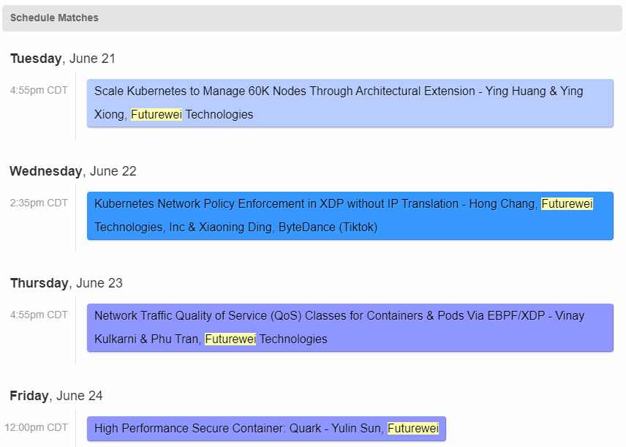
Centaurus Project Ecosystem
https://www.centauruscloud.io/

Slide 3
2022/23 Cloud Compute Project – Centaurus 2.0
Centaurus Regionless Computing
Goals & challenges
New model to use cloud – from resource-based to application-based cloud (cloud native 2.0)
Manage 2 million+ compute nodes from big, small & edge data centers as global resources
Distributed scheduling algorithm and scheduler architecture to scale to 10K RPS throughput.
Design geo-distributed data consistent KV store to manage 100 millions application instances
Large scale virtual network (VPC) to provision & manage 1 million+ application/vm instances
Centaurus Edge & Serverless Computing
Goals & challenges
Extreme low latency (<100 ms) for starting application instance at edge & auto scale to handle burst requests
The platform itself must be very Lightweight – use minimum resources (less than 10GM/3CPU to manage 5K application instances
Multi-tenant edge computing clusters with strong computing/networking isolation.
High performance scheduling algorithm (<10ms) to allocate application instance onto a node
Centaurus 2.0
Centaurus Regionless Computing Platform (Arktos 2.0)
New Application Model and API
Global Resource Management Service
Global Distributed Scheduler
Geo-Distributed
KV Data Store
Distributed Data and Message Bus
Universal Virtual Network (U-VPC)
Centaurus Edge Serverless Platform（Fornax Serverless ）
Centaurus Container Virtualization ( Quark Container Engine)
Centaurus Container Runtime Engine
Goals & challenges
High performance and secure container runtime – 3X Kata & gVisor in RPS & Throughput
Light weighted container – memory overhead 1/3 of gVisor and 1/15 of Kata container
RDMA based network communication & NVMe/NVMeOF based direct device access – 30% Performance Gain

Slide 4
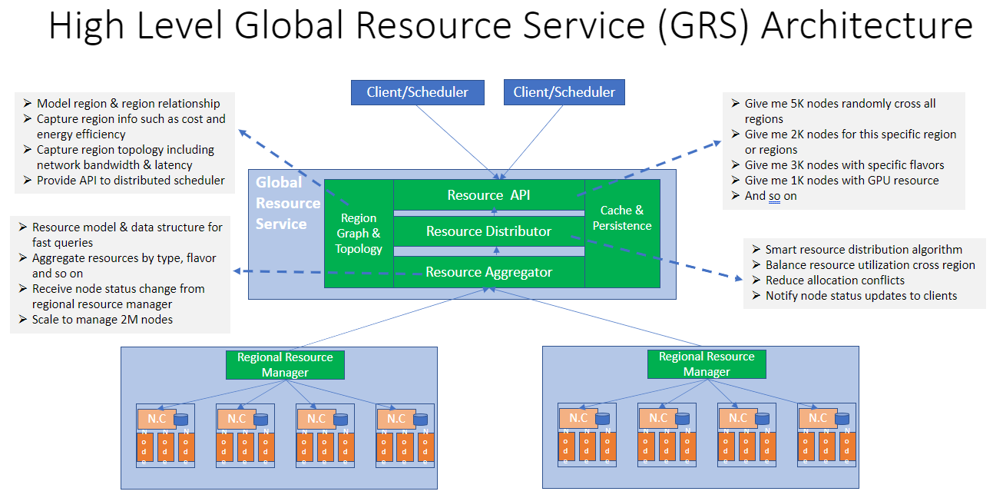
Centaurus 2.0 – Regionless Platform: Global Resource Services
Centaurus Regionless Computing
Goals & challenges
New model to use cloud – from resource-based to application-based cloud (cloud native 2.0)
Manage 2 million+ compute nodes from big, small & edge data centers as global resources
Distributed scheduling algorithm and scheduler architecture to scale to 10K RPS throughput.
Design geo-distributed data consistent KV store to manage 60 millions application instances
Large scale virtual network (VPC) to provision & manage 1 million+ application instances

Slide 5
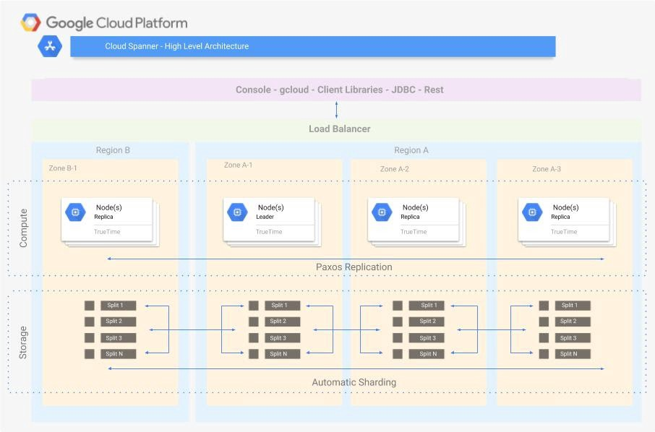
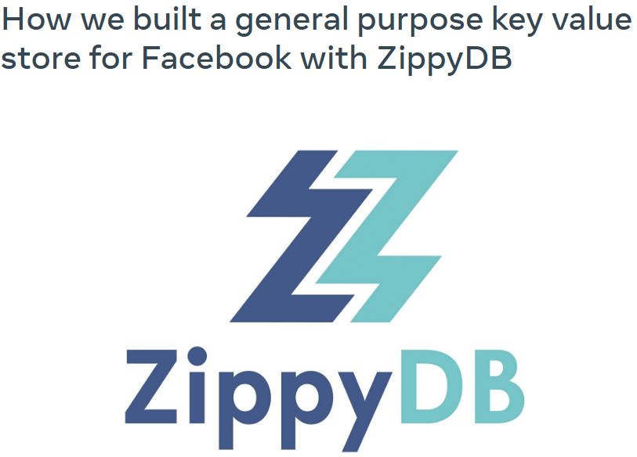
Centaurus 2.0 – Regionless Platform: Global KV Store Service
Problem: How to build a geo-distributed KV store guaranteeing low latency for strongly consistent access
Why: A fundamental component for a regionless platform or a service
Approach: Two in parallel
A true Spanner-like geo-distributed database with strong consistency
A global layer with smart partition/sharding and smart cache, and somewhat consistency cross region
Centaurus Regionless Computing
Goals & challenges
New model to use cloud – from resource-based to application-based cloud (cloud native 2.0)
Manage 2 million+ compute nodes from big, small & edge data centers as global resources
Distributed scheduling algorithm and scheduler architecture to scale to 10K RPS throughput.
Design geo-distributed data consistent KV store to manage 100 millions application instances
Large scale virtual network (VPC) to provision & manage 1 million+ application instances

Slide 6
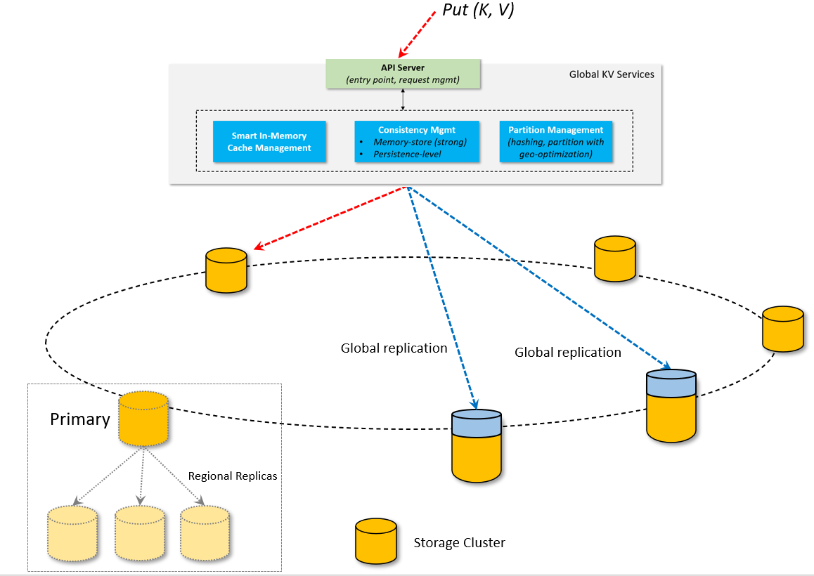
Centaurus 2.0 – Regionless Platform: Global KV Store Service
Centaurus Regionless Computing
Goals & challenges
New model to use cloud – from resource-based to application-based cloud (cloud native 2.0)
Manage 2 million+ compute nodes from big, small & edge data centers as global resources
Distributed scheduling algorithm and scheduler architecture to scale to 10K RPS throughput.
Design geo-distributed data consistent KV store to manage 100 millions application instances
Large scale virtual network (VPC) to provision & manage 1 million+ application instances
Innovation Areas
Special Hashing Algorithm
Sharding Management
Smart Cache
In-Memory Consistency / Transaction Management
What it is?
etcd
Ignite
Hazelcast
Anna

Slide 7
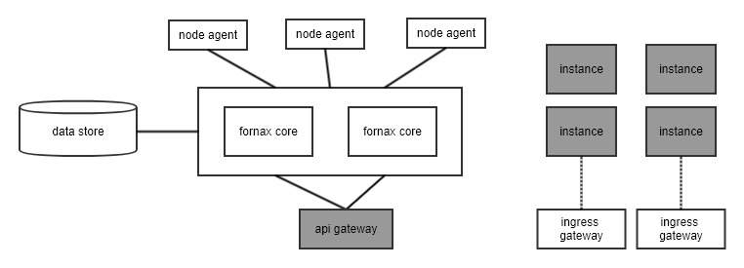
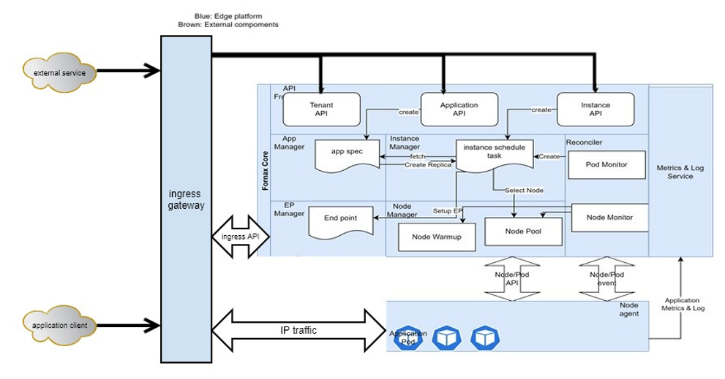
Centaurus 2.0 – Fornax Serverless
Centaurus Edge & Serverless Computing
Goals & challenges
Extreme low latency (<100 ms) for starting application instance at edge & auto scale to handle burst requests
The platform itself must be very Lightweight – use minimum resources (less than 5GB/2CPU to manage less than 8k-10K application instances
Multi-tenant edge computing clusters with strong computing/networking isolation.
High performance scheduling algorithm (<10ms) to allocate application instance onto a node
Fornax Serverless Platform
Fornax Serverless Core (process)
Optimized cluster & node management
Fast scheduling & instance management
Runtime sandbox pool management
Data store – Optimized etcd
Node agent – Optimized Kubelet.
Ingress gateway – TCP to RDMA
Quark container runtime
High performance & lightweight
Multi-Tenant
Secure container
Network isolation

Slide 8
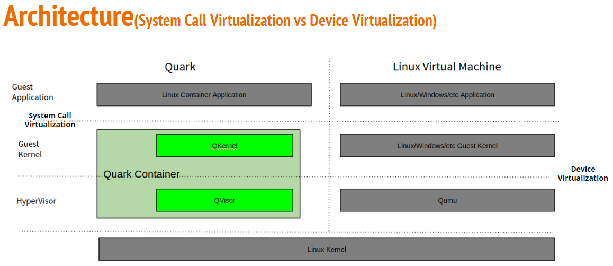
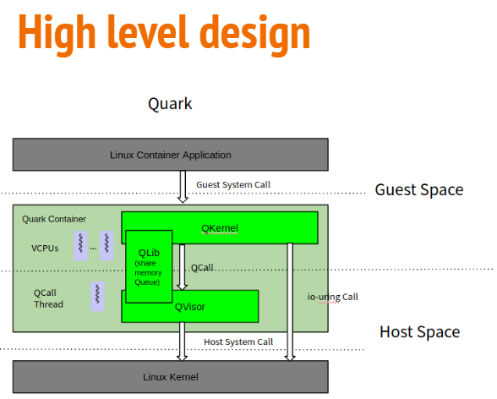
Centaurus 2.0 – Quark Secure Container (V1.0)
Centaurus Container Runtime Engine
Goals & challenges
High performance and secure container runtime – 3X Kata & gVisor in RPS & Throughput
Light weighted container – memory overhead 1/3 of gVisor and 1/15 of Kata container
RDMA based network communication & NVMe/NVMeOF based direct device access – 30% Performance Gain
High Level Design Points
System Call virtualization – Reimplement 80% system calls
QCall: Share memory-based communication between QKernel and QVisor
IO-Uring: IO data plane between QKernel and host Kernel

Slide 9
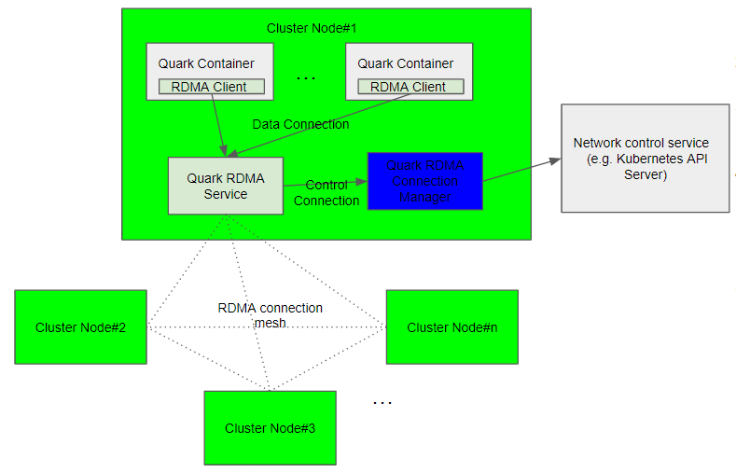
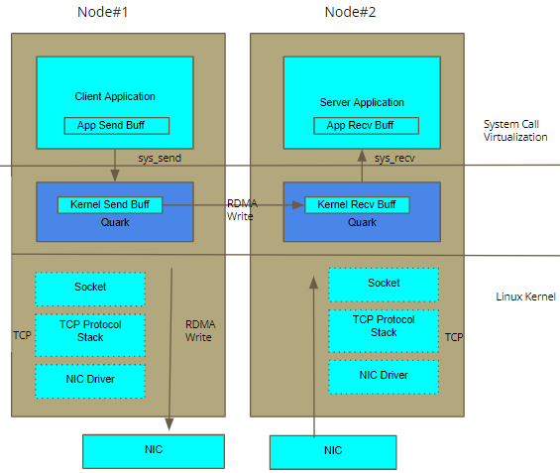
Centaurus 2.0 – Quark Secure Container (V1.0)
TCP Socket Over RDMA
Use RDMA to send TCP buffer instead of TCP stack
High Performance
Low latency
High throughput
Low CPU footprint
Less CPU switch/cache pollution
Transparent to application with TCP socket
Architecture Design
RDMA Mesh: Full RDMA connection mesh between Cluster Nodes
RDMA Channel: Multiplex TCP connections over RDMA Connection
RDMA Channel based VPC: <VPC#, IP, Port> → RDMA Channel
RDMA Service: (1) ClusterIP → Container IP handling (2) Network Policy (3) QoS
RDMA Connection Service:
ClusterIP → Container IP
Network Policy
Container ID → <VPC#, IP, Port>
QoS

Slide 10
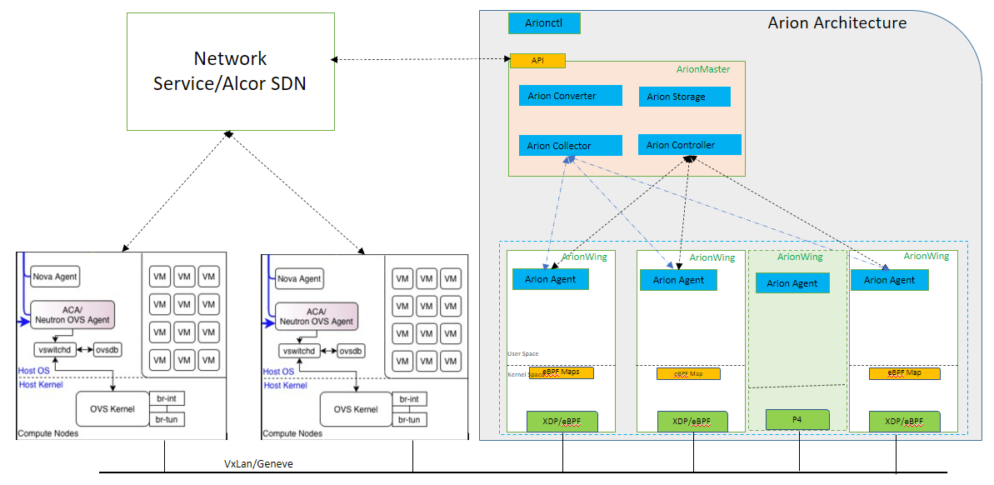
Cloud Network Alcor 2.0 – Arion data-plane platform
Arion Data-Plane Network Platform Goals & challenges
Scale to 100M+ network rules/policies changes, and achieve 10K RPS
Achieve network rule/policy lookup at milli second (ms) level
Support P4 network programming in large scale cloud environment
Traffic flow and throughput to near line-rate on 100G SmartNic/Switch

Slide 11
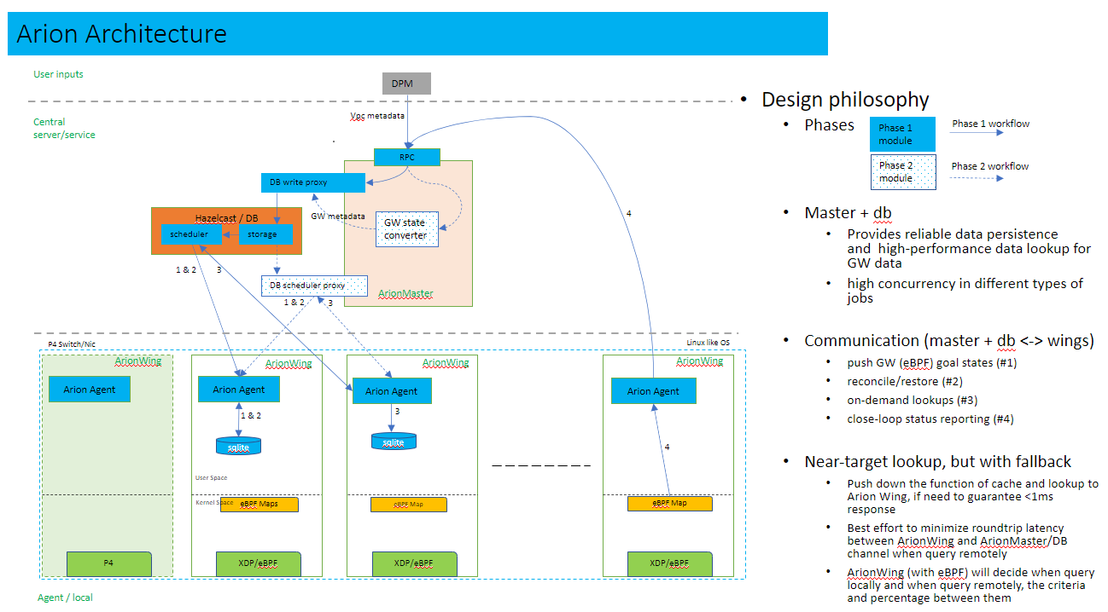
Cloud Network Alcor 2.0 – Arion data-plane platform

Slide 12
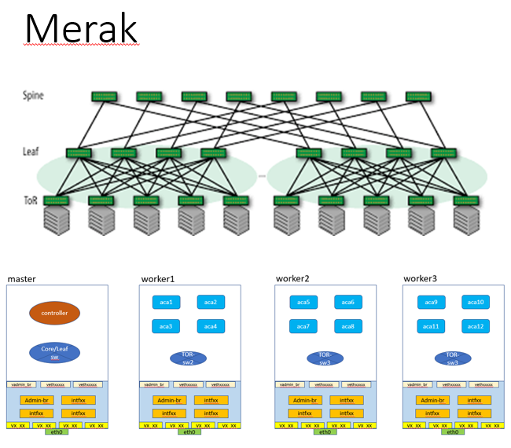
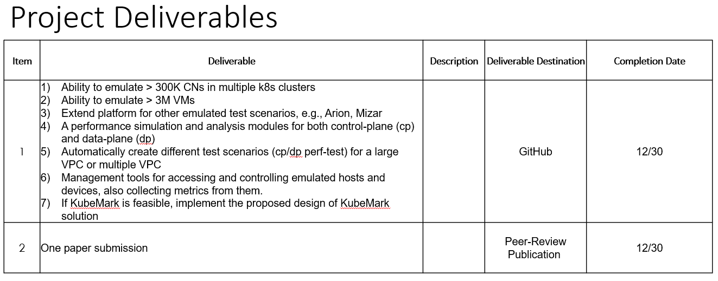
Cloud Network Alcor 2.0 – Merak Network Simulation
Merak network Simulation Goals & Challenges
A distributed SDN Network Emulation Framework that mocks up a public cloud-scale infrastructure up to 1 million servers & 3M+ VMs
Emulate overlay/virtual networks and support multi-tenancy
Mimic a physical network in modern data center (ToR/leaf/spine) and supports various topologies including customized topology
Support performance & scalability test for infrastructure services including network control plane
Conduct connectivity test for overlay (ovs/ebpf/p4) and underlay networks

Slide 13
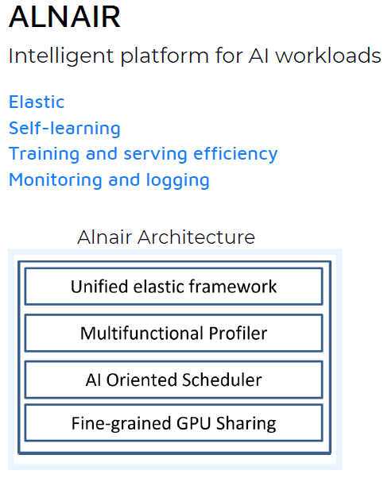
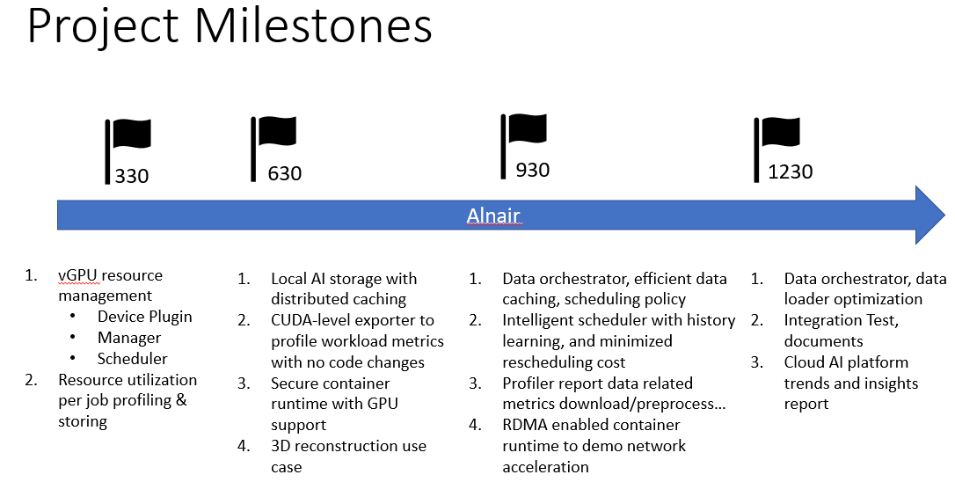
Cloud AI – Alnair Platform
Project Background
Serving AI workloads is one of the most important missions for next generation cloud platform
Cloud platform needs to be tailored based on the special characteristics of AI workloads, e.g., parallel computation and heavy data ingestion in training, low latency in inference
AI platform touches various domain, e.g., hardware accelerators, data storage/pipeline, resource management, ML framework, etc.
This year focus on (platform building blocks, small and medium size training jobs)
GPU sharing and profiling
Intelligent scheduling
Data orchestration / cache for AI jobs

Slide 14
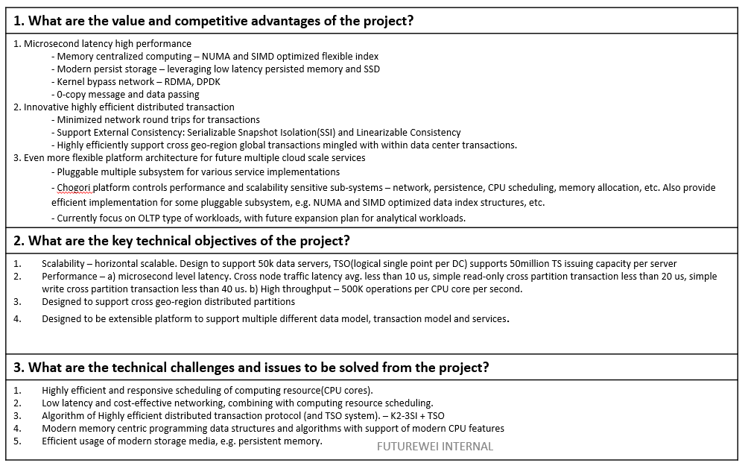
Cloud Storage & Data – Chogori Platform
Project Background
Chogori is piloting project for next generation of distributed data and storage platform, taking the challenge of cloud scale, high performance, strongly consistent transaction system, with geo-distributed datasets.
Chogori will march forward on fronts that existing competing service(e.g., Google Spanner) has not achieved based on business need and improved newly available technologies:
Microsecond latency distributed system
Highly efficient distributed transaction, optimized for deployment in a cloud architecture with reduction of network round trips
Chogori will serve as a foundational storage for various query and compute engines, including SQL and Graph.

Slide 15
Thank You

