Slide 1
Motivation
Stateless CP
SCP
SCP
CP
CP
CP
Write
Read
etcd
etcd
etcd
RKV
Metadata:
Pods, deployments, etc
Read
Write
R2
R3
R3
Write
R2
R1
R1
Regional
Regionaless

Slide 2
 | Regionless KV Service
Client Scenario | Large-scale orchestration system Geo-distributed data centers
Data Store Type | MVCC Key-value store
API | CRDU, list-watch, range query, batch operation (etcd compatible)
Data partition/sharding | Automatically for load balancing, HA
Replication | N replicas per revision of key-value pairs For HA and read optimization Automatically selected
Replication Consistency | Linearizable, sequential
Performance | Optimized based on latency and consistency setting
Backend Store | Open-choice (e.g., Redis)

Slide 3



Release Road Map
Next Step
Smart Cache
Current Release
RKV
V 0.2.0
Region$x$
RKV
V 0.1.0
Region$y$
RKV
RKV
RKV
Region$x$

Slide 4
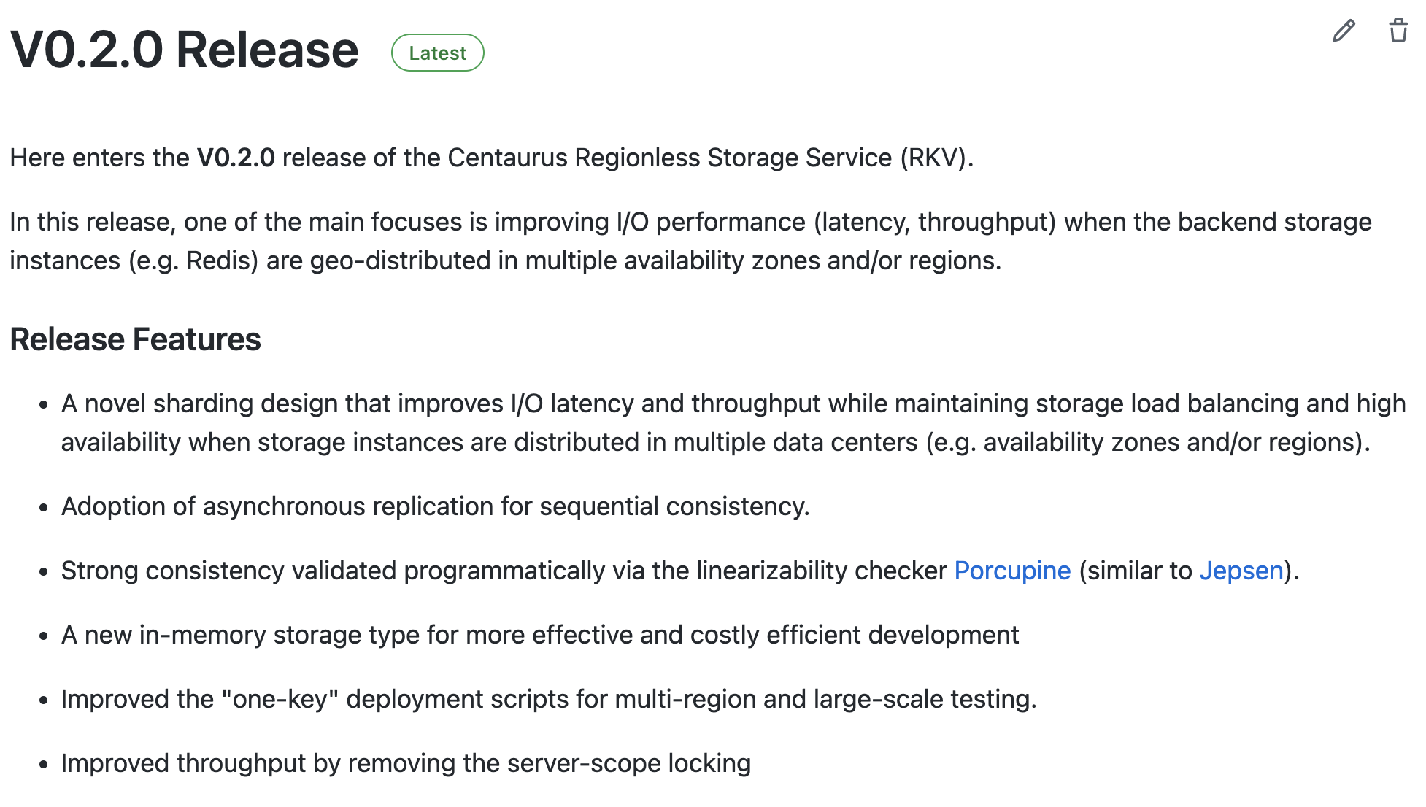
Link
Perf optimization for multi-region deployment

Slide 5
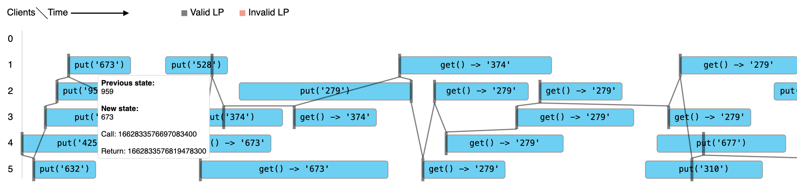
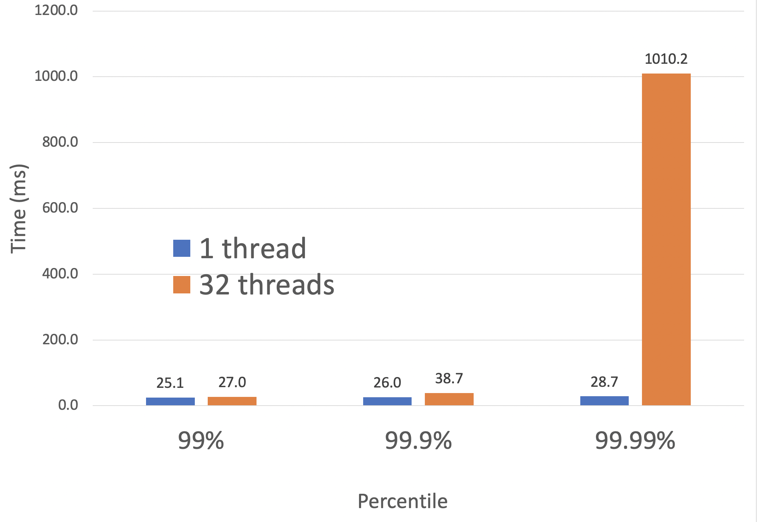
V0.2.0 Release
Capacity
100M
3 regions, 4 AZs
21 hr and 42 min
WRITE (in ms)
READ (in ms)
99th: 25
99.9th: 26
99.99th: 28
99th: 2.2
99.9th: 4.9
99.99th: 7.4
Latency
single thread call
2 sync + 1 async replication
Consistency
Linearizable Verified
3 sync replication
Programmatically
Concurrency (in OPS)
1280.3
Scalability
32 thread
100M env
write
In comparison 7/30: 220
4 thread

Slide 6
Regionless KV Service Configuration: 3 replicas for each rev of a key
No two replicas of the same rev of a key land in the same AZ
Redis is used as backend store on each , single thread per Redis, in-memory storage
m5a.2xlarge (32G mem) VM running Redis
us-east-2
c
us-east-1
2b
1a
x 12
Jaeger (profiling)
US-West-1
KV Service Instance
x 12
c
~ 20 ms
YCSB
(benchmark)
1b
< 10 ms
1b
x 18
x 12
~ 100 ms
us-west
us-east
Network Latency

Slide 7
CRUD, List/Watch
Regionless Caching
RKV
RKV
RKV
Region $c$
Region $a$
Region $b$

