Slide 1
Actor Model and Dapr

Slide 2
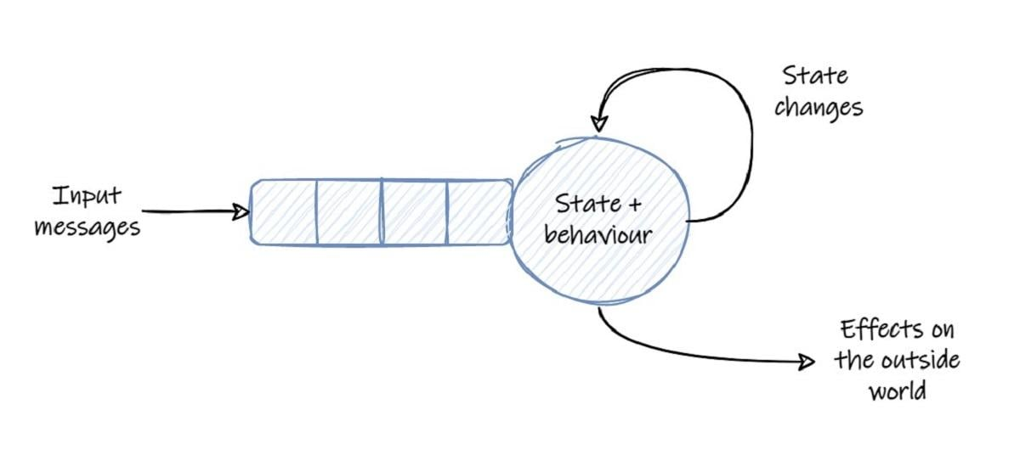
What is Actor Model
*The actor model originated in 1973.(Hewitt, Carl)
Notes:
Actor definition and behavior
Actor is an independent unit of compute and state.
Actors never share memory.
Actors communicate with each other using messages.
When an actor receives a message, it can change its internal state, and send messages to other (possibly new) actors.

Slide 3
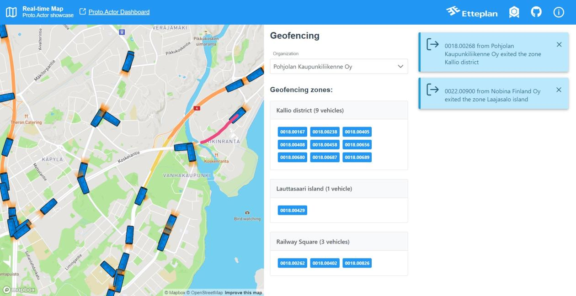
Why Actor-problem
Notes:
Show the latest position of the bus.
Show its trail over the last 5 minutes.
Update the map in real time, but only the visible part. Limit the bus positions transferred over the network to only those that the user cares about.
When the bus is standing still for more than 10 minutes and the door is closed, send a notification to the user.
An organization that owns the bus can define geofences. Notify the user if a bus has entered or exited the geofence.

Slide 4
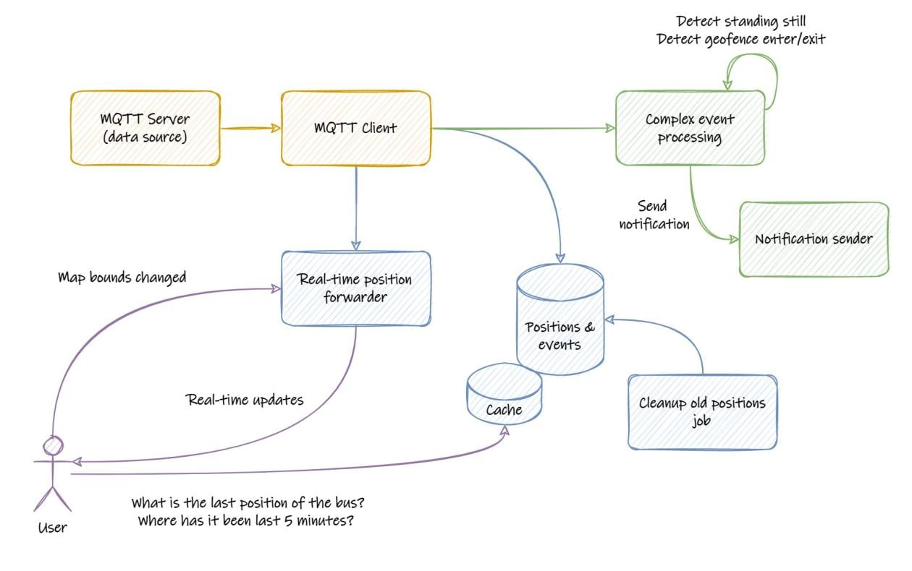
Old
Way
Notes:
We do not have a model of the real world in this application (no buses, no organizations). Instead we’re thinking in terms of a “stream of positions” that needs to be processed.
We have expensive queries on the positions database, that need to be cached.
We need to think about ways to scale the database itself.
We have to think about latency and complexities of communicating over the network.
We have concurrency issues to deal with.
We need a robust tech stack, which also means we need people who have broad competences to work with this stack.
Overall, this architecture seems more complex than required for a relatively simple problem. The complexity is introduced by the scaling issues.

Slide 5
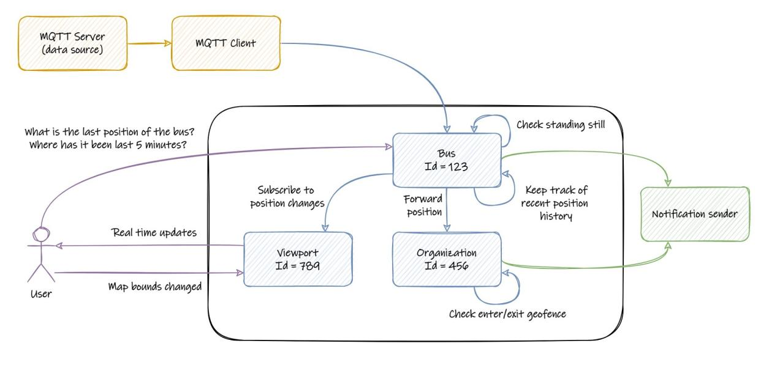
Actor way

Slide 6
Virtual actor pattern
Introduced by Project Orleans
Benefits
No need to explicitly create actors
Actors are activated implicitly using type and Id

Slide 7
When to use actor
Problem space involves concurrency
Problem space can be partitioned into small, independent, and isolated units of state and logic. (actor!!)
No need for low-latency reads of the actor state.
No need to query state across a set of actors
Notes:
Low-latency reads cannot be guaranteed because actor operations execute serially.
Querying across actors is inefficient because each actor's state needs to be read individually and can introduce unpredictable latencies.

Slide 8
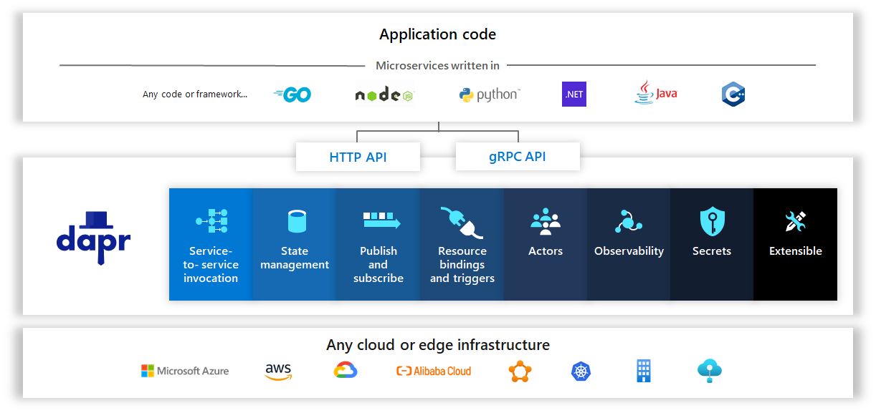
Dapr - Distributed Application Runtime )
Notes:
State management: Support contextual information for long running stateful services.
Service invocation: Invoke direct, secure service-to-service calls using platform agnostic protocols and well-known endpoints.
Publish and subscribe: Implement secure, scalable pub/sub messaging between services.
Bindings: Trigger code from events raised by external resources with bi-directional communication.
Observability: Monitor and measure message calls across networked services.
Secrets: Securely access external secret stores.
Actors: Encapsulate logic and data in reusable actor objects.

Slide 9
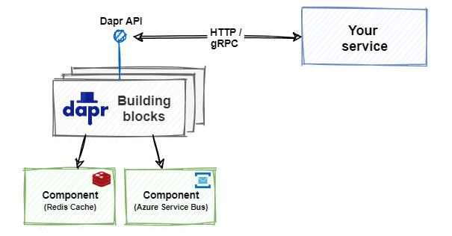
Interaction

Slide 10
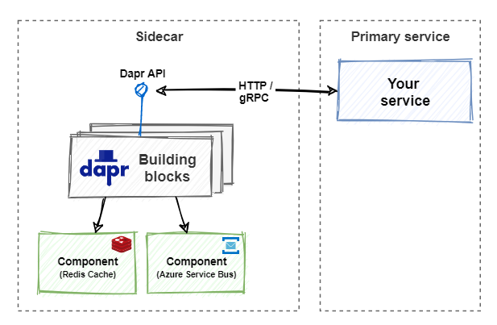
Sidecar Architecture

Slide 11
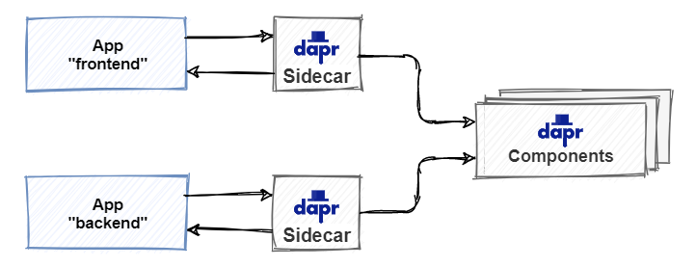
Performance consideration
In most cases, the additional overhead should be sub-millisecond.
Notes:
Invoking a Dapr operation requires at least one out-of-process network call.
The Dapr team has invested heavily in performance.
Calls between Dapr sidecars are always made with gRPC,

Slide 12
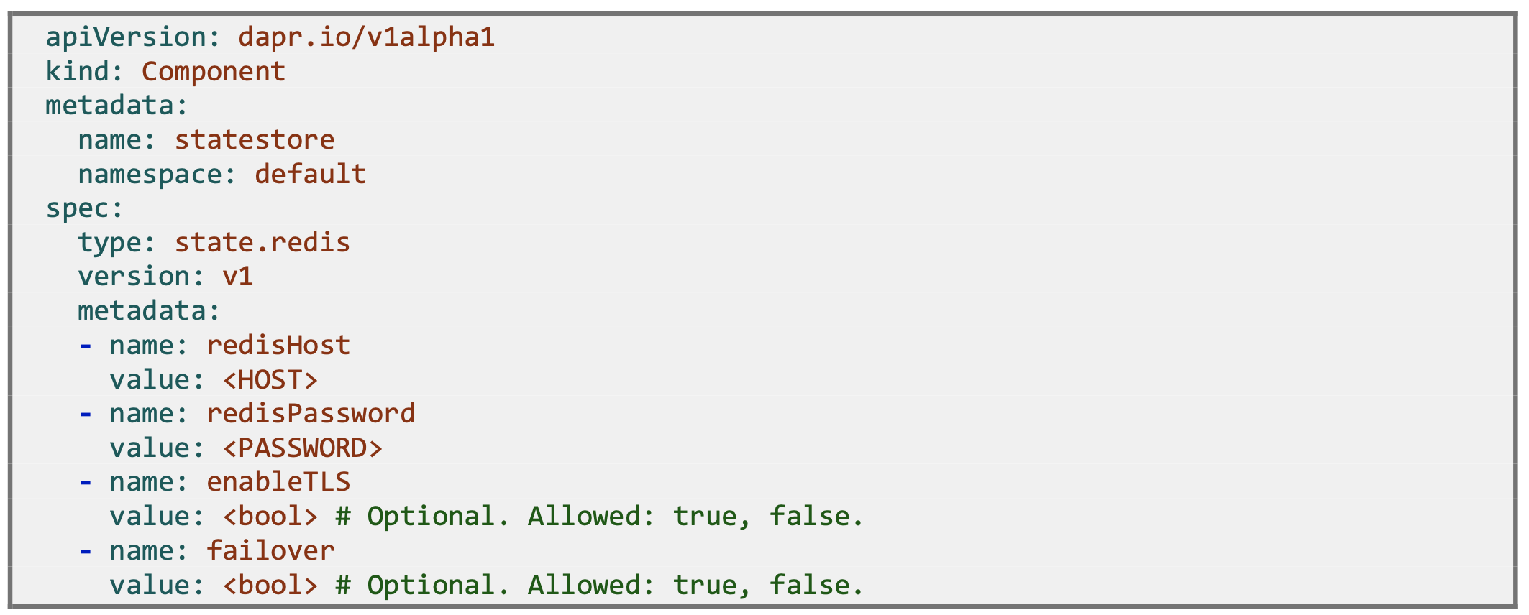
State Store example

Slide 13
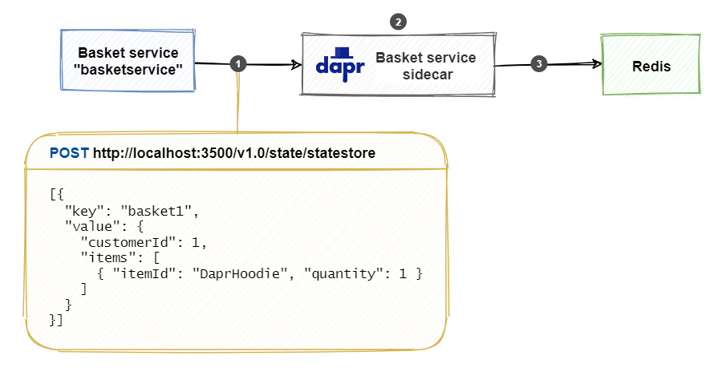
State store - How it works
URL for HTTP API:
http://localhost:<dapr-port>/v1.0/state/<store-name>/
Notes:
The basket service calls the state management API on the Dapr sidecar. The body of the request encloses a JSON array that can contain multiple key/value pairs.
The Dapr sidecar determines the state store based on the component configuration file. In this case, it's a Redis cache state store.
The sidecar persists the data to the Redis cache.
curl http://localhost:3500/v1.0/state/statestore/basket1

Slide 14
State Store -supported storage
AWS DynamoDB
Aerospike
Azure Blob Storage
Azure CosmosDB
Azure Table Storage
Cassandra
Cloud Firestore (Datastore mode)
CloudState
Couchbase
Etcd
HashiCorp Consul
Hazelcast
Memcached
MongoDB
PostgreSQL
Redis
RethinkDB
SQL Server
Zookeeper

Slide 15
Dapr Actor
Base url for HTTP API
http://localhost:<daprPort>/v1.0/actors/<actorType>/<actorId>/
<daprPort>: the HTTP port that Dapr listens on.
<actorType>: the actor type.
<actorId>: the ID of the specific actor to call.
Dapr actor runtime
Manages how, when and where each actor runs
Routes messages between actors
Deactivates idle actor and removes it from memory
Reactivate actor

Slide 16
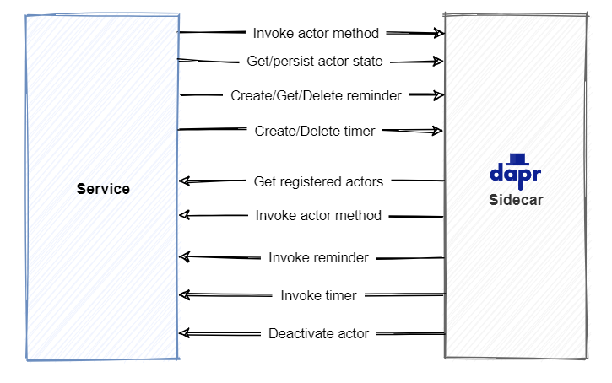
API calls between app and Dapr

Slide 17
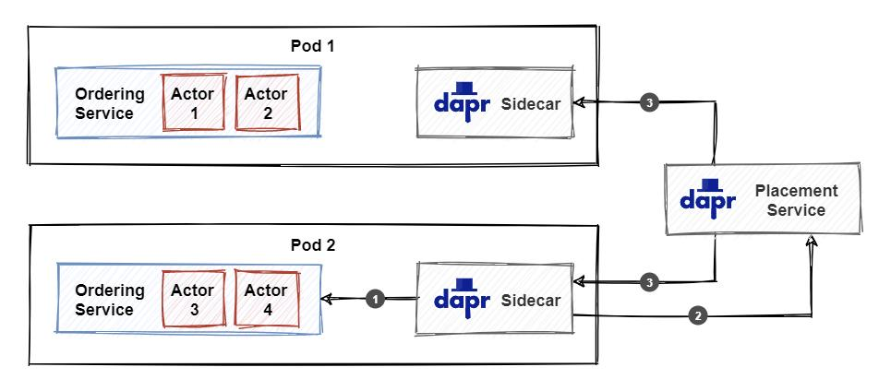
Placement service
On startup, the sidecar makes a call to the actor service to get the registered actor types as well as actor configuration settings.
The sidecar sends the list of registered actor types to the placement service.
The placement service broadcasts the updated partitioning information to all actor service instances. Each instance will keep a cached copy of the partitioning information and use it to invoke actors.

Slide 18
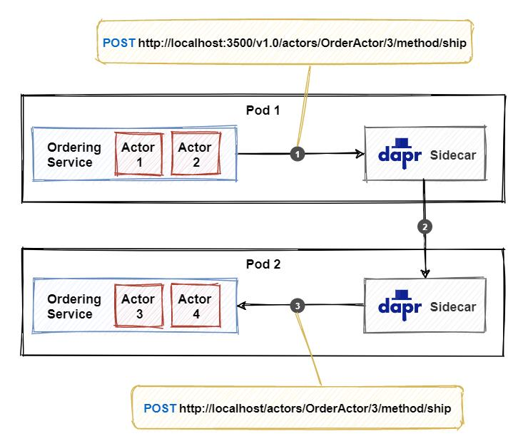
Actor interaction
Notes:
1. The service calls the actor API on the sidecar. The JSON payload in the request body contains the data to send to the actor.
2. The sidecar uses the locally cached partitioning information from the placement service to determine which actor service instance (partition) is responsible for hosting the actor with ID 3. In this example, it’s the service instance in pod 2. The call is forwarded to the appropriate sidecar.
3. The sidecar instance in pod 2 calls the service instance to invoke the actor. The service instance activates the actor (if it hasn’t already) and executes the actor method.

Slide 19
Timers and reminders
Timers
Only stay active as long as the the actor is activated.
Will not reset the idle- timer, so they cannot keep an actor active on their own.
Reminders
outlive actor activations
If an actor is deactivated, a reminder will re-activate the actor.
Reminders will reset the idle-timer.
Notes:
Actors can use timers and reminders to schedule calls to themselves

Slide 20
State persistence
Use State management building block to persist actor state
Following state stores support multi-item transactions:
Azure Cosmos DB
MongoDB
MySQL
PostgreSQL
Redis
RethinkDB
SQL Server

Slide 21
Actor Model Frameworks
Orleans
Akka
Proto.Actor
Dapr
https://www.etteplan.com/stories/comparing-net-virtual-actor-frameworks

Slide 22
Framework benchmark
https://www.etteplan.com/stories/benchmark-net-virtual-actor-frameworks

Slide 23
Reference
https://www.etteplan.com/stories/how-virtual-actors-will-help-you-scale-your-applications-easy-way
https://learn.microsoft.com/en-us/dotnet/architecture/dapr-for-net-developers/
https://www.etteplan.com/stories/comparing-net-virtual-actor-frameworks
https://www.etteplan.com/stories/benchmark-net-virtual-actor-frameworks

