Slide 1
Intro to Data Science for Developers with Azure Machine Learning Studio
Gorka Madariaga
Technical Evangelist
@Gk_8 – gorkma@microsoft.com

Slide 2
What is Machine Learning?
Computing systems that become smarter with experience
“Experience” = past data + human input

Slide 3



Machine Learning
Adoption Challenges
Specialized skills
Infrastructure
Long time to insight
Productization
Complexity

Slide 4
Microsoft & Machine Learning
Answering questions with experience
1991
1997
2008
2009
2010
2014
2014
Microsoft Research formed
Hotmail launches
Which email is junk?
Bing maps
launches
What’s the best way home?
Bing search launches
Which searches are most relevant?
Kinect launches
What does that motion “mean”?
Skype Translator launches
What is that person saying?
Azure Machine Learning launches
What will happen next?

Slide 5




What can Azure ML do for you…?
Telemetry data analysis
Buyer propensity models
Social network analysis
Predictive maintenance
Web app optimization
Churn analysis
Natural resource exploration
Weather forecasting
Healthcare outcomes
Fraud
detection
Life sciences research
Targeted advertising
Network intrusion detection
Smart meter monitoring

Slide 6
Trained models

Slide 7
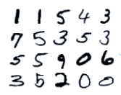

1 | 1 | 5 | 4 | 3
7 | 5 | 3 | 5 | 3
5 | 5 | 9 | 0 | 6
3 | 5 | 2 | 0 | 0
Training Examples
Training Labels
Accurate digit classifier
2
Machine Learning System

Slide 8
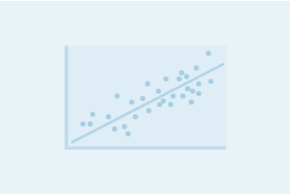

Regression versus Classification
Do you want to…
…predict/estimate a number?
Regression problems
…or apply a label/category?
Classification problems

Slide 9

Binary versus Multiclass Classification
Do you want a yes/no answer?
Binary problems
Multiclass problems

Slide 10
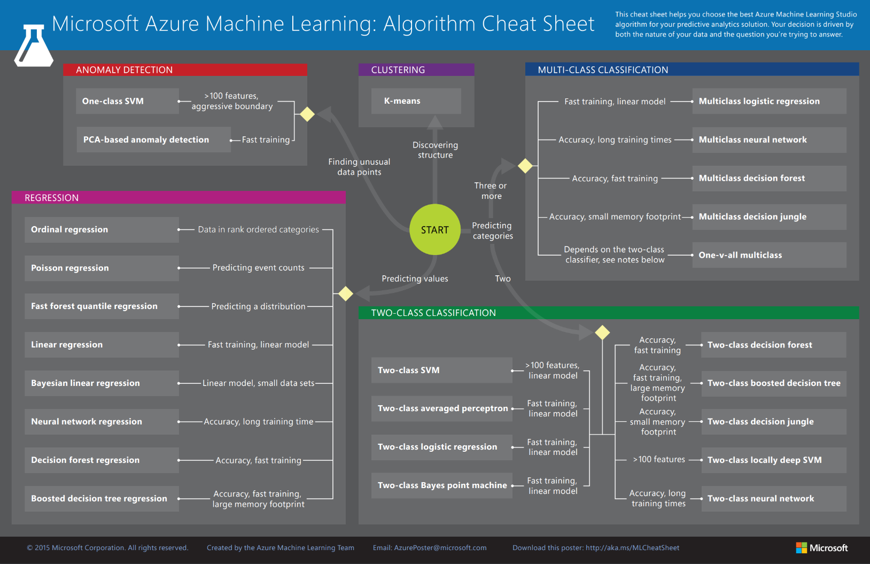

Slide 11
Which algorithm should you pick?
Depends on your problem – what does your data look like?
  Logistic regression, support vector machines are good for linear problems
  Decision trees are intuitive and easy to interpret
  Decision trees naturally handle categorical data, data scaling not required
  Support vector machines are effective for high dimensional data
  Basic decision trees are not as accurate…
Do what data scientists do…try multiple algorithms and select the best model for your data!

Slide 12
Lessons learned…
Know your data
80% preparing – 20% analyzing
Try different algorithms/adjustments
It will get better over time!

Slide 13
Thank you! ☺ https://aka.ms/innovation-day-esdx
Gorka Madariaga
@Gk_8
gorkma@microsoft.com

