Slide 1
UFS case study 20200105/00z
Greg Thompson
RESULTS using existing subroutine progcld6 – using Ruiyu’s pull request parameter changes to Thompson-MP
FV3 info…
C768 resolution with L127
Thompson microphysics
dt_atmos = 120
dt_inner = 60
fhswr = 1200
fhlwr = 1200
Plots of:
total albedo (swuptop/swdowntop)
outgoing shortwave radiation (instantaneous) at top-of-atmos
outgoing longwave radiation (instantaneous) at top-of-atmos
max-in-column cloud fraction
cloud fraction at level ~175hPa (below tropopause in tropics – anvil ice region
total column liquid water path produced by explicit microphysics
total column liquid water path produced by cloud fraction scheme (N/A)
total column ice water path produced by explicit microphysics
total column ice water path produced by cloud fraction scheme (N/A)
Plot times:
12-hour forecast
24-hour forecast
plots generated and available for 1, 2, 3, …, 12, 15, 18, 21, 24 hour forecasts

Slide 2
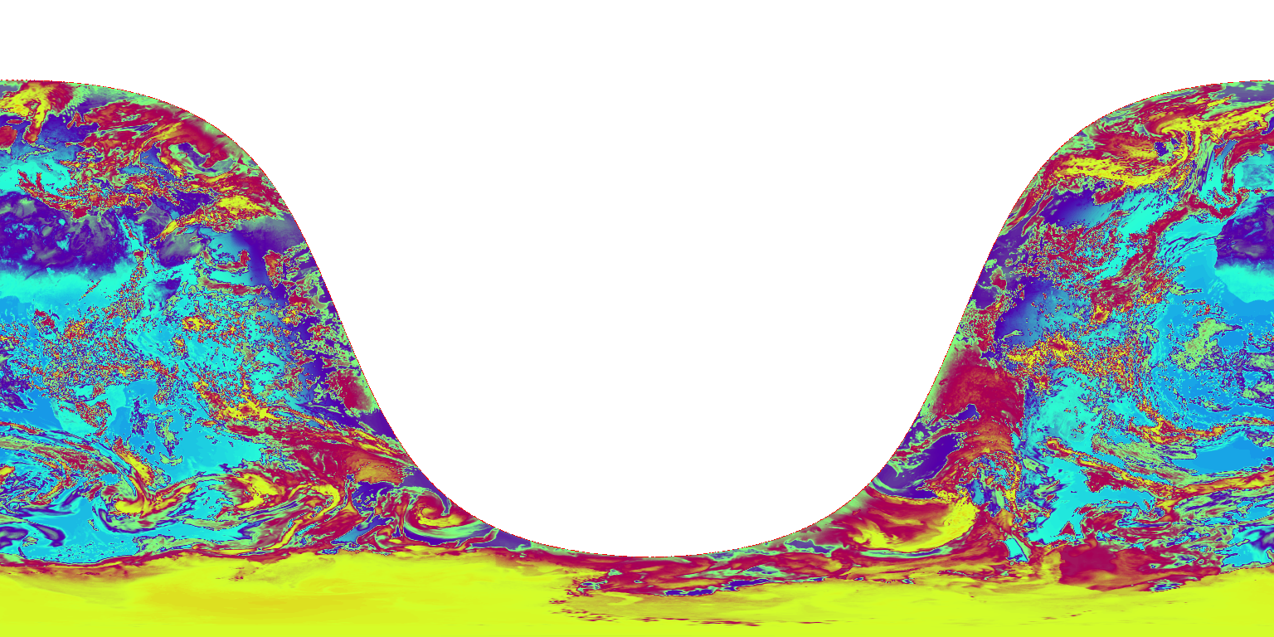
12-h albedo (total sky): outgoing/incoming shortwave radiation, top-of-atmos
ncview “gauss” colorscale (linear) from 0 to 0.85

Slide 3
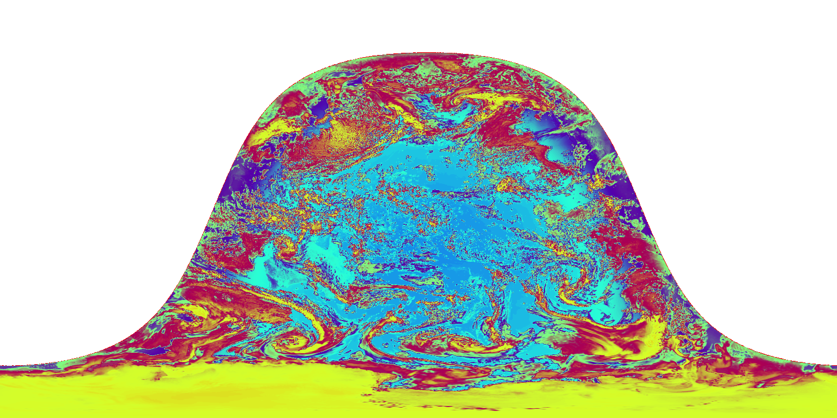
24-h albedo (total sky): outgoing/incoming shortwave radiation, top-of-atmos
ncview “gauss” colorscale (linear) from 0 to 0.85

Slide 4
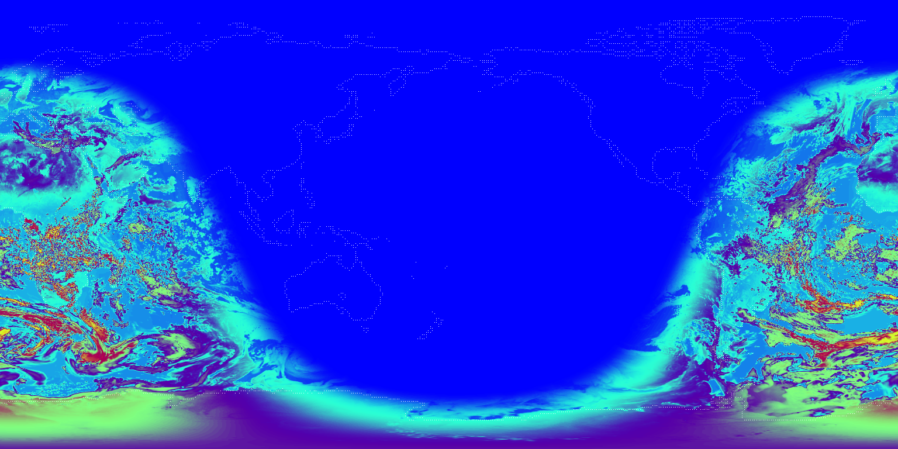
12-h outgoing shortwave radiation, top-of-atmos
ncview “gauss” colorscale (linear) from 0 to 1050 W/m²

Slide 5
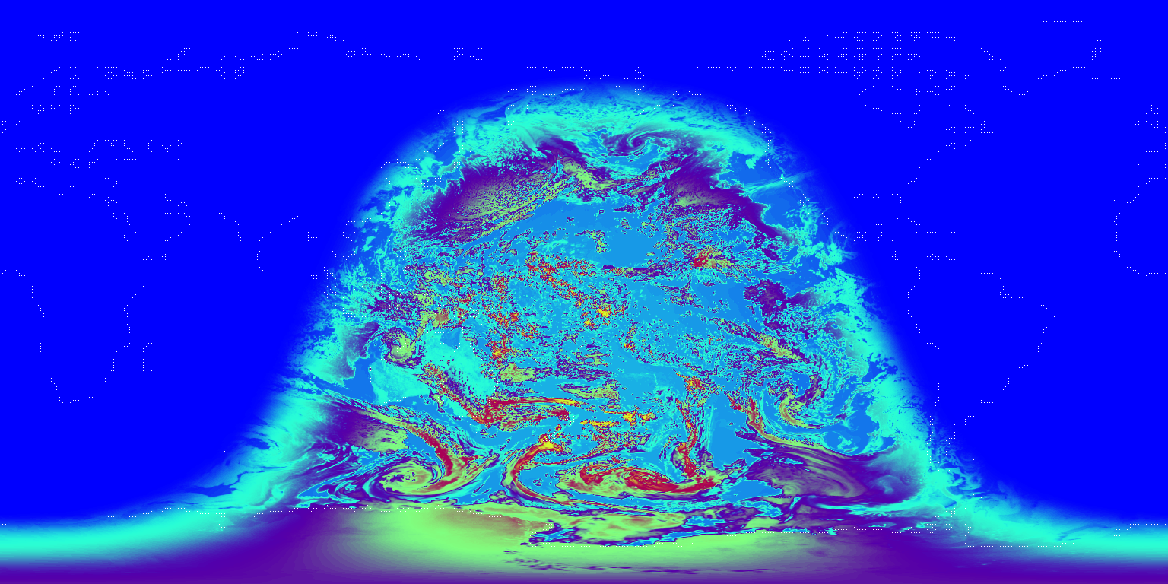
24-h outgoing shortwave radiation, top-of-atmos
ncview “gauss” colorscale (linear) from 0 to 1050 W/m²

Slide 6
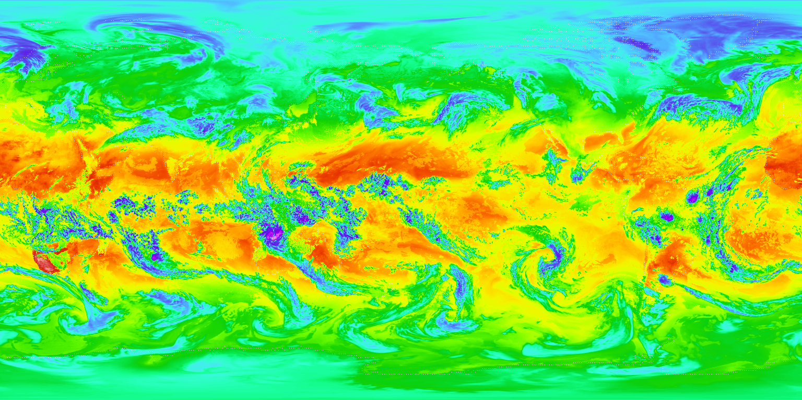
12-h outgoing longwave radiation, top-of-atmos
ncview “bright” colorscale (linear) from 70 to 370 W/m²

Slide 7
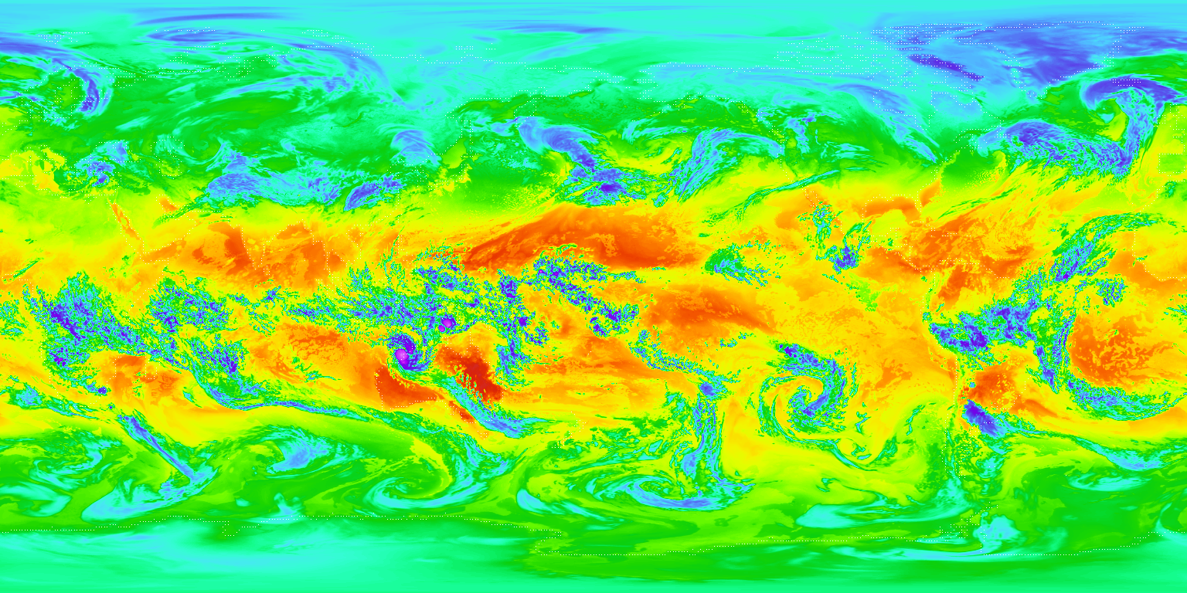
24-h outgoing longwave radiation, top-of-atmos
ncview “bright” colorscale (linear) from 70 to 370 W/m²

Slide 8
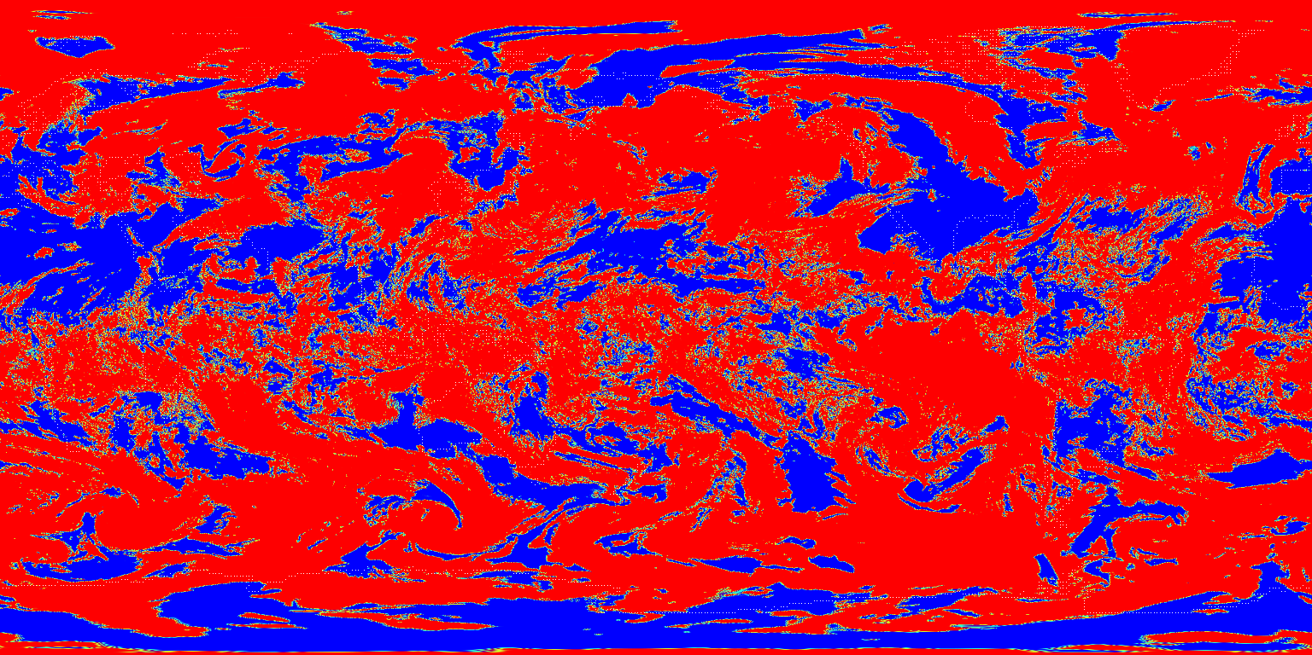
12-h max-in-column cloud fraction
ncview “gauss” colorscale (linear) from 0 to 1

Slide 9
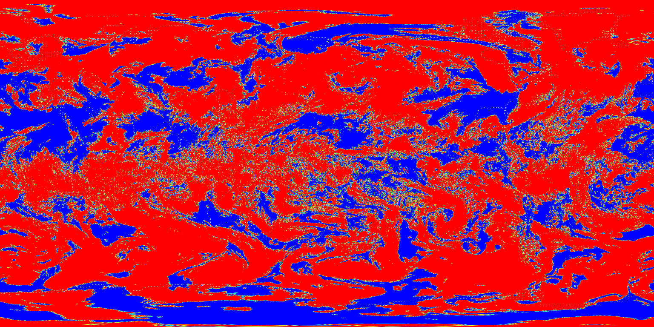
24-h max-in-column cloud fraction
ncview “gauss” colorscale (linear) from 0 to 1

Slide 10
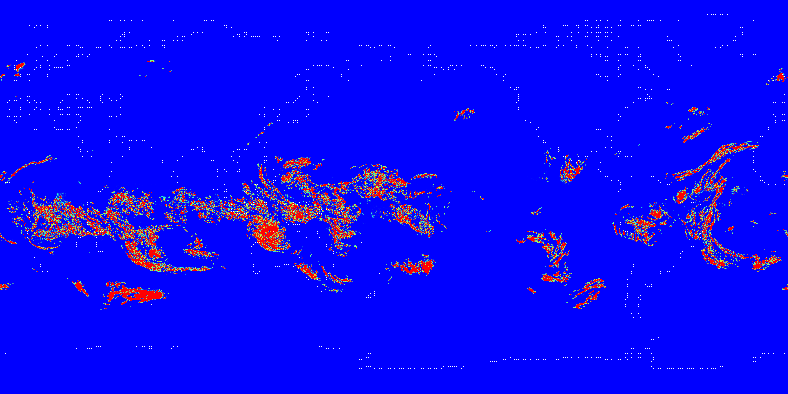
12-h single-layer cloud fraction ~175hPa (~tropopause in tropics)
ncview “gauss” colorscale (linear) from 0 to 1

Slide 11
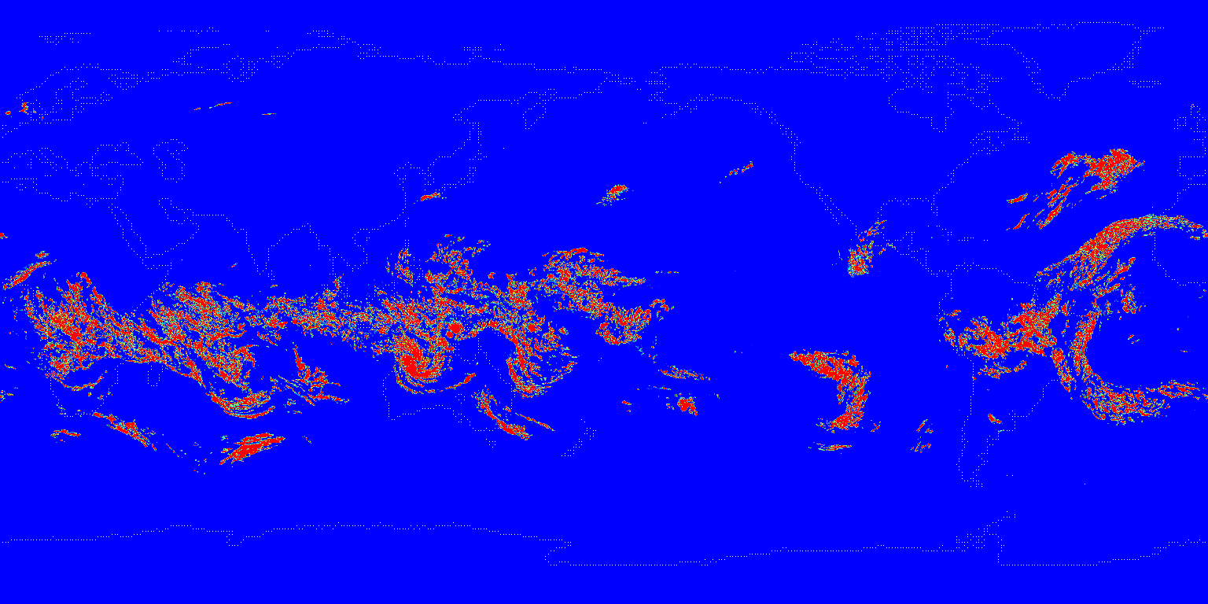
24-h single-layer cloud fraction ~175hPa (~tropopause in tropics)
ncview “gauss” colorscale (linear) from 0 to 1

Slide 12
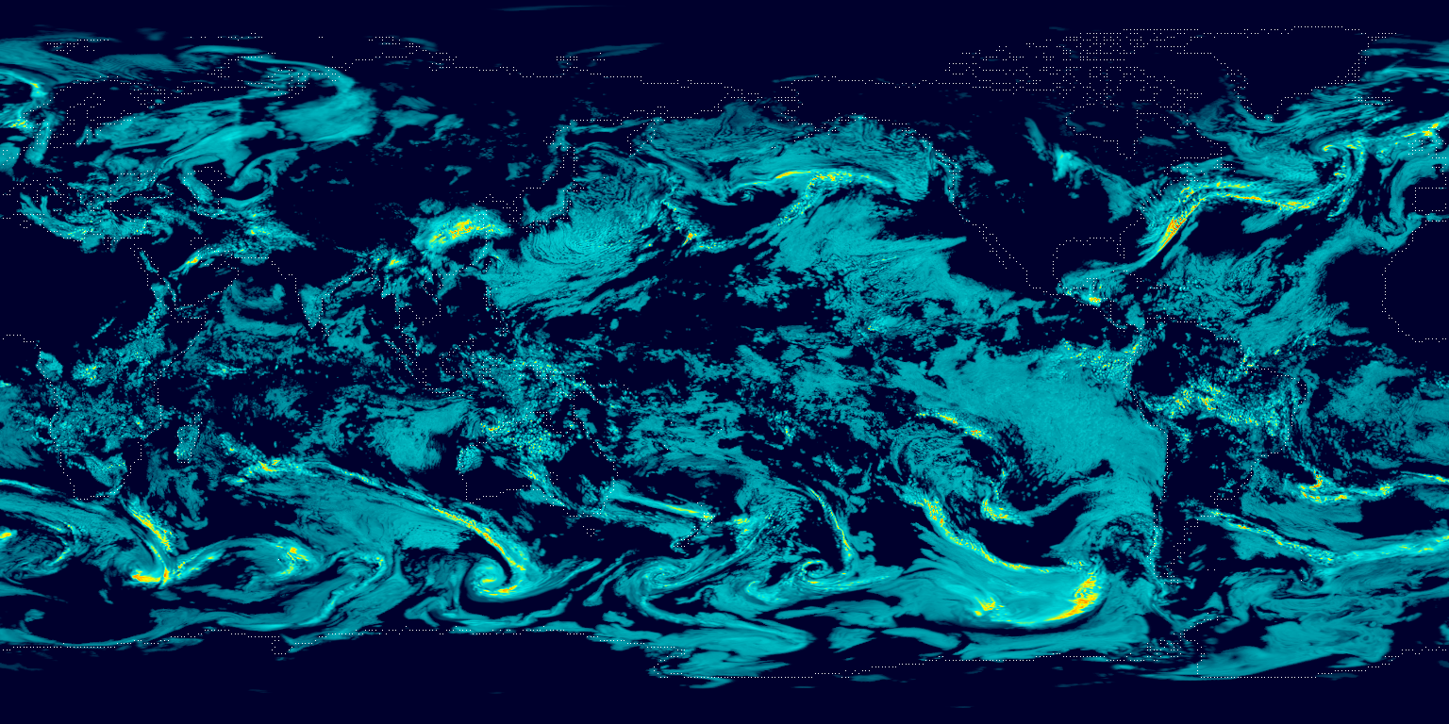
12-h column-total liquid water path from explicit microphysics
ncview “ssec” colorscale (low) from 0 to 3 kg/m²

Slide 13
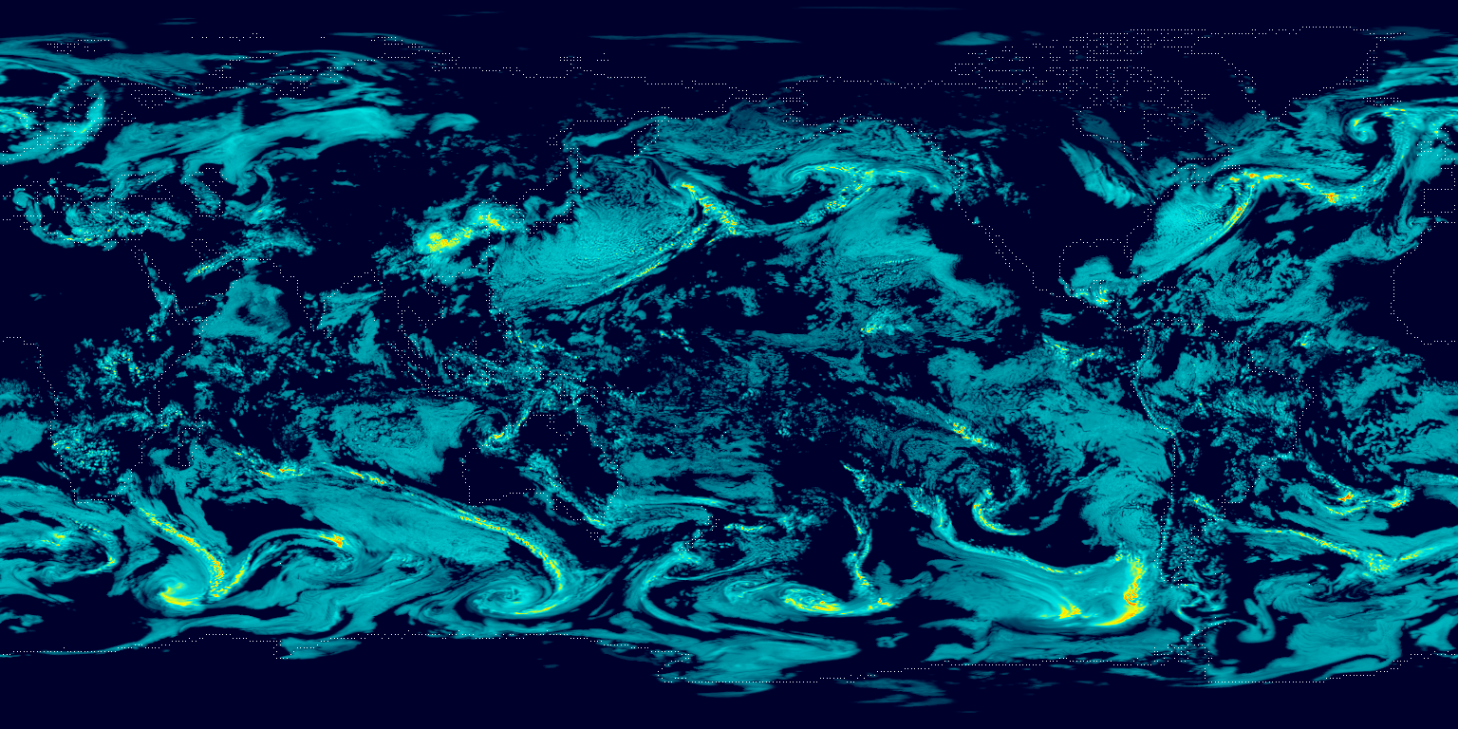
24-h column-total liquid water path from explicit microphysics
ncview “ssec” colorscale (low) from 0 to 3 kg/m²

Slide 14
12-h column-total liquid water path from cloud fraction scheme
ncview “ssec” colorscale (low) from 0 to 1 kg/m²
page intentionally left blank because progcld6 does not create any cloud water used for radiation in grid volumes with cloud fraction between zero and one (exclusive)

Slide 15
24-h column-total liquid water path from cloud fraction scheme
ncview “ssec” colorscale (low) from 0 to 1 kg/m²
page intentionally left blank because progcld6 does not create any cloud water used for radiation in grid volumes with cloud fraction between zero and one (exclusive)

Slide 16
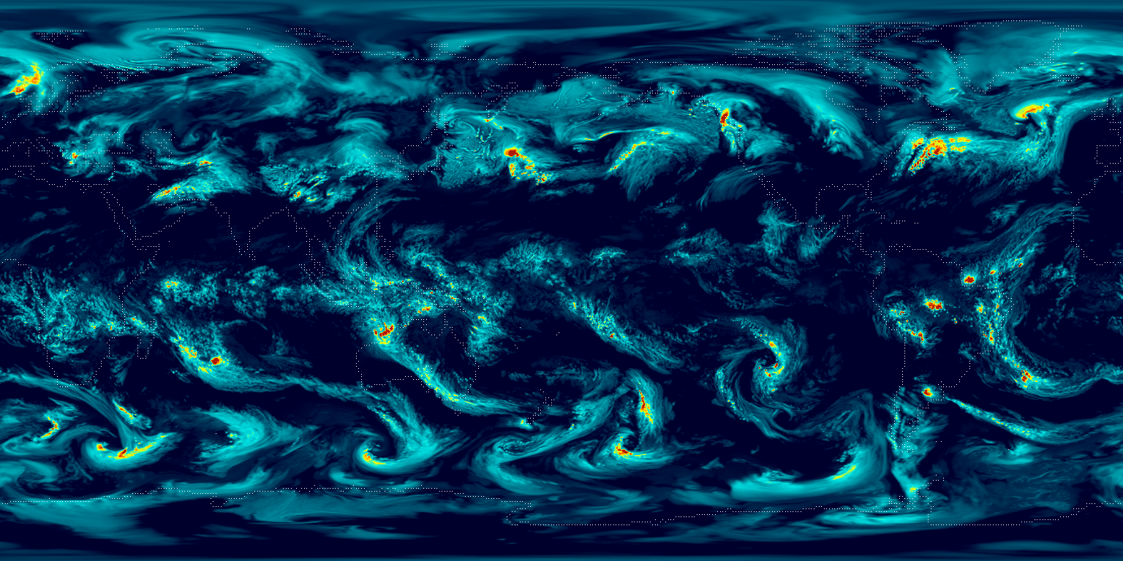
12-h column-total ice water path from explicit microphysics
ncview “ssec” colorscale (low) from 0 to 5 kg/m²

Slide 17
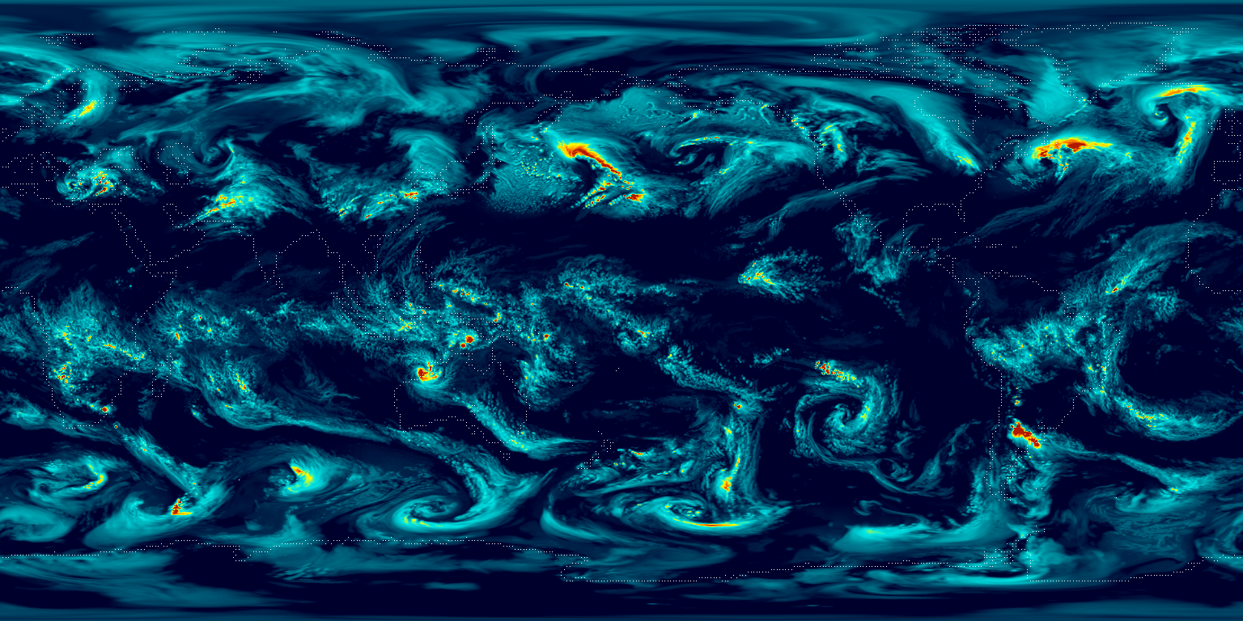
24-h column-total ice water path from explicit microphysics
ncview “ssec” colorscale (low) from 0 to 5 kg/m²

Slide 18
12-h column-total ice water path from cloud fraction scheme
ncview “ssec” colorscale (low) from 0 to 1 kg/m²
page intentionally left blank because progcld6 does not create any cloud ice used for radiation in grid volumes with cloud fraction between zero and one (exclusive)

Slide 19
24-h column-total ice water path from cloud fraction scheme
ncview “ssec” colorscale (low) from 0 to 1 kg/m²
page intentionally left blank because progcld6 does not create any cloud ice used for radiation in grid volumes with cloud fraction between zero and one (exclusive)

