Slide 1
First steps to porting WAVEWATCH III to GPU
Lewis Sampson
Muhammed Asif
Chris Bunney
Breogán Gómez

Slide 2
Contents
Our project so far:
Introduction to the team, details on how we have created and ported test cases for WW3, which combined into our initial full configuration port. General project timeline and overview.
Summarise OpenACC and the changes we have made.
Basic information of GPU fundamentals. Further details on the OpenACC directives, general code changes, and placement of pragmas.
Demonstrate performance
Show the results that we have got so far for our accelerated configuration, and some tools we use for analysing the performance.
Source term refactoring
How we have investigated the current source-term loop structure and are attempting to improve the scalability and portability to GPU.
Further improvements
Talk about the next steps, optimisations, potential collaborations, and intentions to revisit technical debt to improve performance.

Slide 3
Project overview
The Team and current roles:
Breogan Gomez: Project management and technical overview.
Lewis Sampson: Lead developer for porting the test cases and initial full configuration. Code management and documentation of acceleration.
Chris Bunney: WW3 codebase expertise, OpenACC support and code reviews. Source term refactoring and integration into WW3 framework.
Muhammad Asif: Development infrastructure, model analysis and code reviews. Research into multi-GPU parallelism and other deployments.
Project aims:
Study the feasibility of porting the current WW3 framework to run on GPU with valid model output.
Optimise the porting efforts in terms of data transfers and kernel launches.
Scope the potential of a separations of concerns (PSyclone) approach to automatically applying the OpenACC directives.
This work used the Isambard 2 UK National Tier-2 HPC Service (http://gw4.ac.uk/isambard/) operated by GW4 and the UK Met Office, and funded by EPSRC (EP/T022078/1)
Notes:
Next Generation-Marine Systems project to research the feasibility of porting the current WW3 modelling framework to run on GPU. Intending to identify the difficulties/limitations, potential speed-up to be expected, and scalability (for next generation HPC’s). Started in 2020 with a 1.0 FTE foundation scientific software engineer, and now includes several members working on the project, including external contractors and scientific managers.
Andy Saulter is the Project executive for the NG-Marine Systems and has overseen this branch of work for the first two years. From here on the deliverables of the project are monitored by Mike Bell and has joined up with other GPU porting activities, such as NEMOVAR and MEDUSA.

Slide 4
Project timeline (one possibility)
Researching OpenACC and GPU components
Creating test cases and porting to run on GPU
Identifying limitations of our initial GPU port, technical debt
Optimisation of data transfers and kernel operations
Integrating directives into WW3 using separation of concerns approach
Expanding to multi-GPU architecture with large domains
Model analysis and recursive testing of OpenACC usage
Source term refactoring feasibility assessment
Integrate new source term loop structure in WW3 framework
Scoping study with STFC on PSyclone
Develop and decide on best implementation of OpenACC pragmas into WW3
Porting test cases and deployment script to Azure
Perform model analysis on Azure for future benchmarking
Notes:
The tasks in grey are considered low risk or low uncertainty tasks, they are likely to be completed as expected, unless delayed or deterred by other tasks. The pink/red tasks highlight areas of possible risk which may not be possible depending on time limits or other difficulties. If these risks occur we expect that the timeline will change appearance but still be complete with other solutions in place of those, e.g. a manual implementation of OpenACC rather than automated via Separation of Concerns.

Slide 5
GPU Fundamentals
Why?
Be prepared for the future possibilities of Next Generation Modelling Systems (NGMS¹) and HPC architectures.
Improved WW3 scalability and run efficiently on a large number of processors while being flexible about the type.
Differences with known parallelism approaches
OpenMP; Uses CPU multithreading and shared memory to parallelize tasks over number of cores. Achieves good performance but limited in scalability.
MPI; Distributed memory between CPU’s, and requires management of data. Highly scalable for large domains and compatible with OpenMP or OpenACC parallelism.
OpenACC; Work offloaded to GPU and run as a highly parallelised kernel; requires data transfer between CPU and GPU memory.
Generalised overview
¹NGMS is a Met Office internal project: "Reformulating and redesigning our complete weather and climate research and operational/production
systems, including oceans and the environment, to allow us to fully exploit future generations of supercomputer for the benefits of society"
Notes:
Additional notes:
OpenMP can be used to accelerate tasks on GPU’s instead of OpenACC however this has not be researched as of yet.
The number of cores available on the GPU is unique for each card, for example the V100 used on Isambard has 5120 CUDA cores. More details available here https://images.nvidia.com/content/technologies/volta/pdf/volta-v100-datasheet-update-us-1165301-r5.pdf
Despite the OpenACC and MPI paired parallelism being possible it is not yet enabled for our configurations, but is a work in progress.

Slide 6
GPU Fundamentals
Difficulties?
Flooding individual GPU’s with enough tasks to achieve a speed-up.
Data management from CPU code components to GPU parallel loops.
Aims for good performance.
Minimal data transfers and kernel launches to reduce initial overhead. GPU resident compute intense code.
Maximise GPU memory throughput.
Collapse and fuse loops to maximise the number of tasks. Ideally the collapsed loop will be lower down the call stack to limit the requirements for data transfers to GPU.
Notes:
Often the best performance comes from multiple pass through of the OpenACC port. For example a first pass would get the code running successfully on the GPU, the second can optimise the data transfers to limit overhead and the third would improve on more complex directives such as reductions, privatisations, updates etc.

Slide 7
GPU Requirements
Porting the WW3 to GPU has tackled the two main difficulties;
Data transfers; by achieving GPU data resident code with optimal explicit transfers or managed memory.
Flooding the GPU; Targeting the largest loops to create a job with a sufficiently large number of independent tasks.
Positives:
Easy to determine appropriate large loops, NSEA, follow OpenMP.
Spatial propagation code contains highly parallelisable loops for GPU acceleration.
Negatives:
Complex data structures and pointers of WW3. This requires precise data transfers and declarations.
Limited parallelisation of source-term due to nested subroutine calls and requirements for additional OpenACC directives.
Notes:
An important note is that all mentions of the GPU port are based on its current state and is subject to change following advancements in porting ability and the results of investigating technical debt.

Slide 8
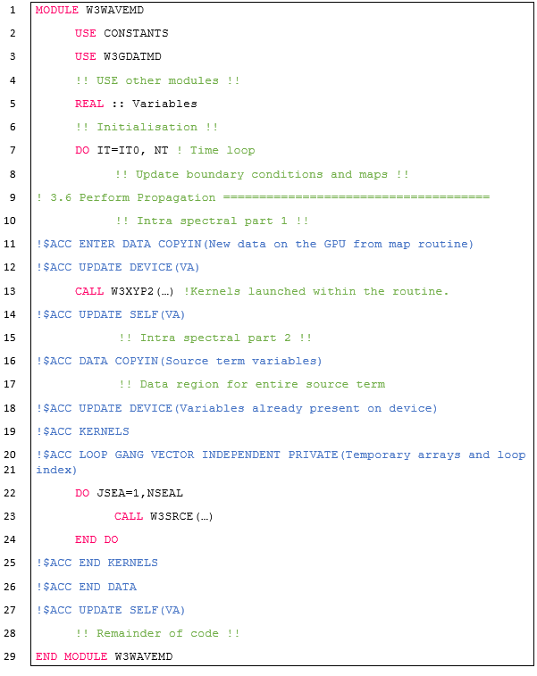
Our GPU Port
We have introduced ACC pragmas to the main W3WAVE routine for data transfers and kernel launches via manual porting.
We currently launch separate kernels for the propagation routine and the source term step.
Both looping structures, for source-term and spatial propagation have been tackled independently for our porting efforts.
We ensured our code will function with both managed memory and explicit transfers.

Slide 9
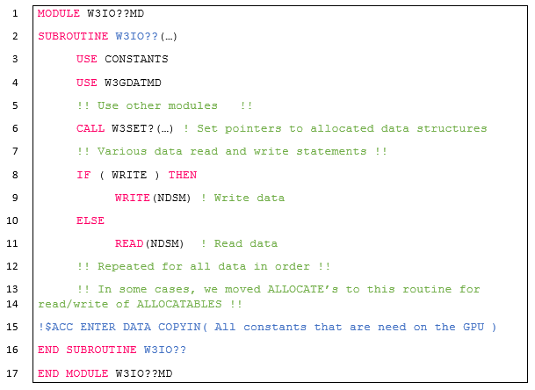
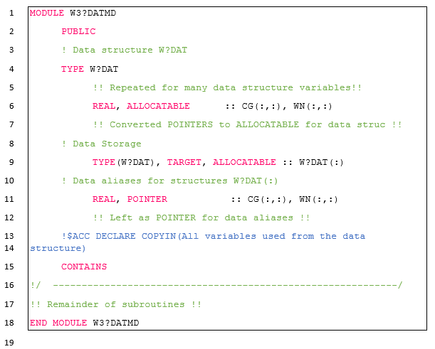
Our GPU Port Initialisations
Pointers > Allocatable
DECLARE
w3io??md.F90
w3?datmd.F90
COPYIN constants

Slide 10
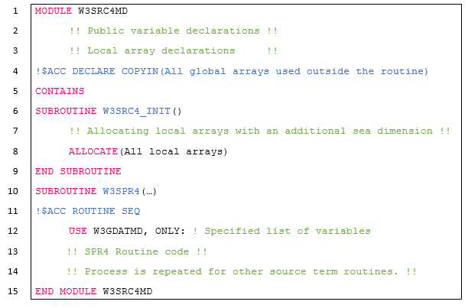
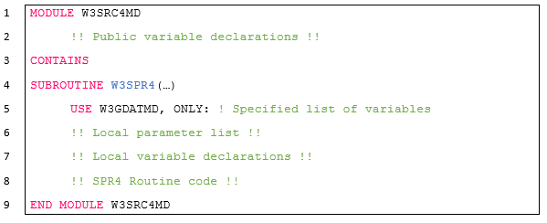
Our GPU Port Initialisations
_INIT subroutines
Local array declarations moved to module level
OpenACC Version
ACC ROUTINE SEQ
Original Version

Slide 11
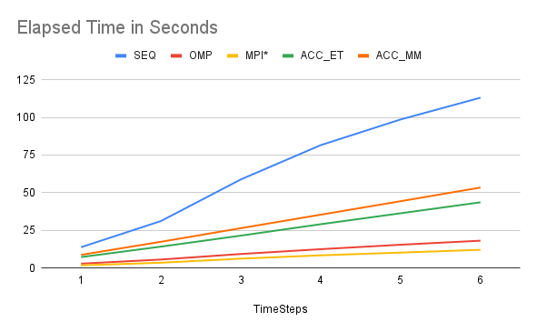
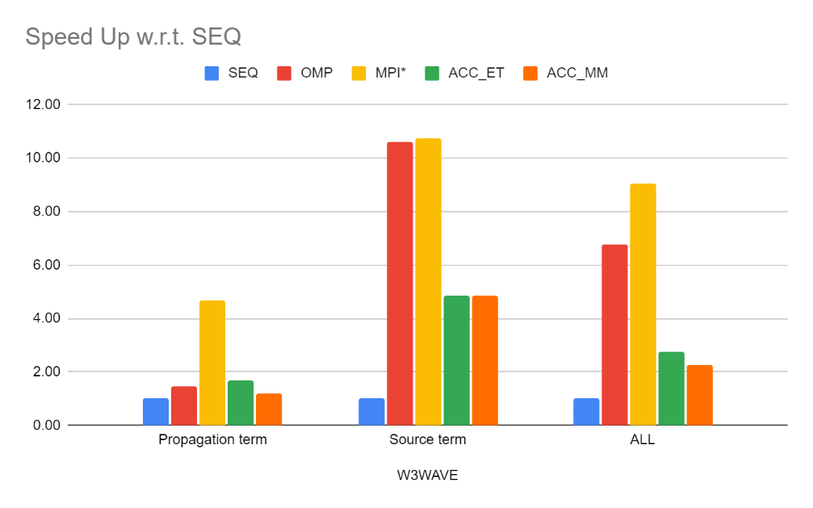
Performance analysis
Full configuration model run for the Persian gulf domain with a range of parallel options; Sequential, OpenMP, MPI, OpenACC (with explicit transfers or managed memory).
Various length of model runs, starting with a single hour up to 6 hours, each with an hour model time step.
We do not get identical scientific output between CPU and GPU with our current port.

Slide 12
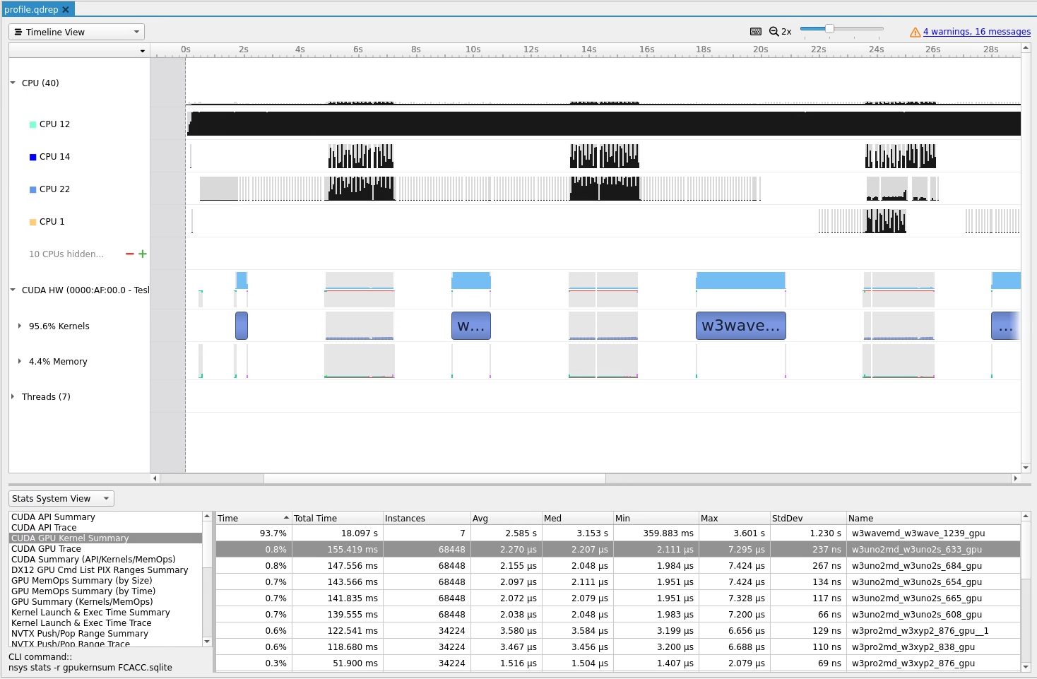
Nsight system and Profiler
Clear indicator for the most expensive kernel launches
Multiple movements to and from the GPU, not resident processing.
Single kernel for source term sea-loop, multiple kernels for spatial propagation sea loops.
Source term
Propagation

Slide 13
Refactoring of source term routines
Source terms have been identified as an area of the model that is computationally expensive.
Difficult to achieve good GPU performance with the current code structure.
We have been investigating refactoring loop structure in the source term code to improve GPU utilisation.

Slide 14
Current source term implementation
Large separation between seapoint loop and freq/dir loops
Loops in source terms are small (nk*nth) compared to number of available GPU threads.
Can’t sufficiently flood GPU with work (poor GPU utilisation)
Acceleration of outer seapoint loop in w3wave requires all subroutines called within to be compiled on GPU.
We need tighter loops over the 3D array of spectra (VA) and targeted GPU kernels in the source term subroutines.
W3WAVE
W3SRCE
W3SLN1
SPEC
1
SPEC
W3SIN4
Spectrum for single seapoint
SPEC
JSEA
VA
W3SDS4
VSxx
SPEC
VDxx
…etc…
NSEAL
SPEC
Loop over seapoints
Lots of temporary arrays size NSPEC
Loops over single spectrum (NK, NTH)
NSPEC = NK * NTH

Slide 15
Current source term implementation
Large separation between seapoint loop and freq/dir loops
GPU parallelism currently over outer NSEA loop in W3WAVE…
W3WAVE
W3SRCE
W3SLN1
SPEC
1
SPEC
W3SIN4
…but ideally we want parallelism to be lower down in individual source term routines (closely nested loops)
Spectrum for single seapoint
SPEC
JSEA
VA
W3SDS4
VSxx
SPEC
VDxx
…etc..
We propose that the seapoint loop needs to be moved down into source routines.
NSEAL
SPEC
Loop over seapoints
Lots of temporary arrays size NSPEC
Loops over single spectrum [NK, NTH]
NSPEC = NK * NTH

Slide 16
Proposed refactoring of source terms
Entire spectral array (VA) passed to source term routines
Passing entire VA array to source term routines facilitates parallelism over larger NSEA dimension.
Potential to significantly improve GPU performance.
BUT – there are many temporary arrays in W3SRCE that are of size NSPEC. To allow parallelism, these require an extra NSEA dimension.
Significant impact on memory usage: a minimum of 12 of these arrays are required. Large grids could use all GPU memory (NVIDIA Volta has 16GB)
An typical grid of 250,000 sea points with a 30x30 spectrum would see memory increase from ~42Kb to >10GB (in a non MPI run)
Minimal benefit to CPU code considering extra memory usage.
W3WAVE
W3SRCE
W3SIN4
VA
VA
…etc...
Loops over all spectra (NK, NTH, NSEA)
Temporary arrays now NSPEC * NSEA: significant extra memory usage
Parallelism now over entire NSEA dimension
NSPEC = NK * NTH

Slide 17
Refactored source term: tiled approach
Entire spectral array (VA) passed to W3SRCE
VA tile passed to source term subroutines
Alternative approach is to “tile” the VA array in W3SRCE routine.
A chunk of the 3D VA array is passed to the source term subroutines
Temporary arrays now have a second dimension of CHUNKSIZE, rather than NSEAL.
Set tile CHUNKSIZE to be:
Large enough to allow performant parallelisation along seapoint dimension in source term routines
Small enough to minimize memory allocation of temporary arrays.
CHUNKSIZE can be set to 1 to keep (roughly) same memory usage on CPU.
W3WAVE
W3SRCE
W3SIN4
VA
VA
Loop over tiles of VA
…etc...
Loops over tiled chunk of spectra array (NK, NTH, CHUNKSIZE)
Temporary arrays now NSPEC * CHUNKSIZE: more manageable.
Parallelism now over large chunk of NSEA dimension
NSPEC = NK * NTH

Slide 18
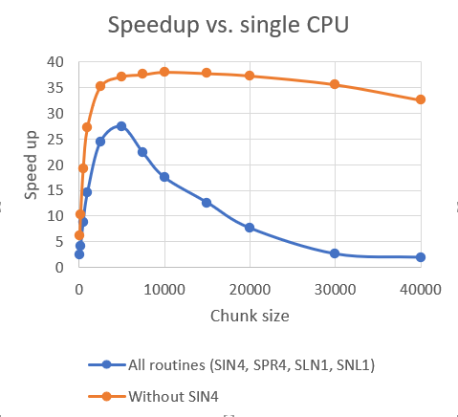
Refactored source term: initial results
Currently being developed and tested via a small “mini-app” that just calls W3SRCE. Only SIN4, SNL1, SLN1 and SPR4 routines have currently been accelerated (more to follow).
(Very) initial results:
Up to ~25x speed up of GPU versus single thread CPU, depending on chunk size.
Currently have poor GPU memory throughput in SIN4 term (~8-10x speedup); all acceleration is on outer seapoint loop – needs more work on accelerating inner loops.
SNL1 term has accelerated very well (inner loops vectorized). Timing tests without the SIN4 routine show at least 35x speed up w.r.t. single CPU.
Encouraging initial results, but still a work in progress – other source terms (e.g. SDS, SBT, etc) need adding.
Considerations:
Adds complexity to the code (which might not benefit non-GPU architecture)
Requires extra memory to allow parallelisation: temporary arrays in w3srce and many private variables in source term routines.
Hybrid MPI/ACC needs to use extra temporary variables for chunking input fields on the “full grid” due to card-deck parallelisation approach (e.g. U10, USTAR, AS, etc).

Slide 19
Next steps
Further porting effort to improve current acceleration.
Engage with other teams working on GPU acceleration: Steven Bruce (Argonne National Laboratory), Olawale Ikuyajolu, et al. (Georgia Tech)
Investigate refactoring of the source term component.
Expand GPU port to other model components, e.g. SMC grid.
Prepare for other HPC architectures, porting to Azure cloud platform and utilising Multi-GPU model runs.
Investigate best methods for integration of OpenACC directives with current WW3 codebase. Explicitly in code for all switch configurations? Or perhaps via a “separation of concerns” approach using an external tool (e.g. Psyclone¹)?
¹ https://psyclone.readthedocs.io

Slide 20
Feedback from WWIII community
If GPU work is successful, it will likely imply:
Refactoring of source terms (i.e. affects a significant part of the code)
Decision on how to accommodate OpenACC directives
What is the opinion of the WWIII community on these potential changes?

