Slide 1


Authoring Tools Framework
Tech Talk

Slide 2
Agenda
Introduction
What is ATF?
Adopters of ATF
Components of ATF
Pros and Cons
Roadmap
Q & A

Slide 3
Max Elliott – manager, Game Tech Group
full-time
Ron Little – Lead
Jianhua Shen (“Shen”)
Julianne Harrington
part-time
Alan Beckus
Patrick O’Leary
Paul Skibitzke

Slide 4
Overview
Loosely-coupled components
Built on .NET 3.5/4.0, C#
Create PC-based game development tools
Plug-in, adaptable, extensible architecture
Mature sample applications
Widely adopted
Visual Studio 2008, 2010, 2012
In the WWS SDK
Notes:
The Authoring Tools Framework is a set of loosely-coupled components, written in C#, for making game development tools on the PC. We try to do the boring uninteresting pieces!

Slide 5
Adopters
(Partial list)
Guerrilla Games
  CoreText Editor
Naughty Dog
  Charter – Level editor
  Shader Editor
Santa Monica Studios
  CreatureEditor – Animation blending tool
  Metrics – performance analyzer
Bend Game Studio
  WPE – Level editor
  Script Debugger
  Resource Manager
Quantic Dream
  StateMachine-based tool

Slide 6
Adopters
(Partial list)
Cambridge Studio
  LittleBigPlanet PSP’s Level Editor and Moderation Viewer
Home
  Home Scene Editor
ATG
  Sulpha – sound visualization and editing
  Nexus – Animation blending tool
TNT
  SLED – LUA IDE & debugger
  State Machine editor
  SCREAM – Audio effects authoring tool
  Modo – Procedural sound effects tool
Liverpool Studios
  Progression Editor
Zipper Interactive
  Atlas – Level editor using ATF 3 and SlimDX

Slide 7
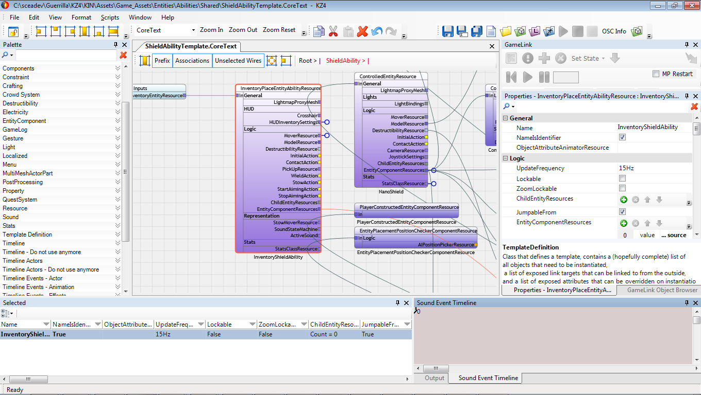
Guerrilla’s CoreText Editor
Notes:
By Mark Meijer at Guerrilla

Slide 8
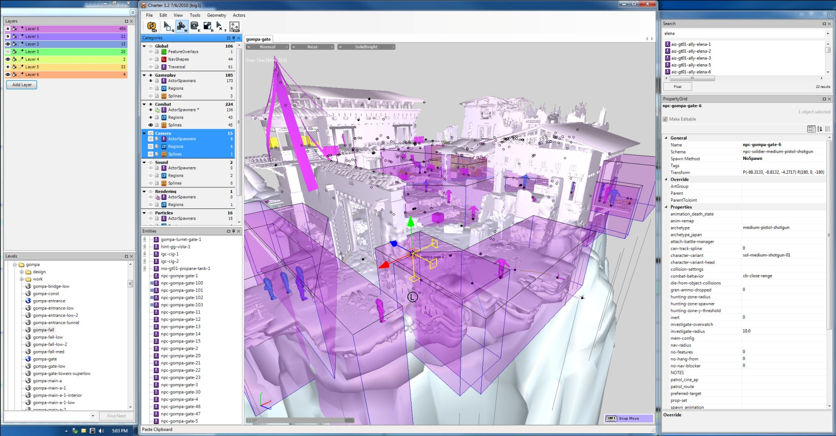
Naughty Dog’s Charter Level Editor

Slide 9
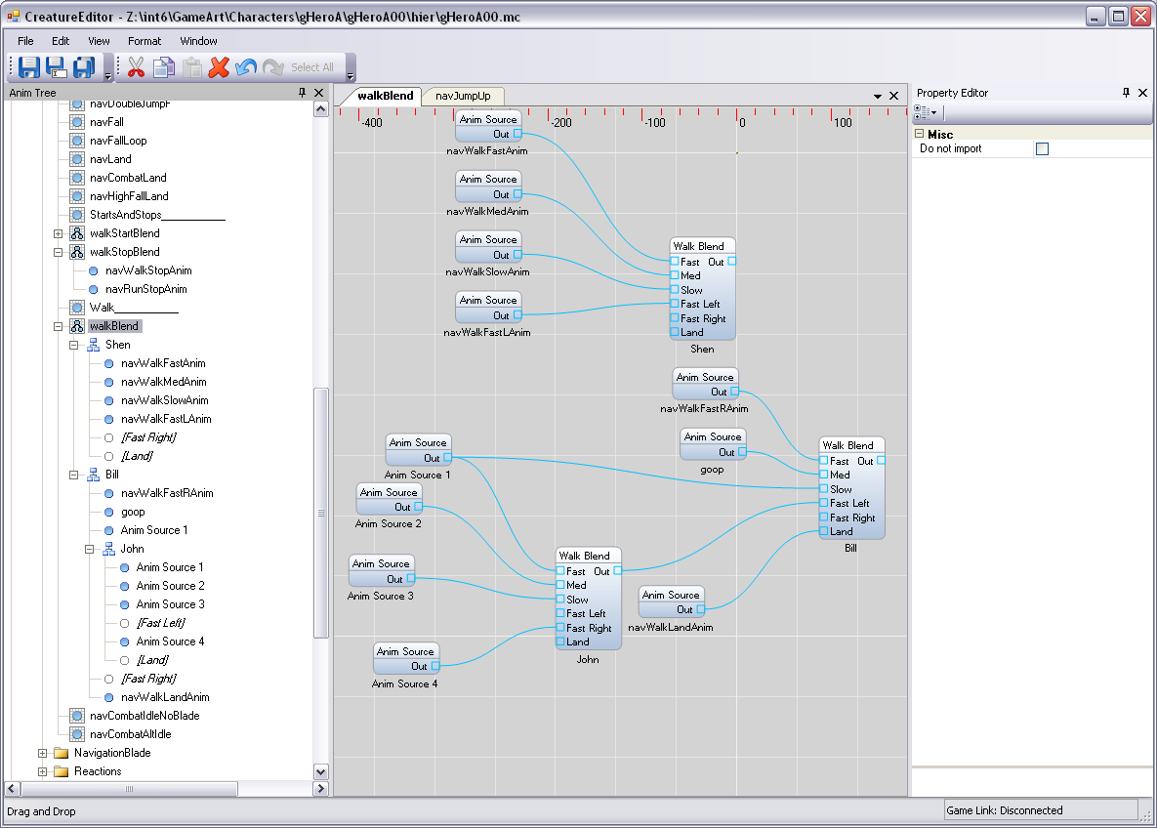
Santa Monica Studios’ Creature Editor
Notes:
By John Butterfield at Santa Monica Studios

Slide 10
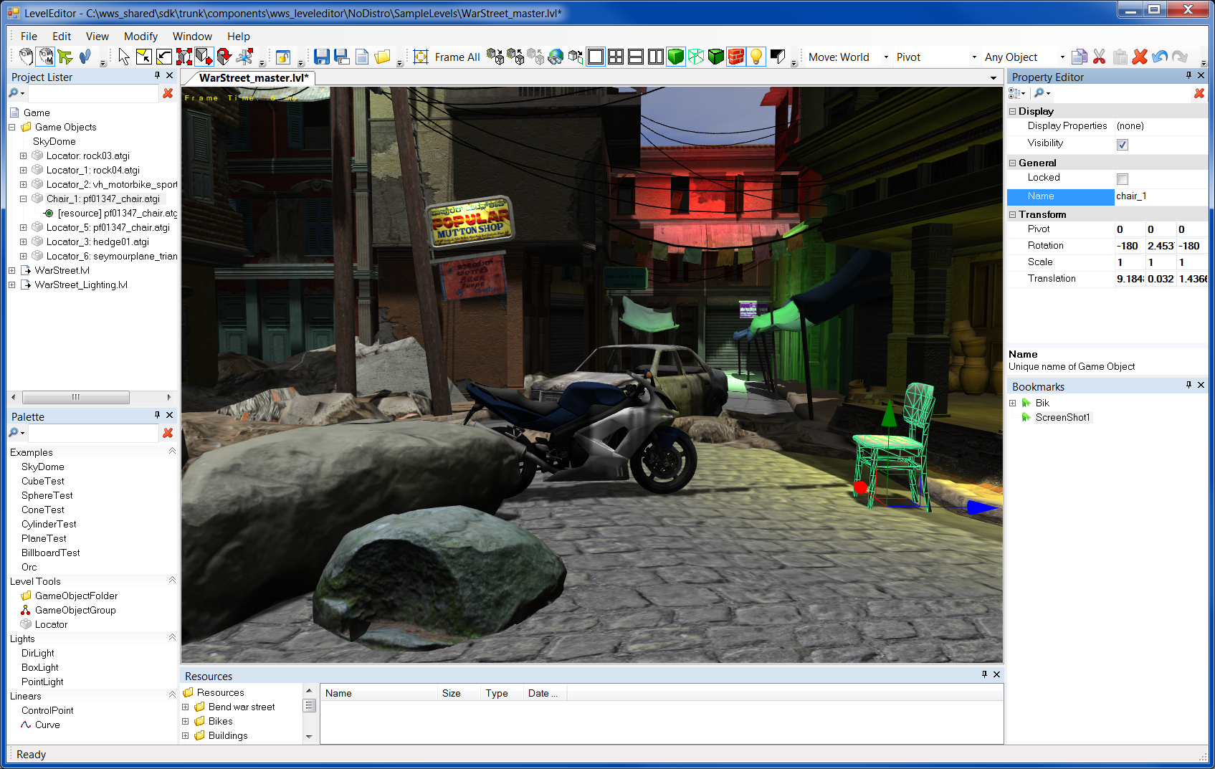
LevelEditor (by Game Tech Group)

Slide 11
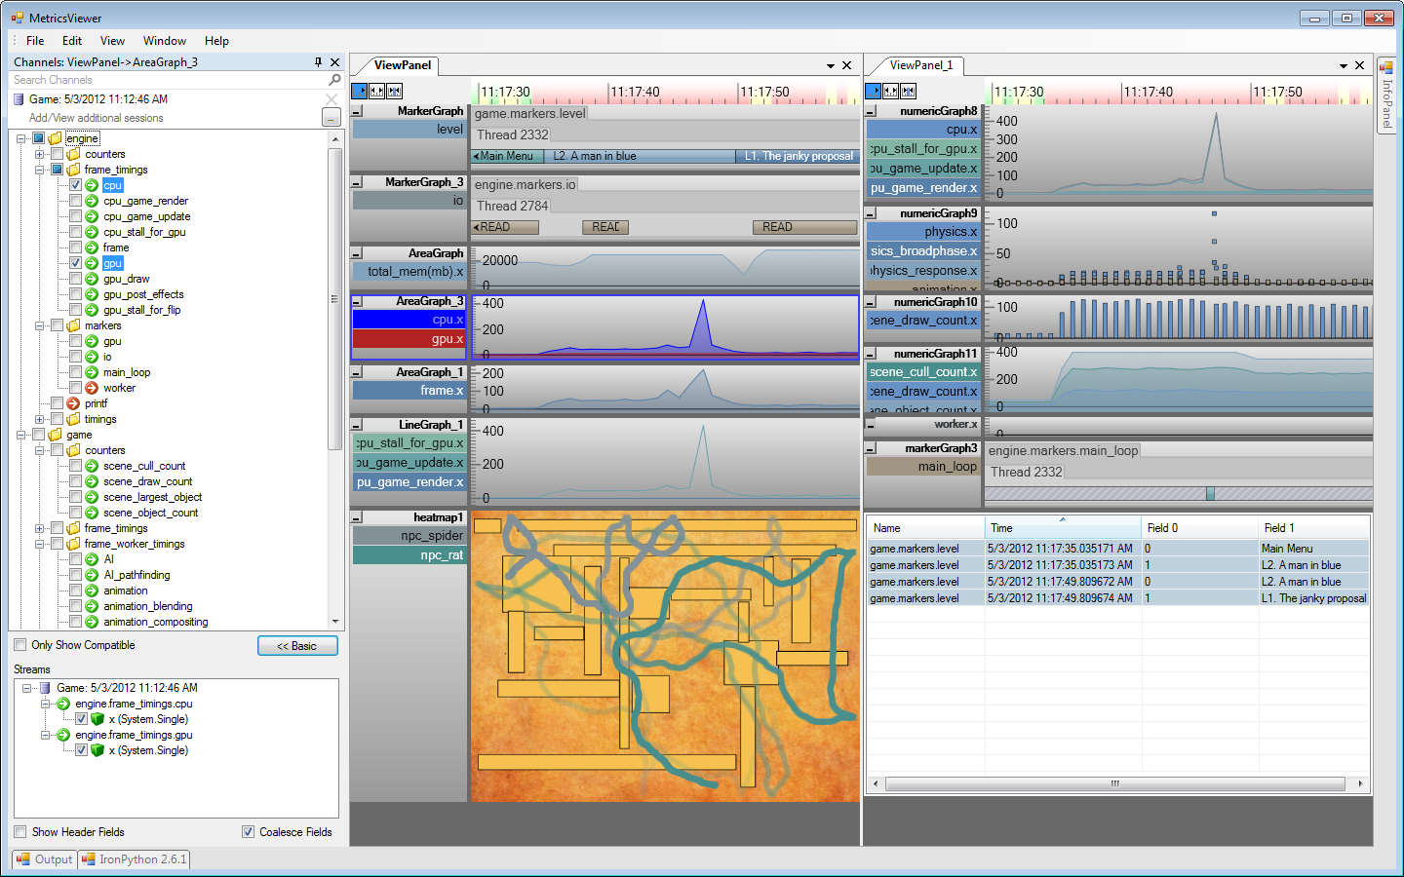
Metrics Viewer (by Game Tech Group)
Notes:
Written by TNT’s Game Tech Group for Santa Monica Studios

Slide 12
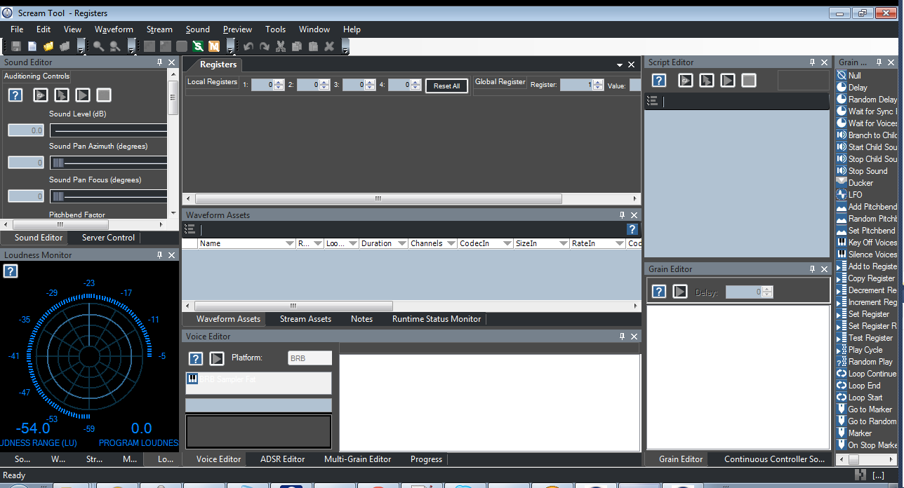
Scream Tool 7

Slide 13
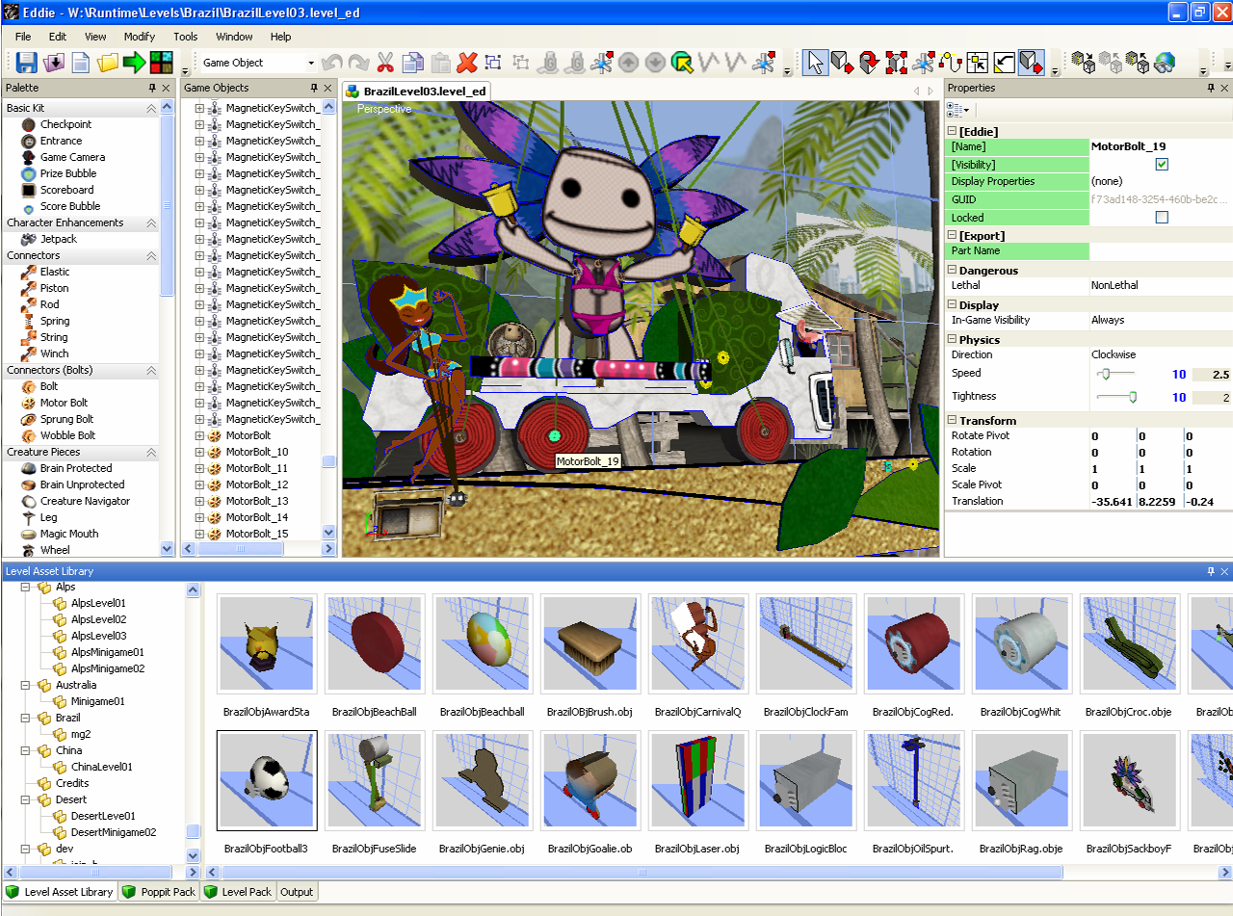
LittleBigPlanet PSP Level Editor
Notes:
By Cambridge Studio

Slide 14
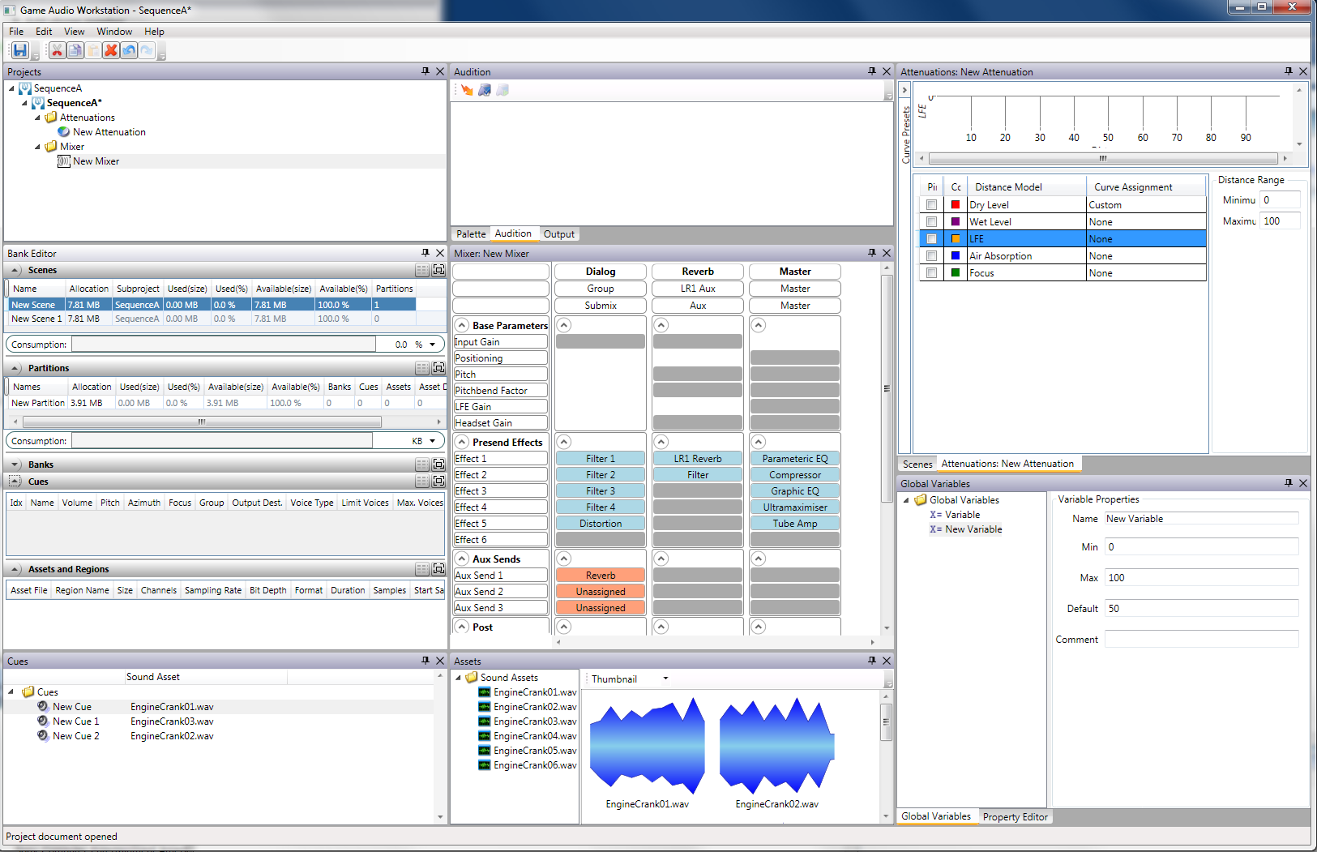
Game Audio Workstation
Notes:
WPF app

Slide 15
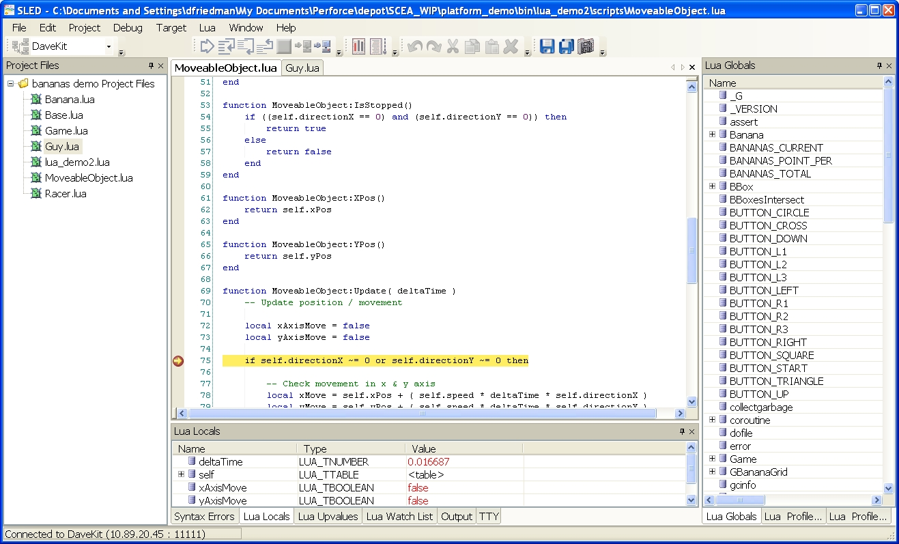
SLED (by Game Tech Group)

Slide 16
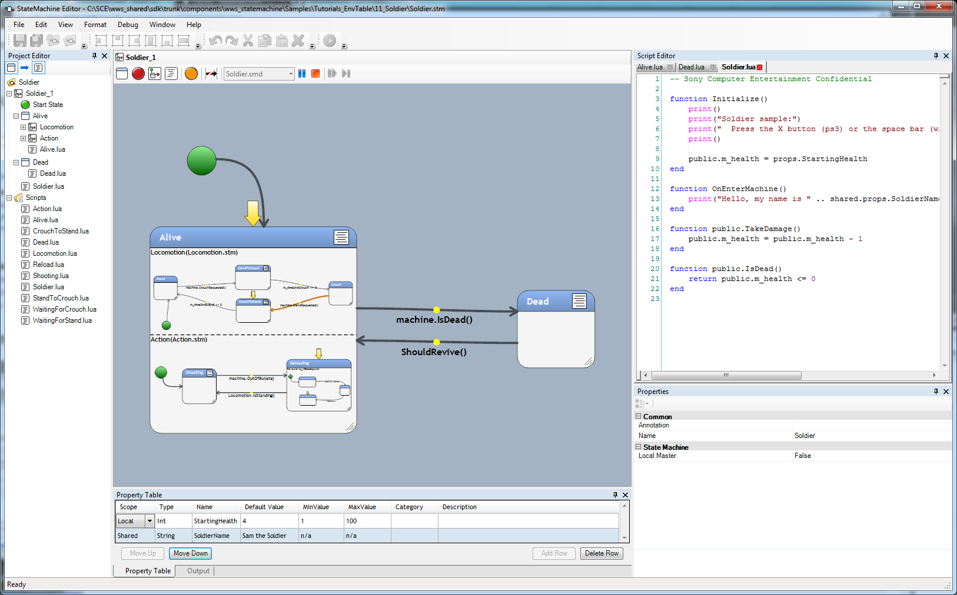
State Machine (by Game Tech Group)

Slide 17
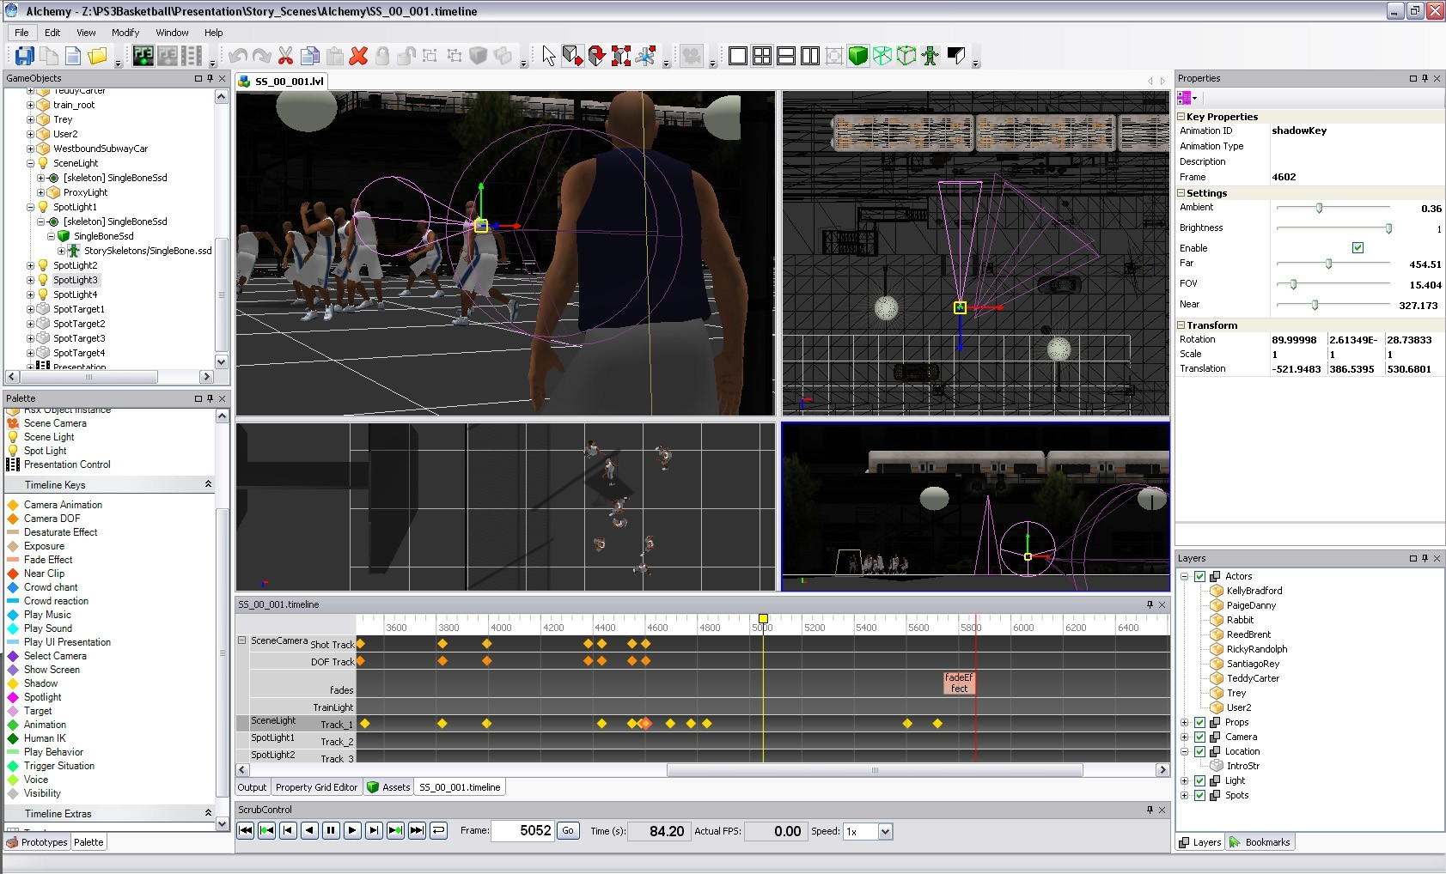
Alchemy
Notes:
NBA Team’s cinematic authoring tool

Slide 18
Main Components
DOM (Document Object Model)
  XML and Schema files can be used, but are optional
MEF (Managed Extensibility Framework)
Editor Infrastructure
  Commands
  Documents
  Transactions
  History
  Contexts
  Search & Replace
Control Host Service with docking
  WPF and WinForms
Maya-like 3D Design View, DirectX 11 native rendering – in LevelEditor project
  ATGI and Collada model support
Circuit, StateChart, Timeline with Direct2D
Script editing with syntax highlighting
Tree Control, Property Grid Editor, etc.

Slide 19
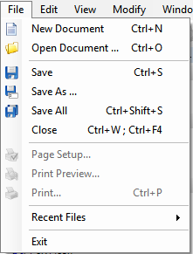
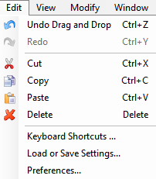
We do the boring stuff…

Slide 20
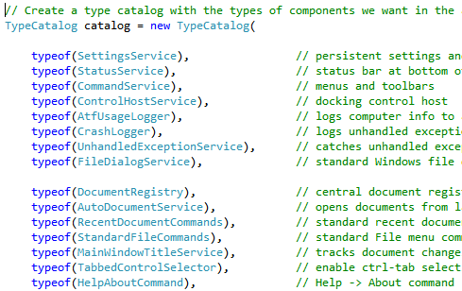
You pick the parts you want…

Slide 21
Managed Extensibility Framework (MEF) is in the .NET Framework
TypeCatalog contains all of the “parts” that compose your app
“Parts” discover each other by importing and exporting types
  ExportAttribute and ImportAttribute
Each part is created on-demand by MEF or up-front if using ATF’s InitializeAll() extension method. We recommend using InitializeAll().

Slide 22
DOM (Document Object Model)
In-memory observable XML-like database
DomNode trees
  Root of a DomNode tree is typically a document
DomNodes have attributes and children
  Specified by a DomNodeType (like a schema type)
  Attributes, like in XML, are simple types (int, float, string, reference) or arrays of simple types.
DomNodes are observable
  Child Added event
  Child Removed event
  Attribute Changed event
Notes:
Enables undo/redo, cut/copy/paste, document persistence

Slide 23
DomNode Hierarchy
Each DomNode has certain attributes and children, specified by the DomNode’s DomNodeType.
DomNodeTypes can be created programmatically or by loading schema file.
Events propagate from children to parents.
Circuit Document Root
Circuit Group
Circuit Element
Circuit Element
Circuit Group
Circuit Element
events

Slide 24

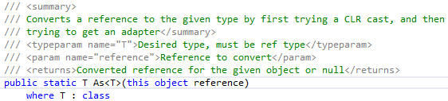
Adaptability
IAdaptable
  Implemented by DomNode and DomNodeAdapter
As<T> extension method on object
  First does C# ‘as’, then checks for IAdaptable

Slide 25
DomNodeAdapters
Clients’ “business classes” derive from DomNodeAdapter and are defined for particular DomNodeTypes. A DomNode is created first and then all defined DomNodeAdapters for that DomNode are automatically created and their OnNodeSet method is called.
CircuitDocument
Root DomNode
Circuit Group DomNode
Circuit Element DomNode
Circuit Element DomNode
Circuit Group DomNode
Circuit Element DomNode
HistoryContext
SelectionContext
class CircuitGroup
class CircuitElement

Slide 26
Contexts
Typically are one-to-one with documents.
SelectionContext
  Tracks user’s selection and has change events
HistoryContext
  Tracks DOM changes to sub-tree for undo/redo
TransactionContext
  Base class of HistoryContext. Tracks when a set of changes begins and finishes, so that validation logic can be executed at correct time.
InstancingContext
  Implements copy, paste, and delete

Slide 27
Registries
One of each of per app
DocumentRegistry – tracks documents
  List of open documents
  Adds and removes documents
  Active document
ContextRegistry – tracks contexts
  List of available “contexts”
  Adds and removes contexts
  Active context
IControlRegistry, IControlHostService
  Clients register Controls, so that they appear in docking framework. Active Control is tracked.

Slide 28
Services
One of each per app. Provides functionality to other components.
ControlHostService
  Docking framework
CommandService
  Menus and toolbars
SettingsService
  User and app settings GUI and persistence
PerforceService
SkinningService
Etc.

Slide 29
Editors
One of each per app; work with active context
PropertyEditor
  2-column property editor with names and values
GridPropertyEditor
  Spreadsheet-style multi-object property editor
TimelineEditor
CircuitEditor
CurveEditor
Etc.

Slide 30
ATF Pros and Cons
Pros
  Easy to create editing tools with all of the standard features -- copy & paste, undo & redo, windows docking, user settings, document persistence (if using XML files), etc.
  Powerful components for specific tasks
    Circuit editing
    Timeline editing
    Property editing
    Maya-like 3D design view in LevelEditor app

Slide 31
ATF Pros and Cons
Cons
  Connections between components are usually abstract and use C# interfaces and Adaptability. It can be difficult to know which components are working with each other. Tip: use debugger.
  Steep learning curve. We’re trying to address this with better docs. We have a very good documentation writer.
  The DOM is difficult to debug. Use DomNodeAdapters, DOM Recorder, and DOM Explorer.

Slide 32
Recent Development
ATF 3.3 and 3.4 in 2012
  Skinning Service
  LiveConnect
  Array Editor property editor
  Grid Property Editor improvements
  Target Enumeration Service
  DOM Recorder
  Circuit Groups
  Thorough review and clean-up of all the comments in the core Framework
ATF 3.5 in January 2013
  Open Sound Control
    Game designers can create their own GUI on iPad!
  Circuit Templates

Slide 33
Roadmap
ATF 3.6 for July 2013
  Circuit Group and editor improvements
  Circuit Templates with Santa Monica Studios
  Timeline Editor improvements
  DOM debugging improvements
    DOM Recorder
      Coverage of all DomNode trees
      Toggle for analyzing HistoryContext coverage
    Visual Studio debugger visualizer for DomNodes

Slide 34
Open Sound Control
Collaboration with Guerrilla Games
Open standard, high-level network protocol
Successor to MIDI
Sends and receives name / value pairs
Lemur ($50) for iPad works great
Non-programmer can create GUI and tools
Demo

Slide 35
Questions?

Slide 36
Resources
WWS SDK Component, on Ship
Full Featured Examples
  Circuit Editor
  Statechart Editor
  Timeline Editor
  Using Direct2D
  Model Viewer
Wikis
JIRA tracker
Blog
Responsive staff ☺
Road trips!

Slide 37
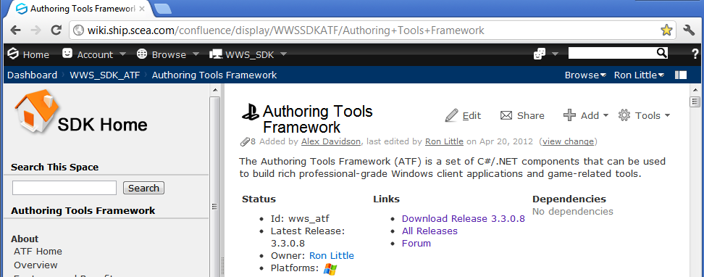
Contact Information
ron_little@playstation.sony.com
max_elliott@playstation.sony.com

Slide 38
Thank You

