Slide 1
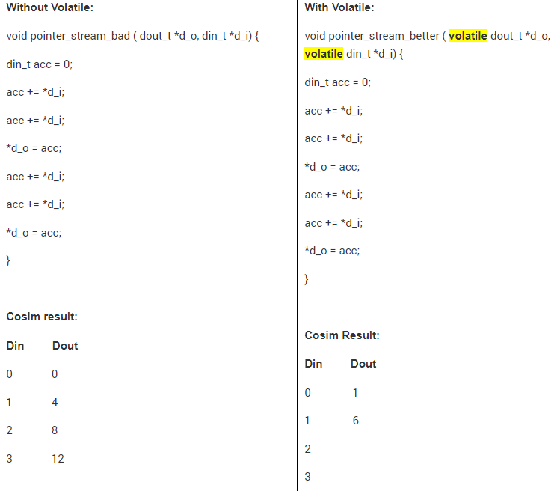
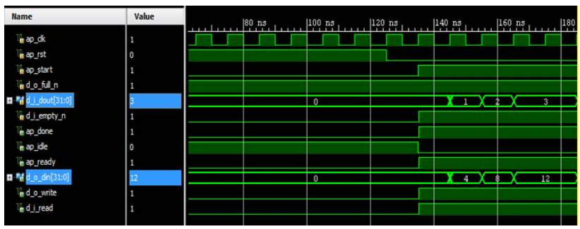
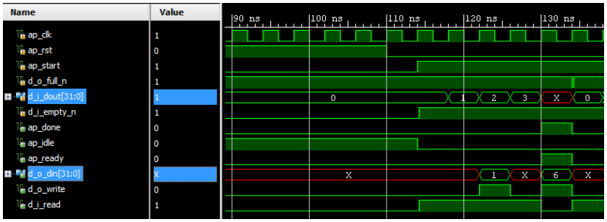
Multi-Access Pointers and RTL Simulation
#pragma HLS INTERFACE ap_fifo depth=4 port=d_i
#pragma HLS INTERFACE ap_fifo depth=2 port=d_o
Using pointers which are accessed multiple times can introduce unexpected behavior after synthesis.
Use the volatile qualifier on any function argument accessed multiple times.
The volatile qualifier tells the C compiler (and Vivado HLS) to make no assumptions about the pointer accesses. That is, the data is volatile and may change.
using the hls::stream class instead of multi-access pointers to avoid some of the difficulties discussed below
Perform co-simulation to ensure it is correct
di
0
1
2
3
Only get one *d_i
Output one *do_o
Others optimized away
https://support.xilinx.com/s/question/0D52E00006hprWiSAI/how-to-properly-dataflow-functions-in-hls?language=en_UShttps://support.xilinx.com/s/article/60434?language=en_US

