Slide 1
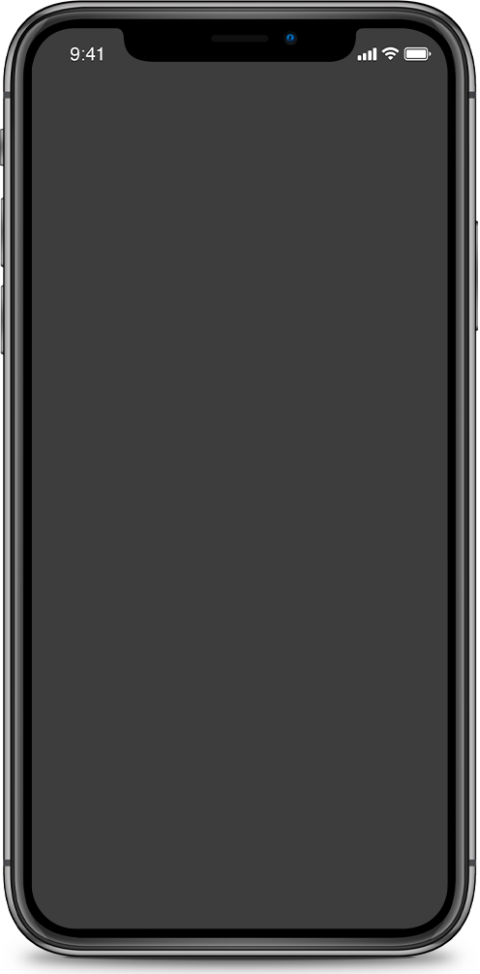
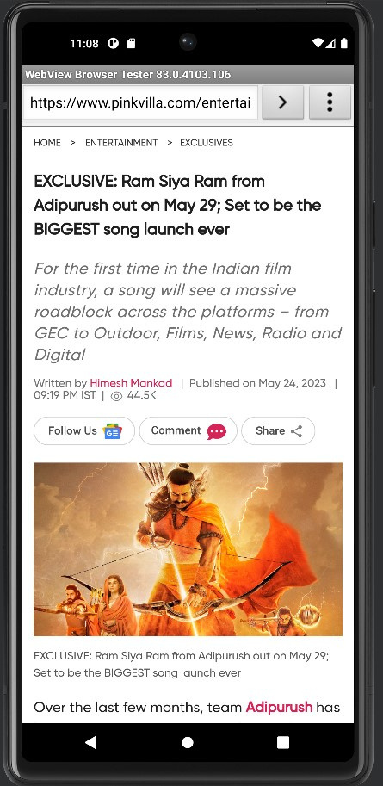

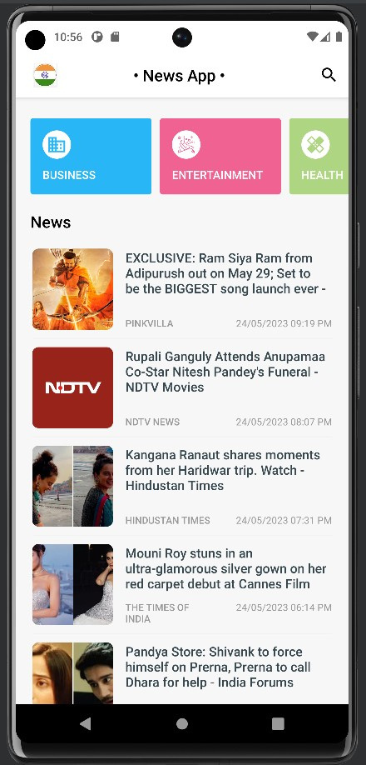
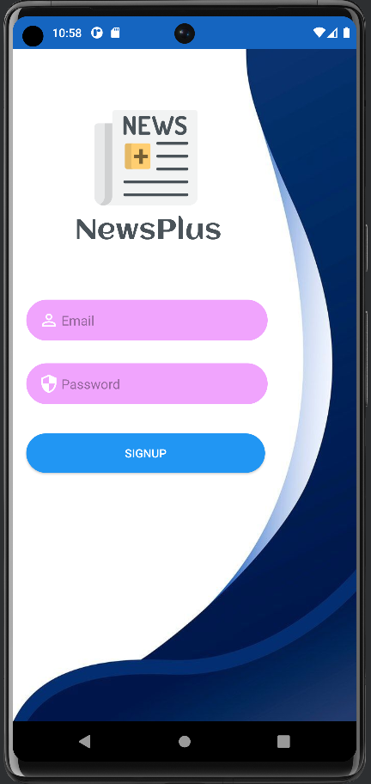
NewsPlus
Get the best out of rest

Slide 2

INTRODUCTION
SIGNING UP
By creating an account, you gain access to a range of features tailored to your preferences. Signing up is quick and hassle-free. Simply provide your email address, choose a secure password, and you're ready to go.
LOGGING IN
For our returning users, logging in is a breeze. Just enter your registered email address and password, and you'll be granted instant access to the news articles, and exclusive content.
REAL-TIME UPDATES
"Newsplus" app needs to improve real-time updates for timely delivery of news articles, enhancing user experience by eliminating delays in receiving the latest content.
SEARCH FUNCTIONALITY
The application includes a robust search functionality that allows users to search for specific news articles, topics, or keywords, making it easy to find the information they are looking for.
CHOOSE COUNTRY OPTION
NewsPlus acknowledges that news preferences may vary depending on the country you reside in or wish to explore. We provide a "Choose Country" option that allows you to select your preferred country. By doing so, you can access news articles specifically tailored to that country.
CATEGORIES
(sports, technology, health, science, entertainment) which helps the users to sort and read about specific category.

Slide 3
ABSTRACT
1. The Newsplus app brings reliable and fast news to users' fingertips, overcoming time constraints and enabling reading habits on the go.
2. Users can stay updated on global events, follow trends, and get highlights of their favorite teams conveniently through the app.
3. The app offers a user-friendly interface with top stories and categorized news sections (sports, technology, health, science, entertainment).
4. It supports multiple languages, catering to users worldwide.
5. The app provides news from various sources, ensuring content diversity and an ad-free experience.

Slide 4
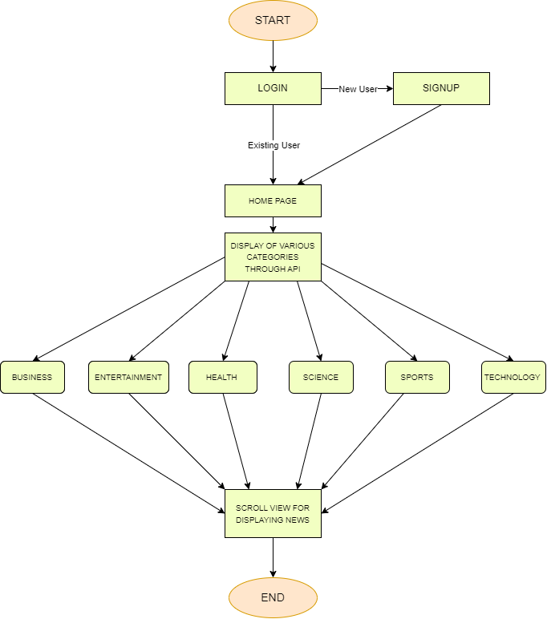
Data Flow Diagram :
START:
The process begins when the user launches the news application on their mobile device.
HOME PAGE:
Once the application is launched, the user is directed to the home page. The home page acts as the central hub for accessing different categories and news articles. It serves as an entry point for the user to explore the available news content.
DISPLAY OF VARIOUS CATEGORIES THROUGH API:
The API call retrieves information about the different categories, such as Business, Entertainment, Sports, Technology, Health, and Science. This data is used to dynamically generate the category options for the user to select from.
CATEGORIES (BUSINESS, ENTERTAINMENT, SPORTS, TECHNOLOGY, HEALTH, SCIENCE):
Once the categories are fetched, the user can choose a specific category of interest. When the user selects a category, the application sends a request to the API to fetch news articles related to that category.
SCROLL VIEW FOR DISPLAYING NEWS:
The retrieved news articles are displayed within a scrollable view. That allows the user to vertically navigate through the list of articles within the selected category. Each article is presented as a preview, showing key details like the headline and source.
END:
The user can choose to end the browsing session by either closing the application or navigating to another screen

Slide 5

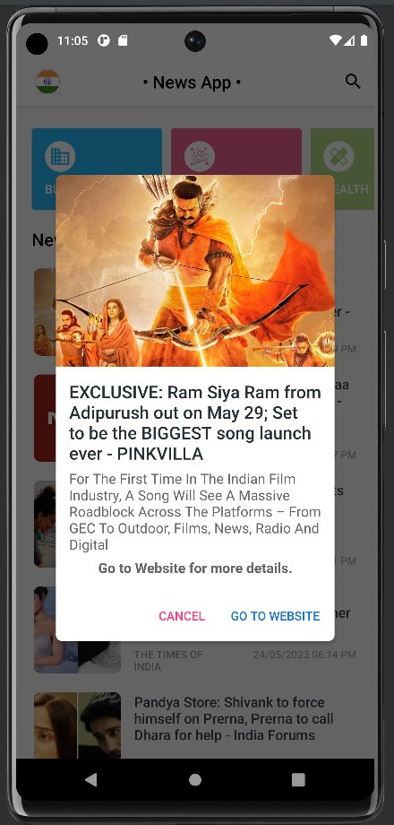
Software Requirements :
  ANDROID STUDIO
  FIREBASE
  JAVA DEVELOPMENT KIT (JDK)
ANDROID SDK
Hardware Requirements :
  OPERATING SYSTEM : WINDOWS 10, MACOS
  STORAGE SPACE:AT LEAST 8GB
  PROCESSOR: GREATER THAN INTEL I3 OR RYZEN 3
  DISPLAY: MINIMUM 1280X800 RESOLUTION.
  RAM: MINIMUM 8GB RAM

Slide 6
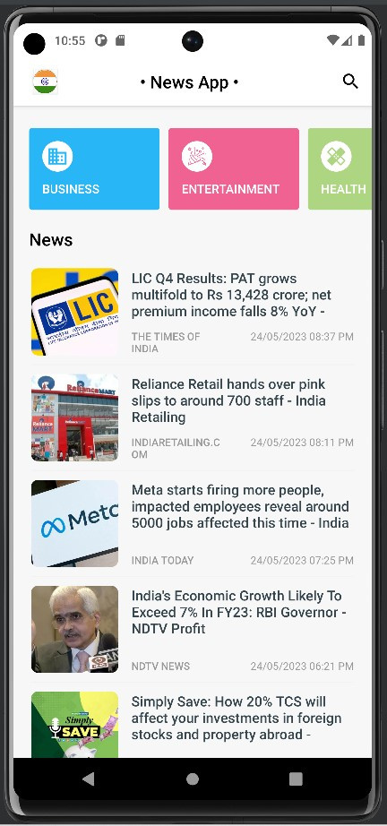
FUTURE WORK
Advanced Personalization : Implement personalized news recommendations based on user preferences, browsing history, and behavior patterns to deliver a customized news experience.
Bookmarking and Saved Articles: Allow users to save articles for later reading, create bookmarks, and organize saved articles for easy access.
Social Media Integration: Enable users to share news articles on popular social media platforms, fostering engagement and expanding the app's reach.
Real-time Notifications: Implement push notifications to notify users of breaking news, personalized updates, and trending stories in real-time.
Offline Reading: Provide offline access to news articles, allowing users to read content even without an active internet connection.

Slide 7

CONCLUSION
A COMPREHENSIVE AND PERSONALIZED NEWS READING EXPERIENCE
The proposed News Plus is a comprehensive news application that provides users with an immersive and personalized news reading experience. With a sleek and user-friendly interface, News Plus aims to deliver the latest and most relevant news from various trusted sources worldwide. The application offers a wide range of features to cater to diverse user preferences. Users can select their preferred country for news coverage, ensuring access to localized content.

Slide 8


THANK YOU!
Get the best out of rest

