Slide 1
Apache Solr
Li Jianhan
7 April 2022

Slide 2
Something missing?

Slide 3
Yes! A search bar!!
???

Slide 4
A blazing-fast, open source enterprise search engine.

Slide 5
Roadmap
What is full-text search?
What is Solr?
Why Solr?

Slide 6
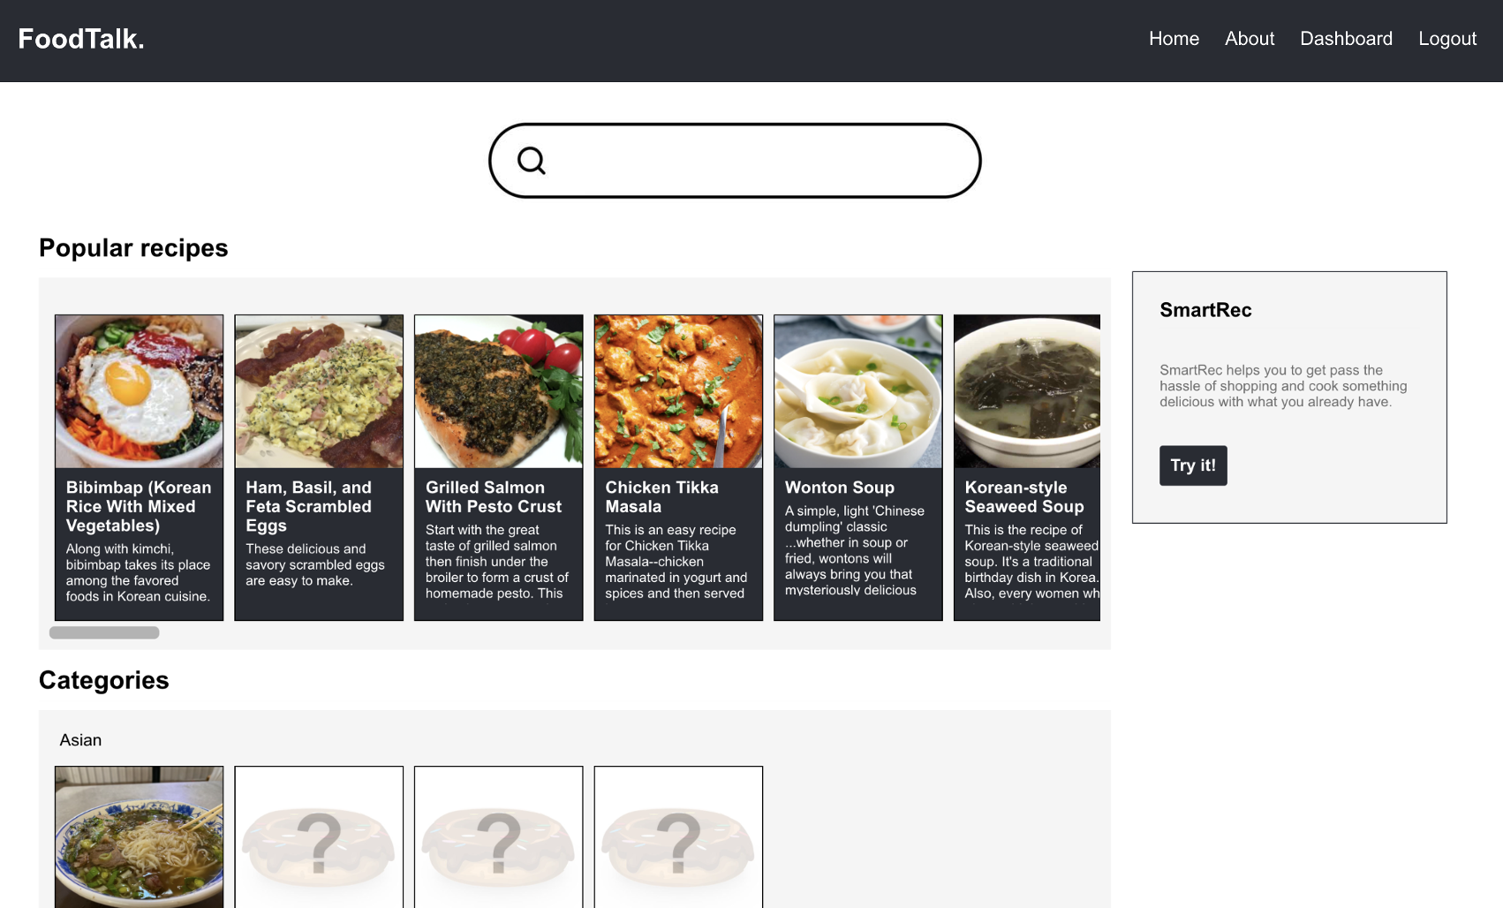
What’s in it for you!
Search server
Your application

Slide 7
What is full-text search?
Chicken rice
Search
Chicken -> 1, 2, …
Rice -> 1, 3, …
Indexing
Search server
Your application
Title
Description
Instructions
Recipe documents

Slide 8
What is Solr?
Chicken rice
Search
Indexing
Search server
Your application
Recipe documents

Slide 9
Why Solr?
Simple yet powerful
Secure
Extremely flexible
Scalable

Slide 10
Solr is simple yet powerful.
Search server

Slide 11
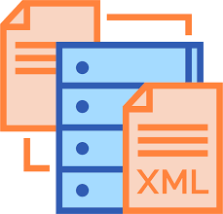
Solr is flexible.
schema.xml

Slide 12
Solr is very flexible.
I am the field to apply text analysis on
Ignore case differences
Remove stop words
Convert the terms to root form
schema.xml

Slide 13
Solr is designed to scale.
Solr
Distributed Indexing
Distributed Search
Index Replication
Index Merging
With minimal custom coding.

Slide 14
Solr gives you security out of the box.
Kerberos Authentication Plugin
Basic Authentication Plugin
JWT Authentication Plugin
Hadoop Authentication Plugin
Rule-Based Authorization Plugin

Slide 15
Solr vs ElasticSearch
Solr
ElasticSearch
Large scale log analytics, processing time series data

Slide 16
Solr vs ElasticSearch
Solr
ElasticSearch
Full-text search, processing massive amounts of static data

Slide 18
Make Solr part of your project today.
Simple yet powerful
Extremely flexible
Scalable
Secure
Easy to setup and manage, near real-time indexing and search
Rich security features out-of-the-box
Gives developers the freedom of choice
Built with scalability in mind, offers distributed solutions
jianhanli.dev@gmail.com

