Slide 1


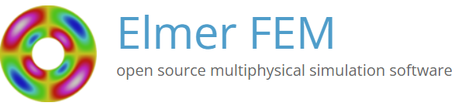
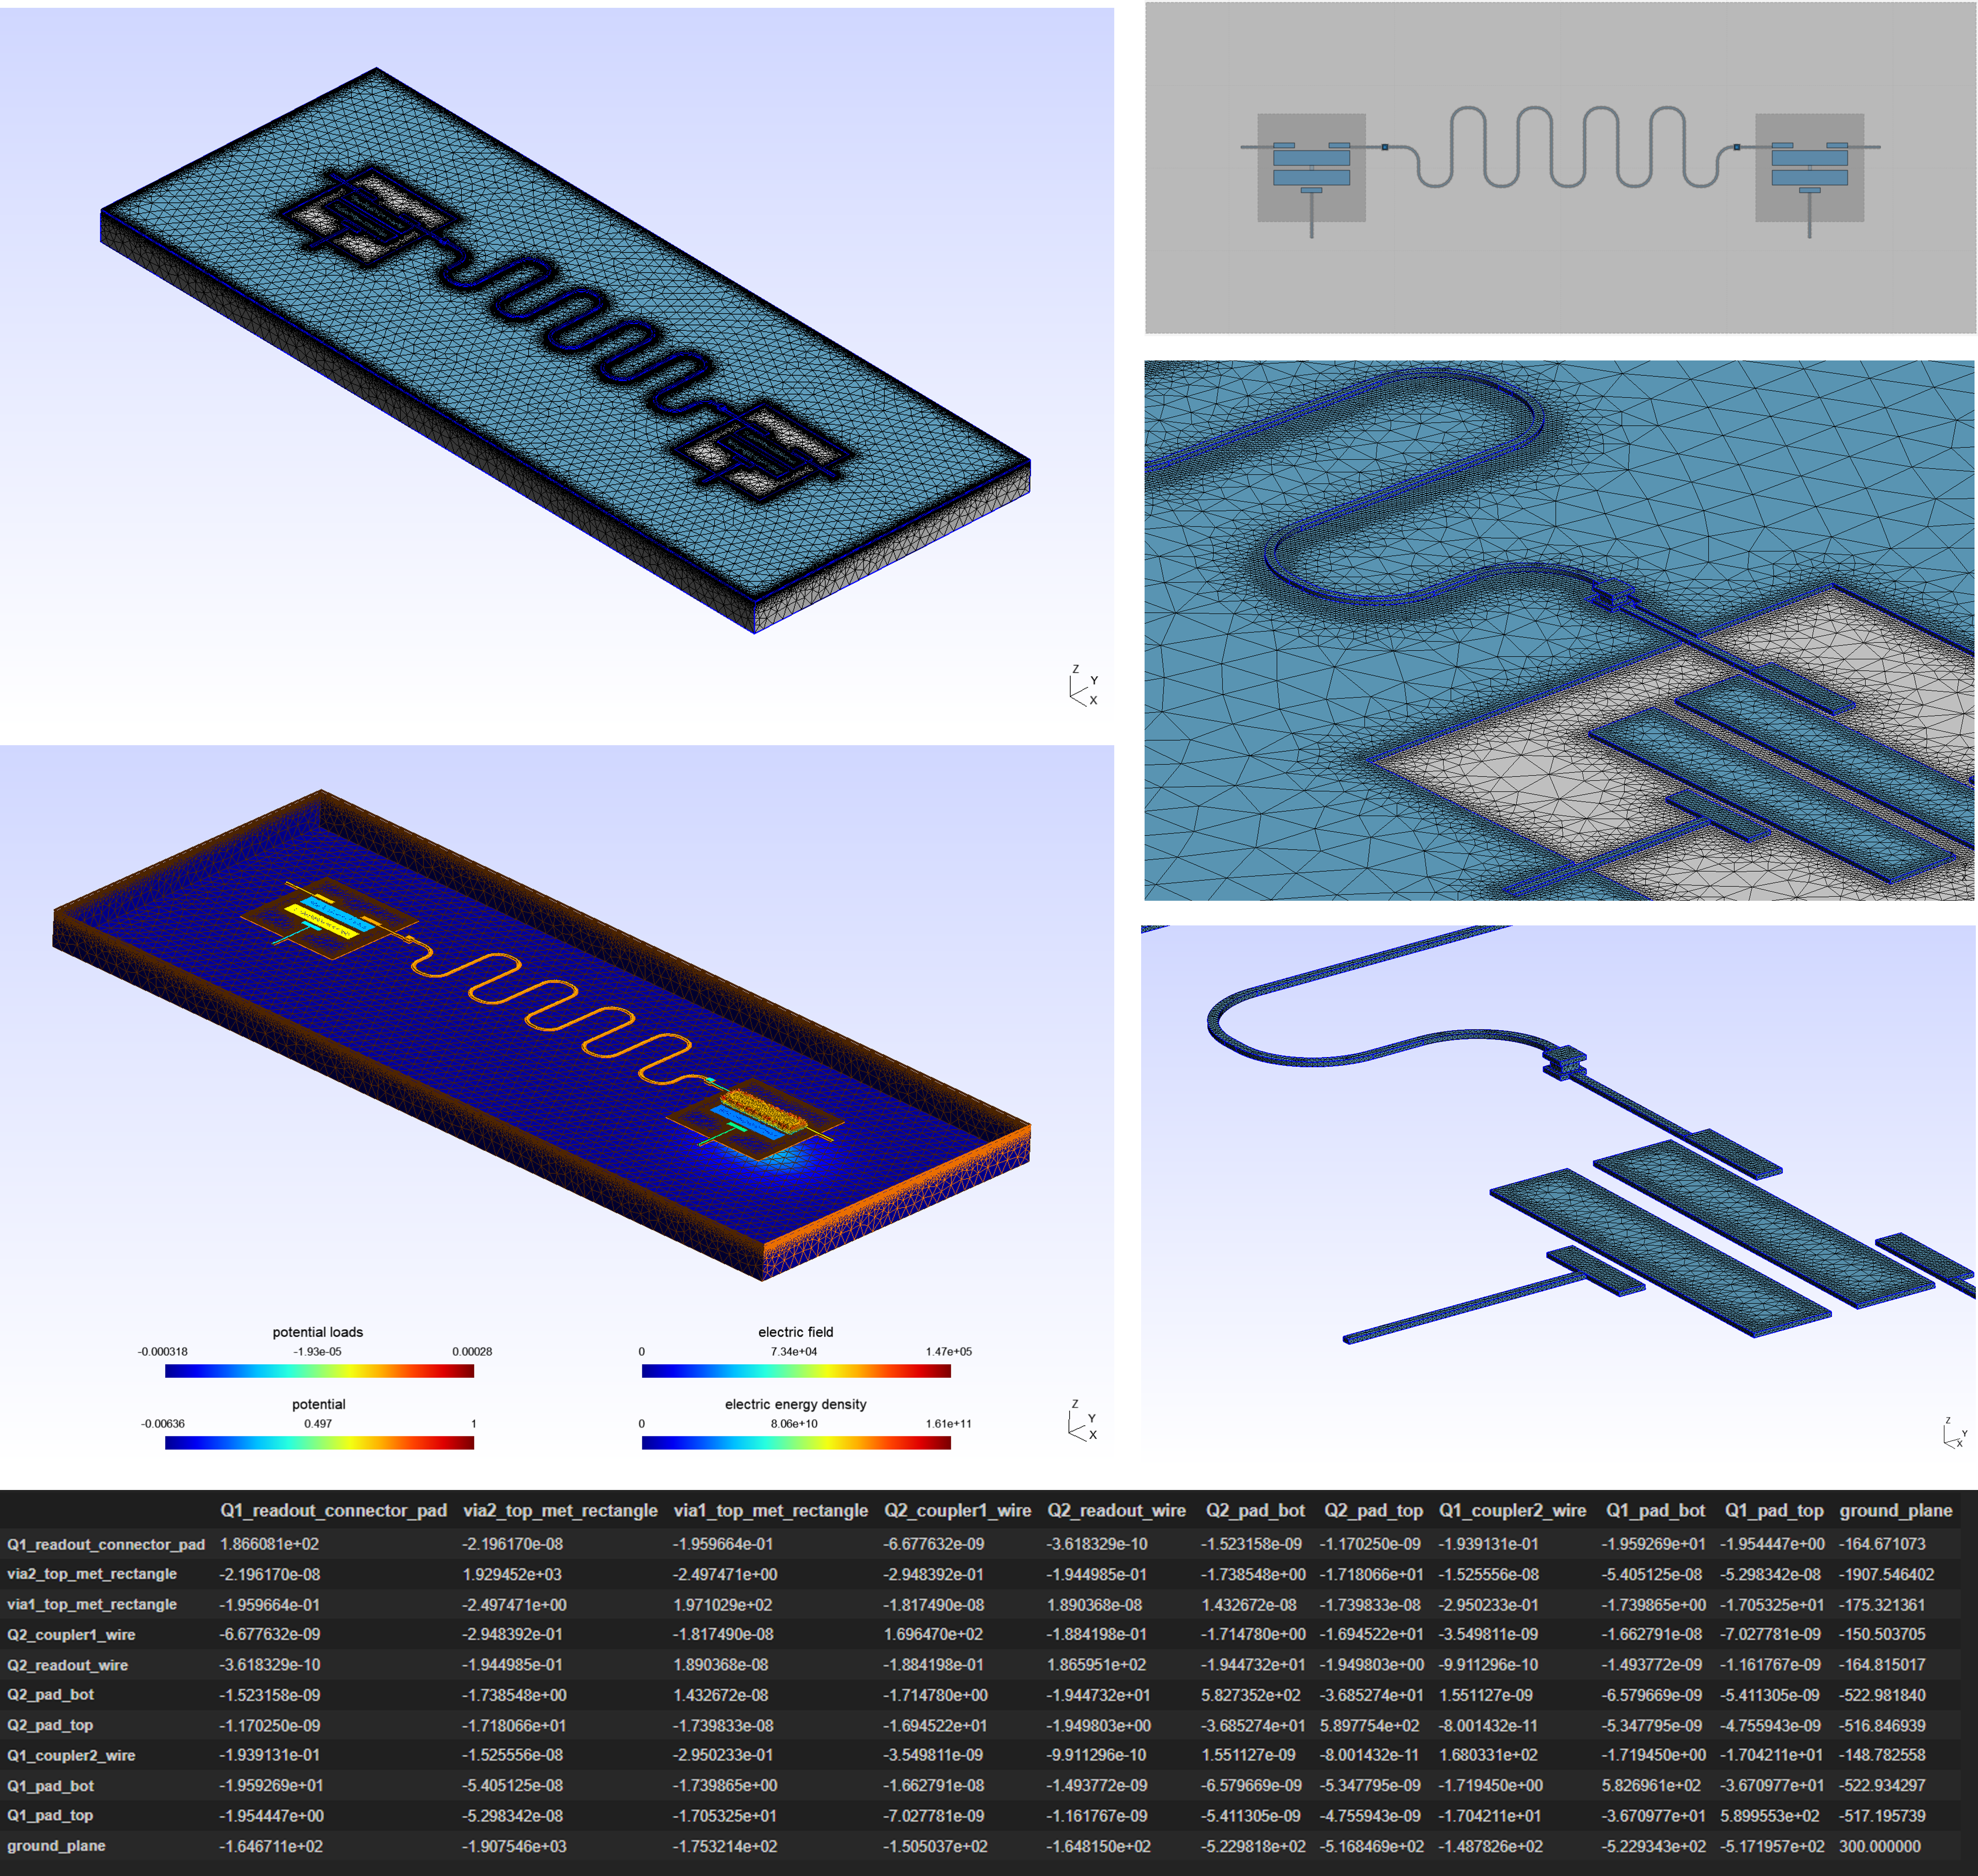

QAMP Fall 2022 – Final Presentation
Project: #12 Open-source FEM solver for Qiskit Metal
Mentee: Diego Emilio Serrano
Mentors: Abeer Vaishnav, Thomas G. McConkey, Priti A. Shah, Patrick Obrien
+

Slide 2
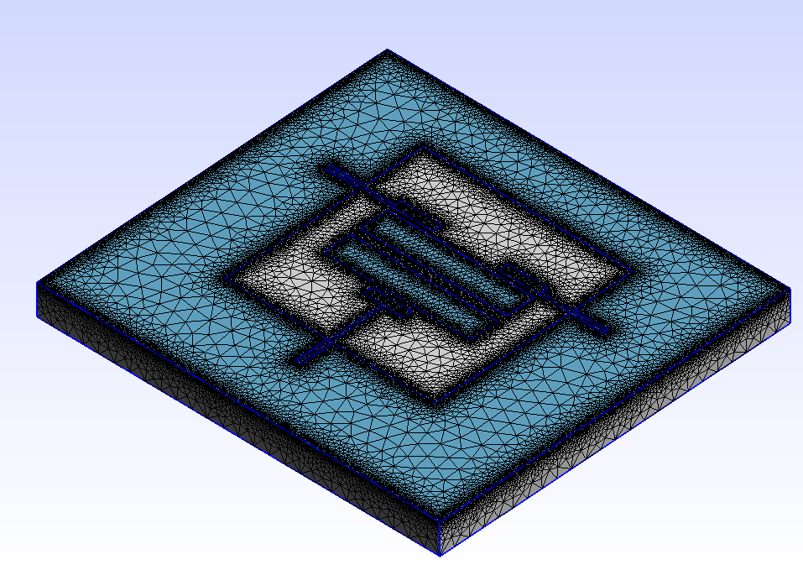
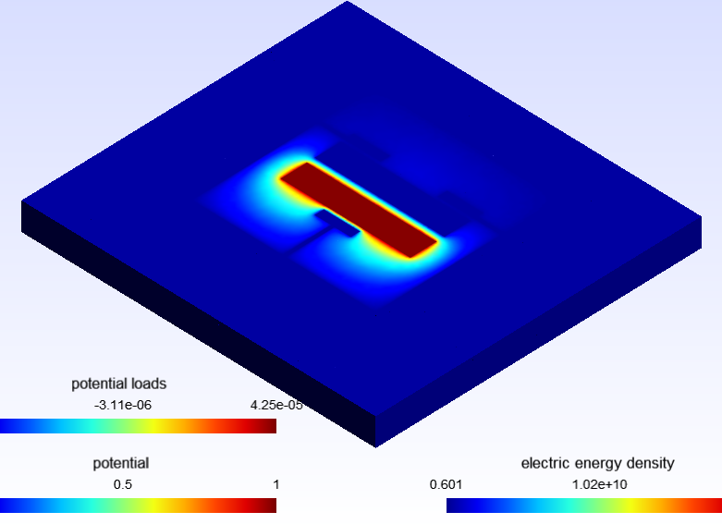
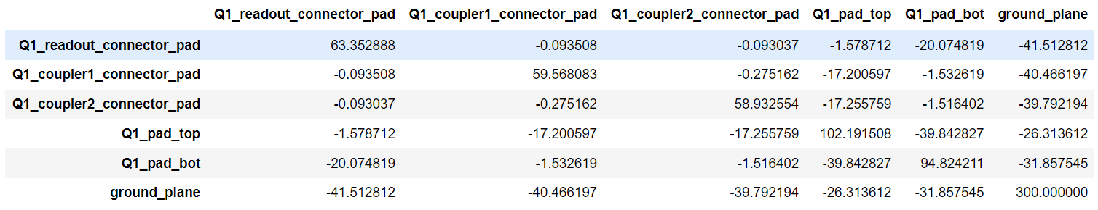
Project Motivation
Qiskit metal is an open-source framework to design superconducting quantum devices
Issue: simulations run using ANSYS, which is NOT open-source (in fact, it is very $$$)
Abeer (mentor) had already added an open-source alternative:
  GMSH for meshing and
  ElmerFEM for Finite Element Modeling (FEM)
However, there were limited to only planar designs
Main aim of this project:
  Make Elmer renderer fully functional
  Make ElmerFEM Multi-layer compatible

Slide 3
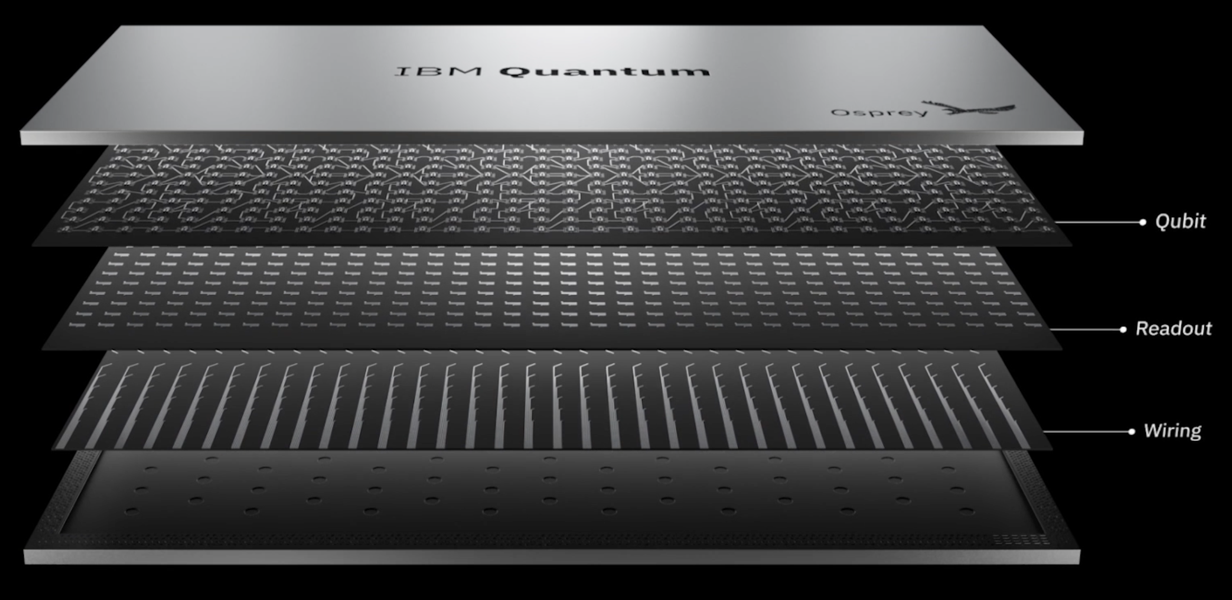
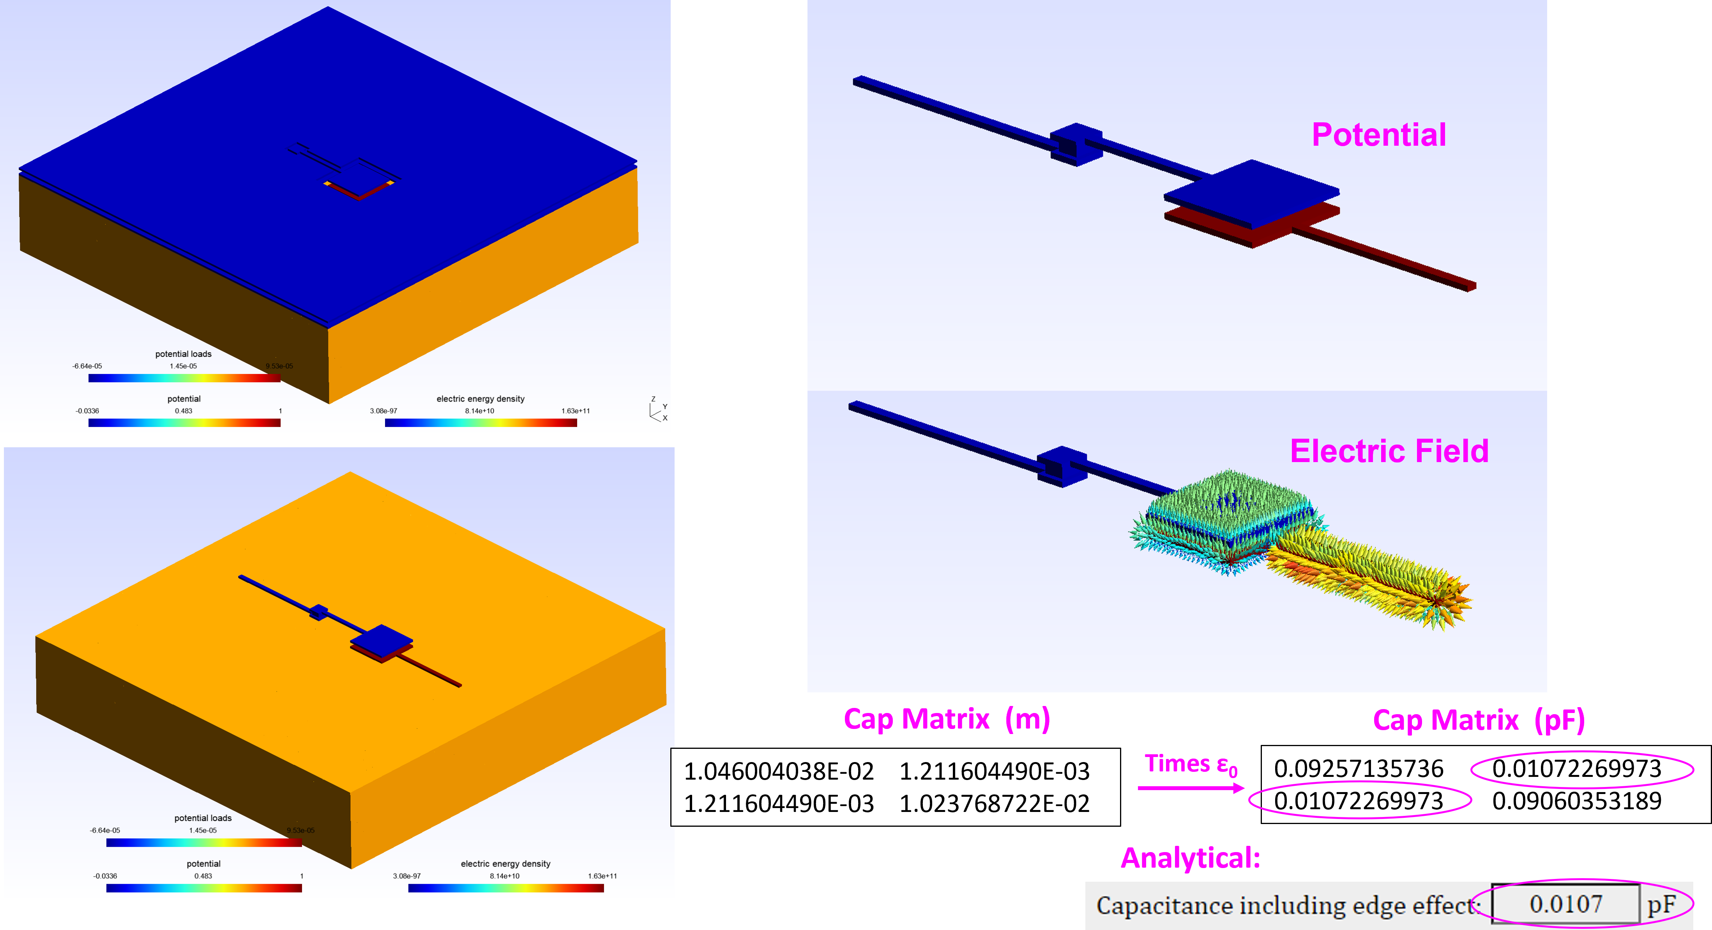
Deliverables and Results
Main deliverable
Expand simulator capability to support multi-planar designs
Current superconducting QPUs are designed in multiple layers
Results
Several bugs in Gmsh Renderer were fixed
Elmer renderer now supports multi-layer cap simulations
PR has been submitted
DEMO

Slide 4

THANK YOU

