Slide 1
Towards a Structured Software Tuning Process
Performance Tuning training for software engineers
Ahmad Yasin
May 2022, rev 1.04
Notes:
goto/StructuredTuning
TMA and perf-tools for performance engineers-20220531_103150-Meeting Recording.mp4
CPU Architect, Performance Analysis Expert.
Structured performance tuning for software engineers
2nd session in training series. Aryan SW Optimization high level, Vish’s (wishing him all the best) pushed. This one connects both talks with hands-on.
Title: TMA and perf-tools for performance engineers
Abstract: This session will briefly recap on the Top-down Microarchitecture Analysis (TMA) method and present the newish perf-tools (https://github.com/aayasin/perf-tools) open-source toolset that features TMA as well as advance performance profiling techniques to ultimately structure performance tuning and optimizations. The session will cover a couple of real-life demos for how the method and the toolset guided what compiler code-gen tuning and ISV enabling that provide double-digit performance gain for the ISPEC17 and Blender benchmarks on Alder Lake and Sapphire Rapids architectures.
rev 1.0 – presented training
0.99 setup details
0.98 bottlenecks
0.97 conclusion
0.96 rehearsing
0.95 finalized UC2
0.93 finalized UC1
0.92: tweaks per Arjan’s training, colored perf-tools,
0.8: post SSG preview fixes!

Slide 2

Outline
Towards a Structured Software Tuning Process
Motivation
Re-cap on Microarchitecture & Top-down Analysis
perf-tools
package
Use Case 1:
Loop Unrolling
Use Case 2:
Exploit Wider Vectors

Slide 3
Correct analysis yields performance WINs
Motivation
SW optimization & tuning are critical for Intel to re-gain performance leadership
Tractions auto-leveraging PMU/Telemetry to gain performance
  Profile-guided optimizations enabled by Intel’s hero PMU
    Google’s AutoFDO provide +10% datacenter perf, and recently Propeller, Facebook’s BOLT & hf-sort, Microsoft’s SPGO
  Intel Thread Director guides OS to schedule right tasks to right core-type in Hybrid client
Imagine if workload’s bottleneck is correctly determined ...
  Out-of-band telemetry for orchestrator in Cloud/datacenter
  Intel acquisition of Granulate
Workloads are diverse!
Version
Bottleneck
Optimization/Tuning Hint
Speedup*
Baseline
External Memory
Increase
compute per byte
1
x
Loop Interchange
Memory Latency Bound
Block data into caches
15
x
Cache
Blocking
Compute Bound
Utilize multi
core
21
x
Parallelization x4
Compute Bound
Utilize multi
core
78
x
Parallelization x24
Core Bound
Improve in
-
core
execution
430
x
Vectorization
Cache Latency Bound
1600
x
*Measured Speedup for Matrix-Matrix Multiply kernel. Source (incl. configuration details): Tuning Performance via Metrics with Expectations. Ahmad Yasin, Avi Mendelson, Yosi Ben-Asher. IEEE Computer Architecture Letters (CAL), 2019 [https://ieeexplore.ieee.org/abstract/document/8714063/]
Notes:
This slide motivates why to care about bottlenecks, their identification methods, and their benefit to focus optimization & tuning
Goal is to show the potential of SW optimization, not to cover the optimizations listed in table, e.g.

Slide 4
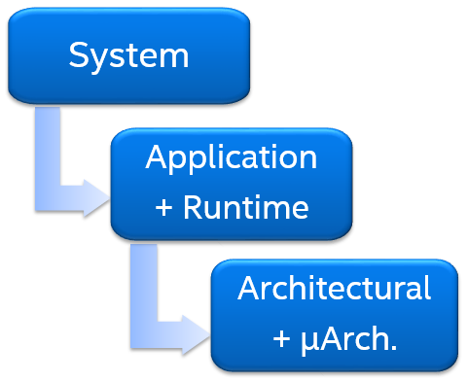
Scope and flow of structured tuning
Motivation
Performance analysis scopes
Mapping a bottleneck to source is key to WIN
Profiling data:
TMA*, metrics, timing
Map it to source at a Loop’s level
Identify right software tuning
Correct interpretation
#1 Bottleneck at the Workload-level
Debug, fix, tune until success
Integrate and Generalize
Assume: CPU Bound, Frequency domain
Our focus today
~10% speedups
*TMA = Top-down Microarchitecture Analysis
Notes:
Integrate: into compiler/libraries/ runtimes/middleware
Fix low hanging system/algorithm etc issues

Slide 5
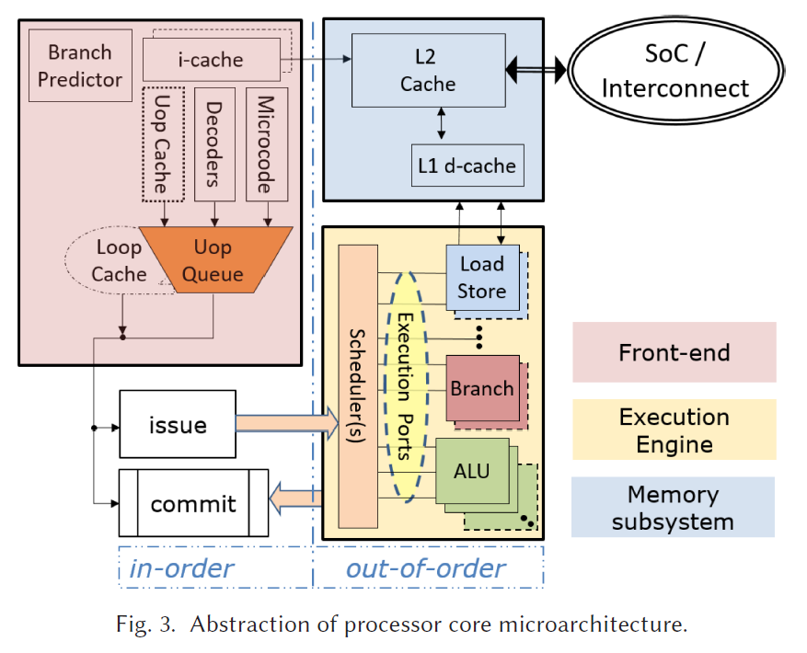
Modern Out-of-Order cores
TMA Re-cap
Pipelined
Superscalar
OOO Execution
Speculation
Multiple Fetch Units
Hierarchical Caches
Memory Pre-fetching and Disambiguation
Vector and Matrix Units
Hybrid cores
TMA Level 1 classification is performed at this stage
Source: A Metric-Guided Method for Discovering Impactful Features and Architectural Insights for Skylake-Based Processors. Ahmad Yasin, Jawad Haj-Yahya, Yosi Ben-Asher, Avi Mendelson. In ACM Transactions on Architecture and Code Optimization (TACO), December 2019

Slide 6
TMA’s Top Level Breakdown
TMA Re-cap
Cycle | 1 | 2 | 3 | 4 | ... | x
Back-end Stall | 0 | 0 | 1 | 0 |  | 0
Topdown Slot 0 | - | v | - | v |  | v
Topdown Slot 1 | - | v | - | v |  | v
Topdown Slot 2 | - | - | - | v |  | v
Topdown Slot 3 | - | - | - | v |  | -
Frontend Bound | 4 | 2 |  | 0 |  | 1
Backend Bound |  |  | 4 | 0 |  | 0
Retiring |  | 2 |  | 1 |  | 2
Bad Speculation |  |  |  | 3 |  | 1
Sample Intel cores | Skylake(s), Tremont | Icelake, Gracemont | Golden Cove, Crestmont | Lion Cove, Skymont
Machine-width | 4 | 5 | 6 | 8
Topdown Slots := number of available slots at the narrowest pipeline. Counts at issue pipe-stage in Intel products. Machine-width of 4 in example.
Bubble := An un-utilized Slot.
Uop
Issue?
Uop ever Retire?
Bad Speculation
Backend
Bound
Retiring
Back-end stall?
Frontend Bound
TMA classifies each Slot into 1 of 4 Categories

Slide 7
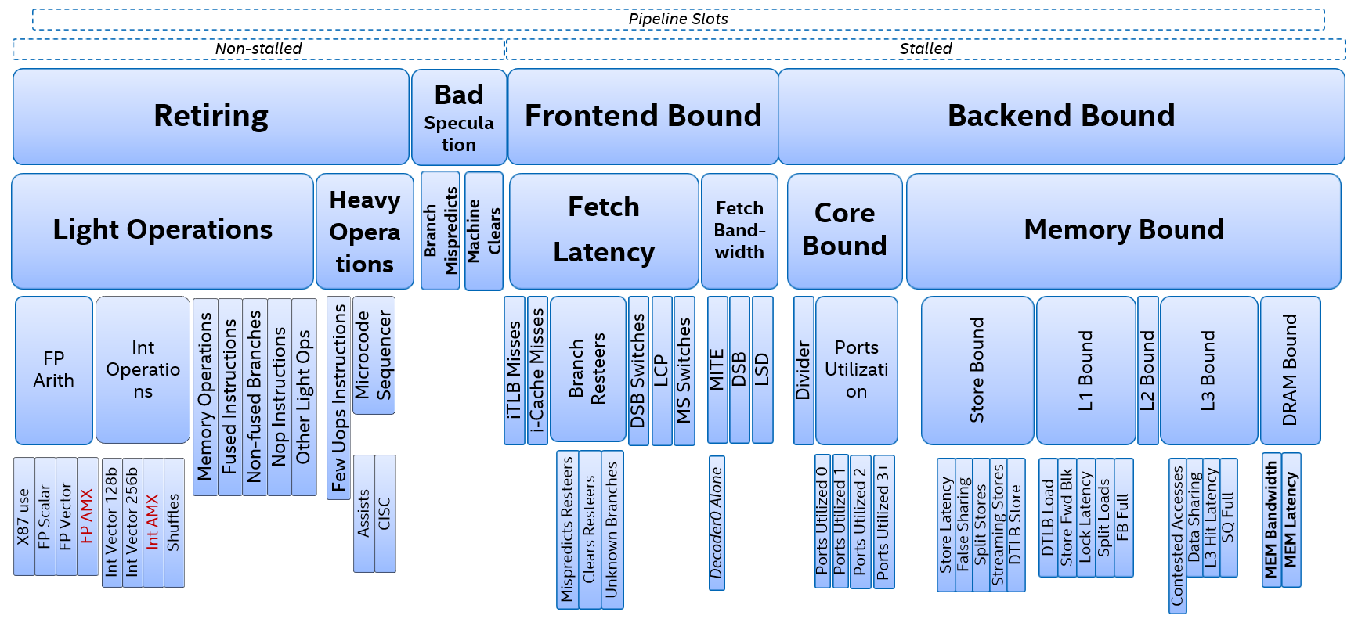
Top-down* µarch Analysis: TMA 4.4 tree. 4-levels [ADL, SPR]
TMA Re-cap
* Reference paper: A. Yasin, “A Top-Down Method for Performance Analysis and Counters Architecture”, ISPASS 2014

Slide 8
Profiling tools
perf-tools pkg
Blue-font denotes package name at github.com
Sample popular performance tools, externally available
Characterization (counting mode, what?)
VTune (SEP, perf)
Linux perf record
Rich/detailed profiling (sampling mode, where?)
EDP (EMON)
Linux perf stat
.
Intel PCM
perf-tools connects the two worlds*
* Requires access to LBR which may not be available in cloud instances

Slide 9
Profiling with perf-tools https://github.com/aayasin/perf-tools
perf-tools pkg
Basic profiling
(perf)
log (HW/SW config details)
TMA + info metrics
(toplev)
Topdown full tree
Topdown 2-levels + lead info metric per category
Advanced profiling
(perf record ++)
LBR-step
(next slide)
PEBS-step
(user-defined precise event)
Per-app counting
(CPU Utilization, Frequency, IPC ..)
System-wide
Stack Sampling
(Hot functions/block/insts)
Topdown 2 levels + FE Bottlenecks ..
<3 more collections>

Slide 10
perf-tools (cont’d)
$ ./do.py profile -a “taskset -c 0 exchange2_r_0.basln 6“
alderlake_hybrid
logging setup ..
topdown 2 levels + FE Bottlenecks ..
# 4.31-full-perf on 12th Gen Intel(R) Core(TM) i9-12900 [adl]
FE Frontend_Bound % Slots 31.7
Info.Inst_Mix IpTB Inst_Metric 9.57
FE Frontend_Bound.Fetch_Bandwidth % Slots 24.0 <==
Info.Bottleneck Instruction_Fetch_BW Scaled_Slots 28.97
FE Frontend_Bound.Fetch_Latency.DSB_Switches % Clocks 8.7
Info.Bottleneck Mispredictions Scaled_Slots 16.65
Info.Thread IPC Metric 2.28
Info.System Time Seconds 101.38
sampling w/ LBR ..
# Branch Statistics:
COND_FWD: 17.8%
COND_BWD: 77.2%
CROSS_4K: 3.2%
UNCOND: 5.0%
instruction-mix for 'exchange2_r_0.b'
1.7% 861665 cmpl $0x0, (%rax)
1.8% 905983 lea 0x70003c(,%rax,4), %rcx
6.7% 3446315 lea 0x1(%rax), %rax
6.8% 3479583 cmpl $0x0, (%rcx)
hot code footprint estimate: 138.44 KB
detailed stats for hot loops ....................
Loop#3: [ip: 0x41f8f0, hotness: 564517, FL-cycles%: 10.34%, size: 6, back: 0x41f909, attributes: -, inner: 3, outer: 0, outer-loops: [0x41f8b0, 0x41f878, 0x41dc60], Conds: 1, IPC-most: 3.0, IPC-num-buckets: 14, 0x41f8f8_taken: 7.27%, tripcount-most: 9, tripcount-num-buckets: 9, tripcount-coverage: 60.93%]
..
Loop#1: [ip: 0x41f7c0, hotness: 740073, FL-cycles%: 16.74%, size: 6, back: 0x41f7d8, attributes: -, inner: 2, outer: 0, outer-loops: [0x41f77c, 0x41dc60], Conds: 1, IPC-most: 3.0, IPC-num-buckets: 14, 0x41f7c7_taken: 8.50%, tripcount-most: 9, tripcount-num-buckets: 9, tripcount-coverage: 61.03%]
perf-tools pkg
TMA 2-levels profile-step outputs the metrics who matter the most
LBR profile-step
  Branch stats
  Instruction mixes
  Code footprint, # unique taken branches
  In-depth loop analysis
    Loop rank, (per) Hotness
    Loop addresses,
    Loop time %
    Loop size (# instructions)
    Tripcount & histogram
    IPC & histogram
    Attributes & more
      In-loop conditional polarity
LBR sampling profile-step outputs: extra global stats
Detects & ranks hot loops: detailed stats

Slide 11
Use Case 1
topdown 2 levels + FE Bottlenecks ..
# 4.31-full-perf on 12th Gen Intel(R) Core(TM) i9-12900 [adl]
FE Frontend_Bound % Slots 33.6 [20.0%]
Info.Thread SLOTS Count 3,073,611,672,055 [20.0%]
Info.Inst_Mix Instructions Count 1,150,767,277,413 [20.0%]
Info.Inst_Mix IpTB Inst_Metric 9.57 [20.0%]
FE Frontend_Bound.Fetch_Bandwidth % Slots 24.1 [20.0%]<==
Info.Bottleneck Big_Code Scaled_Slots 0.04 [20.0%]
Info.Bottleneck Instruction_Fetch_BW Scaled_Slots 31.11 [20.0%]
FE Frontend_Bound.Fetch_Latency.DSB_Switches % Clocks 9.3 [20.0%]
Info.Bottleneck Mispredictions Scaled_Slots 14.92 [20.0%]
Info.Thread IPC Metric 2.25 [20.0%]
Info.Frontend DSB_Misses Slots 0.24 [20.0%]
Info.System CPU_Utilization Metric 1.00 [20.0%]
Info.System Time Seconds 102.82
==> Look for Loop with IpTB < 9
perf-tools employs the following:
  aggressively filters output
    Keep what matters. Hide irrelevant stuff. In example: only a subset of FE tree metrics (3 out of 21!) are kept.
    The <== points to the most critical tree-node
  intermixes tree- and info-metrics (black font)
    Info metrics are key to map insights to source code and to guide SW tuning efforts
Interpretation
  TMA tree has Fetch_Bandwidth at 24%
  Instruction_Fetch_BW is even at 31%
  Average Instruction per Taken Branch (IpTB) at 9.5 which is < 2x the machine-width
Setup details - Use case 1
  SPEC CPU 2017.exchange2_r single-thread
  Intel LLVM compiler (prior to ICX 2022.0)
  Linux: kernel 5.17. Ubuntu 20.04.
  HW: Alder Lake (12th Gen Intel(R) Core(TM) i9-12900). Atom & SMT are disabled.
Compared to perf-tools (toplev), EDP collects tree nodes only and shows all of them by default (does not parse Thresholds)
Notes:
if a top-down oriented process would ‘per the book’

Slide 12
Mapping to ASM & SW tuning
Use Case 1
Original
IpTB = 6
Partial loop unrolling
IpTB = 12
1 Non-Taken + 1 Taken branches / iteration
3 NT + 1 Taken branches / iteration
BB2: cmp %r14, %rax
lea 0x1(%rax), %rax
jz Exit
lea 0x70003c(,%rax,4), %rcx
cmpl $0x0, (%rcx)
jle BB2
BB4:
BB2: cmp %r14, %rax
lea 0x1(%rax), %rax
jz Exit
lea 0x70003c(,%rax,4), %rcx
cmpl $0x0, (%rcx)
jg BB4
cmp %r14, %rax
lea 0x1(%rax), %rax
jz Exit
lea 0x70003c(,%rax,4), %rcx
cmpl $0x0, (%rcx)
jle BB2
BB4:
Flip Cond Branch’s polarity
Performance of 1-copy exchange2: >10% speedup on Core/GLC, +4.6% on Atom/GRT
Ack: Tianle Liu, Wei Xiao

Slide 13
Generalizing: Unroll Tight Loops
Use Case 1
Insight: Tight Loops challenge wider-issue cores
  Tight: is-a short (small # of instructions) and quick (small trip-count) loop
  Such Tight Loops, or highly branchy code, stress the front-end, limit ILP; beyond high looping overhead.
  Symptom: High Instruction Fetch BW and low IpTB
Tuning: Unroll Tight Loops
  Or critical paths of bigger loop, or partial loop unrolling if removal of looping overhead is hard. Direct/help the compiler as needed.
  Improves IpTB (Instructions per Taken Branch) for front-end pipeline of the CPU and,
  ILP (Instruction Level Parallelism) for back-end
  Reduces Branching_Overhead Bottleneck (with full unrolling)
Notes:
Outlier analysis
What-if? E.g. can DPGO fix slowdowns?

Slide 14
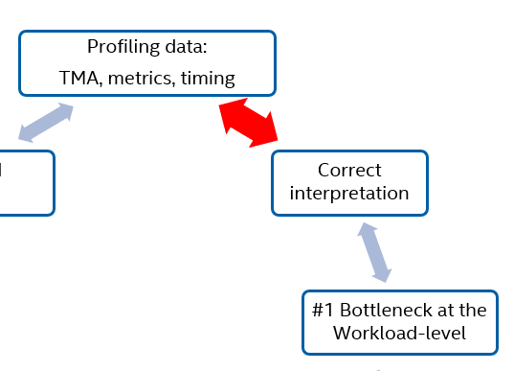
topdown 2-levels 1 runs .. (SMT enabled)
# 4.39-full-perf on 12th Gen Intel(R) Core(TM) i9-12900 [adl]
FE Frontend_Bound % Slots 25.6 [ 5.0%] +- 0.4 <==
Info.Core CoreIPC Core_Metric 2.81 [ 5.0%] +- 0.0
Info.Inst_Mix Instructions Count 11,143,359,731,525 [ 5.0%] +- 2,228,671,946.3
FE Frontend_Bound.Fetch_Latency % Slots 15.2 [ 5.0%] +- 0.1
FE Frontend_Bound.Fetch_Bandwidth % Slots 10.4 [ 5.0%] +- 0.4
Info.System GFLOPs Metric 58.99 [ 5.0%] +- 0.4
Info.Thread IPC Metric 1.41 [ 5.0%] +- 0.0
Info.Core ILP Core_Metric 3.47 [ 5.0%] +- 0.0
Info.Core Core_Bound_Likely Metric 0.85 [ 5.0%] +- 0.0
Info.Core CORE_CLKS Count 3,959,317,118,737 [ 5.0%] +- 791,863,423.7
Info.System Time Seconds 158.68 +- 1.0
Use Case 2
Setup details - Use case 2
  Blender 3.1.0 Alpha – multithreaded. bmw27_cpu input.
  Intel LLVM compiler (prior to ICX 2022.0)
  Linux: kernel 5.17, transparent hugepages enabled. Ubuntu 20.04
  HW: Alder Lake (12th Gen Intel(R) Core(TM) i9-12900). SMT enabled, E-cores disabled.
Notes:
if a top-down oriented process would ‘per the book’

Slide 15
topdown 2-levels 1 runs .. (SMT enabled)
# 4.39-full-perf on 12th Gen Intel(R) Core(TM) i9-12900 [adl]
FE Frontend_Bound % Slots 25.6 [ 5.0%] +- 0.4 <==
Info.Core CoreIPC Core_Metric 2.81 [ 5.0%] +- 0.0
Info.Inst_Mix Instructions Count 11,143,359,731,525 [ 5.0%] +- 2,228,671,946.3
FE Frontend_Bound.Fetch_Latency % Slots 15.2 [ 5.0%] +- 0.1
FE Frontend_Bound.Fetch_Bandwidth % Slots 10.4 [ 5.0%] +- 0.4
Info.System GFLOPs Metric 58.99 [ 5.0%] +- 0.4
Info.Thread IPC Metric 1.41 [ 5.0%] +- 0.0
Info.Core ILP Core_Metric 3.47 [ 5.0%] +- 0.0
Info.Core Core_Bound_Likely Metric 0.85 [ 5.0%] +- 0.0
Info.Core CORE_CLKS Count 3,959,317,118,737 [ 5.0%] +- 791,863,423.7
Info.System Time Seconds 158.68 +- 1.0
Use Case 2
Notes:
if a top-down oriented process would ‘per the book’

Slide 16
topdown 2-levels 1 runs .. (SMT enabled)
# 4.39-full-perf on 12th Gen Intel(R) Core(TM) i9-12900 [adl]
FE Frontend_Bound % Slots 25.6 [ 5.0%] +- 0.4 <==
Info.Core CoreIPC Core_Metric 2.81 [ 5.0%] +- 0.0
Info.Inst_Mix Instructions Count 11,143,359,731,525 [ 5.0%] +- 2,228,671,946.3
FE Frontend_Bound.Fetch_Latency % Slots 15.2 [ 5.0%] +- 0.1
FE Frontend_Bound.Fetch_Bandwidth % Slots 10.4 [ 5.0%] +- 0.4
Info.System GFLOPs Metric 58.99 [ 5.0%] +- 0.4
Info.Thread IPC Metric 1.41 [ 5.0%] +- 0.0
Info.Core ILP Core_Metric 3.47 [ 5.0%] +- 0.0
Info.Core Core_Bound_Likely Metric 0.85 [ 5.0%] +- 0.0
Info.Core CORE_CLKS Count 3,959,317,118,737 [ 5.0%] +- 791,863,423.7
Info.System Time Seconds 158.68 +- 1.0
Use Case 2
topdown 2-levels 1 runs .. (SMT disabled)
# 4.39-full-perf on 12th Gen Intel(R) Core(TM) i9-12900 [adl]
BE Backend_Bound % Slots 41.9 [33.3%] +- 0.2
Info.Core CoreIPC Core_Metric 2.02 [33.3%] +- 0.0
Info.Inst_Mix Instructions Count 11,146,620,044,857 [33.3%] +- 4,458,648,017.9
BE/Core Backend_Bound.Core_Bound % Slots 28.9 [33.3%] +- 0.3<==
Info.System CPU_Utilization Metric 1.00 [33.3%] +- 0.0
Info.Core CORE_CLKS Count 5,506,692,904,568 [33.3%] +- 1,652,007,871.4
Info.System Time Seconds 193.35 +- 0.0
Notes:
if a top-down oriented process would ‘per the book’

Slide 17
topdown 2-levels 1 runs .. (SMT enabled)
# 4.39-full-perf on 12th Gen Intel(R) Core(TM) i9-12900 [adl]
FE Frontend_Bound % Slots 25.6 [ 5.0%] +- 0.4 <==
Info.Core CoreIPC Core_Metric 2.81 [ 5.0%] +- 0.0
Info.Inst_Mix Instructions Count 11,143,359,731,525 [ 5.0%] +- 2,228,671,946.3
FE Frontend_Bound.Fetch_Latency % Slots 15.2 [ 5.0%] +- 0.1
FE Frontend_Bound.Fetch_Bandwidth % Slots 10.4 [ 5.0%] +- 0.4
Info.System GFLOPs Metric 58.99 [ 5.0%] +- 0.4
Info.Thread IPC Metric 1.41 [ 5.0%] +- 0.0
Info.Core ILP Core_Metric 3.47 [ 5.0%] +- 0.0
Info.Core Core_Bound_Likely Metric 0.85 [ 5.0%] +- 0.0
Info.Core CORE_CLKS Count 3,959,317,118,737 [ 5.0%] +- 791,863,423.7
Info.System Time Seconds 158.68 +- 1.0
Use Case 2
topdown 2-levels 1 runs .. (SMT disabled)
# 4.39-full-perf on 12th Gen Intel(R) Core(TM) i9-12900 [adl]
BE Backend_Bound % Slots 41.9 [33.3%] +- 0.2
Info.Core CoreIPC Core_Metric 2.02 [33.3%] +- 0.0
Info.Inst_Mix Instructions Count 11,146,620,044,857 [33.3%] +- 4,458,648,017.9
BE/Core Backend_Bound.Core_Bound % Slots 28.9 [33.3%] +- 0.3<==
Info.System CPU_Utilization Metric 1.00 [33.3%] +- 0.0
Info.Core CORE_CLKS Count 5,506,692,904,568 [33.3%] +- 1,652,007,871.4
Info.System Time Seconds 193.35 +- 0.0
topdown 5-levels, nodes > 1%
# 4.39-full-perf on 12th Gen Intel(R) Core(TM) i9-12900 [adl]
FE Frontend_Bound % Slots 26.6 [ 2.3%]<==
BAD Bad_Speculation % Slots 10.3 < [ 2.3%]
BE Backend_Bound % Slots 14.1 < [ 2.3%]
RET Retiring % Slots 49.0 < [ 2.3%]
BE/Mem Backend_Bound.Memory_Bound % Slots 5.7 < [ 2.3%]
BE/Core Backend_Bound.Core_Bound % Slots 8.3 < [ 2.3%]
RET Retiring.Light_Operations % Slots 45.5 < [ 2.3%]
RET Retiring.Heavy_Operations % Slots 3.5 < [ 2.3%]
BE/Mem Backend_Bound.Memory_Bound.L1_Bound % Stalls 18.6 < [ 2.3%]
BE/Mem Backend_Bound.Memory_Bound.L1_Bound.DTLB_Load % Clocks_est 17.9 < [ 2.3%]
BE/Mem Backend_Bound.Memory_Bound.L1_Bound.DTLB_Load.Load_STLB_Hit % Clocks_est 17.5 < [ 2.3%]
BE/Mem Backend_Bound.Memory_Bound.Store_Bound.DTLB_Store % Clocks_est 2.4 < [ 2.3%]
BE/Mem Backend_Bound.Memory_Bound.Store_Bound.DTLB_Store.Store_STLB_Hit % Clocks_est 2.4 < [ 2.3%]
BE/Mem Backend_Bound.Memory_Bound.DRAM_Bound.MEM_Bandwidth % Clocks 2.6 < [ 2.3%]
BE/Mem Backend_Bound.Memory_Bound.DRAM_Bound.MEM_Latency % Clocks 31.6 < [ 2.3%]
BE/Core Backend_Bound.Core_Bound.Divider % Clocks 7.1 < [ 2.3%]
BE/Core Backend_Bound.Core_Bound.Ports_Utilization % Clocks 57.9 < [ 2.3%]
BE/Core Backend_Bound.Core_Bound.Ports_Utilization.Ports_Utilized_0 % Clocks 15.8 < [ 2.3%]
BE/Core Backend_Bound.Core_Bound.Ports_Utilization.Ports_Utilized_1 % Clocks 26.5 < [ 2.3%]
BE/Core Backend_Bound.Core_Bound.Ports_Utilization.Ports_Utilized_2 % Clocks 19.6 < [ 2.3%]
BE/Core Backend_Bound.Core_Bound.Ports_Utilization.Ports_Utilized_3m % Clocks 24.6 < [ 2.3%]
BE/Core Backend_Bound.Core_Bound.Ports_Utilization.Ports_Utilized_3m.ALU_Op_Utilization % Core_Execution 37.3 < [ 4.5%]
RET Retiring.Light_Operations.FP_Arith.FP_Scalar % Uops 4.6 < [ 2.3%]
RET Retiring.Light_Operations.FP_Arith.FP_Vector % Uops 19.2 < [ 2.3%]
RET Retiring.Light_Operations.FP_Arith.FP_Vector.FP_Vector_128b % Uops 19.2 < [ 2.3%]
BE/Core Backend_Bound.Core_Bound.Ports_Utilization.Ports_Utilized_3m.Load_Op_Utilization % Core_Execution 26.0 < [ 2.3%]
BE/Core Backend_Bound.Core_Bound.Ports_Utilization.Ports_Utilized_3m.Store_Op_Utilization % Core_Execution 16.4 < [ 2.3%]
RET Retiring.Light_Operations.FP_Arith % Uops 23.8 < [ 2.3%]
RET Retiring.Light_Operations.Memory_Operations % Slots 15.6 < [ 2.3%]
RET Retiring.Light_Operations.Other_Light_Ops % Slots 2.3 < [ 2.3%]
Setup details - Use case 2
  Blender 3.1.0 Alpha – multithreaded. bmw27_cpu input.
  Intel LLVM compiler (prior to ICX 2022.0)
  Linux: kernel 5.17, transparent hugepages enabled. Ubuntu 20.04.
  HW: Alder Lake (12th Gen Intel(R) Core(TM) i9-12900). SMT enabled, Atom disabled.
==> Look for code using 128-bit vector
Notes:
if a top-down oriented process would ‘per the book’

Slide 18
Mapping to ASM & SW tuning
Use Case 2
Loop#3: [ip: 0x30a32d0, hotness: 228270, FL-cycles%: 4.10%, size: -, back: 0x30a4cb3, entry-block: -, attributes: indirect;scalar-fp;vec128-fp, inner: 0, outer: 0, IPC-most: 2.1, IPC-num-buckets: 22, tripcount-most: 2, .. ]
Loop#2: [ip: 0x30abc80, hotness: 229602, FL-cycles%: 0.97%, size: 10, back: 0x30abc99, entry-block: -, attributes: scalar-fp, inner: 0, outer: 0, Conds: 1, IPC-most: 1.4, IPC-num-buckets: 25, 0x30abc84_taken: 0.00%, tripcount-most: 13, .. ]
Loop#1: [ip: 0x3d952c0, hotness: 275058, FL-cycles%: 10.45%, size: 40, back: 0x3d9536f, entry-block: 0x3d95220, attributes: vec128-fp, inner: 2, outer: 0, outer-loops: [0x3d95280, 0x3d95220], Conds: 2, IPC-most: 0.7, IPC-num-buckets: 31, tripcount-most: 1, ..]
Hitcounts & ASM of loop 0x3d952c0 .. //40 instructions
275063 0000000003d952c0 vmovupsx 0x20(%rax,%rbx,1), %xmm1
275063 0000000003d952c6 vsubps %xmm7, %xmm1, %xmm1
275063 0000000003d952ca vmulps %xmm1, %xmm11, %xmm1
275064 0000000003d952ce vmovupsx 0x20(%rax,%r8,1), %xmm2
275064 0000000003d952d5 vsubps %xmm5, %xmm2, %xmm2
275064 0000000003d952d9 vmulps %xmm2, %xmm12, %xmm2
275064 0000000003d952dd vmaxps %xmm2, %xmm1, %xmm1
...
221366 0000000003d9535f prefetcht0z 0x40(%r13)
221366 0000000003d95364 and %ecx, %edi
223706 0000000003d95366 jnz 0x3d9537a
149601 0000000003d95368 mov %r13, %rax
149601 0000000003d9536b test $0x8, %r13b
153434 0000000003d9536f jz 0x3d952c0
Metric | Blender Baseline | Blender Tuned (BVH8 in Embree) | Tuned / Baseline
GFLOPs | 59.25 | 67.37 | 1.137x
FP_Vector_128b (L5 Retiring) | 19.2 | 14.9
FP_Vector_256b (L5 Retiring) | 0.0 | 3.6
Ports_Utilization (L3 Backend) | 57.9% | 42.5%
Instructions | 11.1T | 10.0T | 0.898x
Ack: Mike Ch, Xavier Hallade, Wei Xiao

Slide 19
Generalizing: exploit wider vectors
Use Case 2
Insight: sub-optimally vectorized code
  Vectorization labor already done, but enabling/tuning is missed
  Symptom: High Core Bound and Low FP vector 256/512-bit usage
    High Backend_Bound.Core_Bound.Ports_Utilization with SMT disabled, or High Core_Bound_Likely (TMA 4.4 new info metric) with SMT-enabled when Frontend Bound is overestimated
    Sizable Retiring.Light_Operations.FP_Arith.FP_Vector (L4 metric) that is mostly .FP_Vector_128b (L5 metric, new in TMA 4.4)
Tuning: exploit wide vectors
  Examine compiler and/or runtime/library flags for widest vector:
    256-bit vector in ADL
    512-bit vector in TGL, ICX and SPR.
  Reduces pressure on execution ports plus reduces path length (instruction count)
Notes:
Outlier analysis
What-if? E.g. can DPGO fix slowdowns?

Slide 20
Summary and call-for-action
Profiling data:
TMA, metrics, timing
Map it to source at a Loop’s level
Identify right software tuning
Correct interpretation
#1 Bottleneck at the Workload-level
Debug, tune until success
Integrate and Generalize
SW optimizations & tuning are critical for Intel to re-gain performance leadership
A structured software tuning process guarantees performance WINs
perf-tools bridges profiling worlds and focuses the user on what matters
Info metrics are key to map bottlenecks to source/assembly code
Two use cases: (1) unroll Tight Loops (2) exploit wide vectors

Slide 21
References
perf-tools command & outputs of presented use cases

Slide 22
perf-tools sample commands
perf-tools pkg
  https://github.com/aayasin/perf-tools
Useful commands
  git clone --recurse-submodules https://github.com/aayasin/perf-tools
  cd perf-tools/
  ./do.py setup-all
  ./do.py disable-smt disable-atom --tune :super:1
  ./do.py profile
  ./do.py log profile tar
  ./do.py enable-smt enable-atom # do not forget once done

Slide 23
profile-steps in do.py
perf-tools pkg
The color bullets map to 0x122 (a HEX value setting bits 1, 5 and 8). -pm from do.py -h:
  -pm MASK, --profile-mask PROFILE_MASK mask to control profiling stages (default: FF)
  A hex bitmap to enable/disable profile-steps selectively. Each step is described in 1 sentence, a single run unless says [x runs].
Basic profiling
  0: logging basic info on the system. App is not run.
  1: per-app counting-mode averaging [3 runs]. Output runtime+variance, IPC and TMA level 1.
  2: system-wide counting-mode. One run but collects counters for everything running on the system
  3: sampling + stack on clockticks. Prints hot modules/functions/time-consuming instructions.
TMA profiling
  4: TMA-full in single run. Collects all 6-levels with counter multiplexing. Suspect counter results.
  5: TMA 2-levels only with counter multiplexing [3 runs]. I trust results.
  6: TMA drill-down. It starts from TMA level 1 then it auto zoom-in to next levels based on previous run values [up to 6 runs]
  7: TMA-full in multiple runs. Collects all 6 levels with no counter multiplexing [n runs]
Advanced profiling
  8: sampling + LBR on taken branches. Reports instruction mixes, hitcounts, global stats (branch types, uniq branches, code footprint estimate) as well as detailed-stats for (auto-detected) hot loops {cycles%, tripcount, IPC, # conditionals & polarity}.
  9: sampling + LBR on precise event:
    DSB misses. Reports type of DSB misses as well as loop detection & stats.
    Mispredicts

Slide 24
Demo’s output
Use Case 1
$ /iusers/ayasin/perf-tools/do.py profile -a "./548-xm3.sh basln ht$HT-demo" -pm 120
topdown 2-levels 1 runs ..
# 4.31-full-perf+ay5 on 12th Gen Intel(R) Core(TM) i9-12900 [adl]
FE Frontend_Bound % Slots 31.7 [16.7%]
Info.Core CoreIPC Core_Metric 2.28 [16.7%]
Info.Inst_Mix IpTB Inst_Metric 9.57 [16.7%]
Info.Bottleneck Big_Code Scaled_Slots 0.05 [16.7%]
Info.Bottleneck Instruction_Fetch_BW Scaled_Slots 28.97 [16.7%]
FE Frontend_Bound.Fetch_Latency.DSB_Switches % Clocks 8.7 [16.7%]
FE Frontend_Bound.Fetch_Latency.DSB_Switches % Clocks 8.7 [16.7%]
Info.Bottleneck Mispredictions Scaled_Slots 16.65 [16.7%]
Info.Thread IPC Metric 2.28 [16.7%]
Info.System Time Seconds 101.38
Info.Frontend Fetch_UpC Metric 4.38 [16.7%]
Info.Frontend DSB_Misses_Cost Slots 0.22 [16.7%]
Info.Core ILP Core_Metric 10.49 [16.7%]
sampling w/ LBR ..
[ perf record: Captured and wrote 133.727 MB 548-xm3-basln-ht1-demo-janysave_type-eevent0xc4umask0x20ppp-c700001.perf.data (171804 samples) ]
Try 'perf report -i 548-xm3-basln-ht1-demo-janysave_type-eevent0xc4umask0x20ppp-c700001.perf.data --branch-history --samples 9' to browse streams
instruction-mix for 'exchange2_r_0.b'
...
1.8% 905983 lea 0x70003c(,%rax,4), %rcx
6.7% 3446315 lea 0x1(%rax), %rax
6.8% 3479583 cmpl $0x0, (%rcx)
code footprint estimate: 138.44 KB
detailed stats for hot loops ....................
Loop#5: [ip: 0x41ef00, hotness: 252339, FL-cycles%: 5.70%, size: 6, back: 0x41ef18, entry-block: 0x41eea4, attributes: -, inner: 2, outer: 0, outer-loops: [0x41eea4, 0x41dc60], Conds: 1, IPC-most: 3.0, IPC-num-buckets: 14, 0x41ef07_taken: 8.97%, tripcount-most: 1, tripcount-num-buckets: 9, tripcount-coverage: 61.40%]
Loop#4: [ip: 0x41f590, hotness: 423427, FL-cycles%: 7.19%, size: 6, back: 0x41f5a8, entry-block: 0x41f53e, attributes: -, inner: 2, outer: 0, outer-loops: [0x41f53e, 0x41dc60], Conds: 1, IPC-most: 3.0, IPC-num-buckets: 14, 0x41f597_taken: 6.46%, tripcount-most: 1, tripcount-num-buckets: 9, tripcount-coverage: 69.33%]
Loop#3: [ip: 0x41f8f0, hotness: 564517, FL-cycles%: 10.34%, size: 6, back: 0x41f909, entry-block: 0x41f8b0, attributes: -, inner: 3, outer: 0, outer-loops: [0x41f8b0, 0x41f878, 0x41dc60], Conds: 1, IPC-most: 3.0, IPC-num-buckets: 14, 0x41f8f8_taken: 7.27%, tripcount-most: 9, tripcount-num-buckets: 9, tripcount-coverage: 60.93%]
Loop#2: [ip: 0x41f650, hotness: 567496, FL-cycles%: 13.47%, size: 6, back: 0x41f668, entry-block: 0x41f605, attributes: -, inner: 2, outer: 0, outer-loops: [0x41f605, 0x41dc60], Conds: 1, IPC-most: 3.0, IPC-num-buckets: 14, 0x41f657_taken: 9.86%, tripcount-most: 1, tripcount-num-buckets: 9, tripcount-coverage: 64.05%]
Loop#1: [ip: 0x41f7c0, hotness: 740073, FL-cycles%: 16.74%, size: 6, back: 0x41f7d8, entry-block: 0x41f77c, attributes: -, inner: 2, outer: 0, outer-loops: [0x41f77c, 0x41dc60], Conds: 1, IPC-most: 3.0, IPC-num-buckets: 14, 0x41f7c7_taken: 8.50%, tripcount-most: 9, tripcount-num-buckets: 9, tripcount-coverage: 61.03%]

Slide 25
Demo’s output
Use Case 2
$ ./do.py --tune :loops:10 -a "./blend.sh bmw27_cpu fz ht1-t9h" profile -pm 120
topdown 2-levels 1 runs .. # 4.392-nda+-perf on 12th Gen Intel(R) Core(TM) i9-12900 [adl]
FE Frontend_Bound % Slots 25.6 [ 5.0%] +- 0.4<==
RET Retiring % Slots 48.2 < [ 5.0%] +- 0.4
Info.Core CoreIPC Core_Metric 2.81 [ 5.0%] +- 0.0
Info.Inst_Mix Instructions Count 11,143,359,731,525 [ 5.0%] +- 2,228,671,946.3
Info.System GFLOPs Metric 58.99 [ 5.0%] +- 0.4
RET Retiring.Light_Operations.FP_Arith.FP_Vector.FP_Vector_128b % Uops 19.3 < [ 5.0%] +- 0.2
RET Retiring.Light_Operations.FP_Arith.FP_Vector.FP_Vector_256b % Uops 0.0 < [ 5.0%] +- 0.0
Info.Bottleneck Branching_Overhead Scaled_Slots 4.04 [ 5.0%] +- 0.0
Info.Bottleneck Base_Non_Br_Comp Scaled_Slots 20.13 [ 5.0%] +- 0.6
Info.Thread IPC Metric 1.41 [ 5.0%] +- 0.0
Info.Bottleneck Other_Bottlenecks Scaled_Slots 34.62 [ 5.0%] +- 0.8
Info.Core ILP Core_Metric 3.47 [ 5.0%] +- 0.0
Info.Core Core_Bound_Likely Metric 0.85 [ 5.0%] +- 0.0
Info.System Time Seconds 158.68 +- 1.0
sampling w/ LBR .. [perf record: Captured and wrote 202.594 MB blend-bmw27_cpu-fz-ht1-t9h-janysave_type-eevent0xc4umask0x20ppp-c2000003.perf.data (260277 samples) ]
instruction-mix for 'blender.ftz.daz’ ..
0.3% 551250 pushq %rbx
0.3% 572392 movq (%rcx,%rdx,8), %rdx
0.3% 582954 vminps %xmm3, %xmm2, %xmm2
0.4% 682583 retq 100% 172995415 ===total
code footprint estimate: 231.81 KB
detailed stats for hot loops ....................
Loop#8: [ip: 0x3d968c0, hotness: 74288, FL-cycles%: 2.53%, size: 39, back: 0x3d96963, entry-block: 0x3d968a7, attributes: vec128-fp, inner: 0, outer: 0, Conds: 2, IPC-most: 0.7, IPC-num-buckets: 30, tripcount-most: 1, tripcount-num-buckets: 9, tripcount-coverage: 42.85%]
Loop#6: [ip: 0x3d95220, hotness: 86823, FL-cycles%: 8.35%, size: -, back: 0x3d95e59, entry-block: -, attributes: scalar-fp;vec128-fp, inner: 0, outer: 1, inner-loops: [0x3d955a0, 0x3d9547b, 0x3d953bf, 0x3d952c0, 0x3d95280], tripcount-most: 1, tripcount-num-buckets: 7, tripcount-coverage: 80.26%]
Loop#5: [ip: 0x3d955a0, hotness: 145365, FL-cycles%: 4.62%, size: 247, back: 0x3d95e53, entry-block: 0x3d95570, attributes: scalar-fp;vec128-fp, inner: 1, outer: 0, outer-loops: [0x3d95220], Conds: 2, tripcount-most: 2, tripcount-num-buckets: 6, tripcount-coverage: 56.34%]
Loop#4: [ip: 0x3d95280, hotness: 164466, FL-cycles%: 5.38%, size: 41, back: 0x3d95345, entry-block: 0x3d95220, attributes: -, inner: 1, outer: 0, outer-loops: [0x3d95220], Conds: 3, IPC-most: 2.3, IPC-num-buckets: 29, tripcount-most: 1, tripcount-num-buckets: 6, tripcount-coverage: 41.72%]
Loop#3: [ip: 0x30a32d0, hotness: 228592, FL-cycles%: 4.08%, size: -, back: 0x30a4cb3, entry-block: -, attributes: indirect;scalar-fp;vec128-fp, inner: 0, outer: 0, IPC-most: 2.1, IPC-num-buckets: 22, tripcount-most: 2, tripcount-num-buckets: 5, tripcount-coverage: 46.74%]
Loop#1: [ip: 0x3d952c0, hotness: 274953, FL-cycles%: 10.53%, size: 40, back: 0x3d9536f, entry-block: 0x3d95220, attributes: vec128-fp, inner: 1, outer: 0, outer-loops: [0x3d95220], Conds: 2, IPC-most: 0.7, IPC-num-buckets: 30, tripcount-most: 1, tripcount-num-buckets: 9, tripcount-coverage: 38.11%]
# 4.391-nda+-perf on 12th Gen Intel(R) Core(TM) i9-12900 [adl]
BE Backend_Bound % Slots 41.9 [33.3%] +- 0.2
Info.Core CoreIPC Core_Metric 2.02 [33.3%] +- 0.0
Info.Inst_Mix Instructions Count 11,146,620,044,857 [33.3%] +- 4,458,648,017
BE/Core Backend_Bound.Core_Bound % Slots 28.9 [33.3%] +- 0.3<==
BE/Core Backend_Bound.Core_Bound.Ports_Utilization % Clocks 30.8 [ 2.0%]<==
Info.Core ILP Core_Metric 3.05 [ 1.9%]
Info.System Time Seconds 193.35 +- 0.0

Slide 26
Analysis of partial unrolling exchange2’s “inner loop”
Demo 1
 |  |  | Tight loop | Partial unrolling | Diff | Ratio
Thread | IPC |  | 2.37 | 2.45 | 0.08 | 1.04x
 | ILP |  | 5.40 | 5.59 | 0.19 | 1.04x
 | IpTB | Instructions per taken branch | 8.57 | 11.65 | 3.09 | 1.36x
% Branches | Cond_NT |  | 0.44 | 0.58 | 0.15 | 1.34x
 | Cond_TK |  | 0.44 | 0.30 | -0.15 | 0.67x
System | Time |  | 104 | 100 | -4 | 0.96x
TMA | Frontend_Bound |  | 25.0 | 21.0 | -4.0 | 0.84x
 |  | Fetch_Latency | 9.0 | 7.8 | -1.2 | 0.87x
 |  | Fetch_Bandwidth | 16.1 | 13.3 | -2.8 | 0.83x
 | Backend_Bound |  | 9.6 | 10.4 | 0.8 | 1.08x
 |  | Core_Bound | 9.2 | 10.4 | 1.2 | 1.13x
 |  | 0 + 1 Ports Utilized (L4) | 22.1 | 20.4 | -1.7 | 0.92x
 | Retiring |  | 49.4 | 52.2 | 2.8 | 1.06x
 |  | Light_Operations | 39.8 | 42.6 | 2.8 | 1.07x
Unrolling helps back-end too
Low IpTB manifest as both Fetch- Latency & -BW

Slide 27
Backup

Slide 28
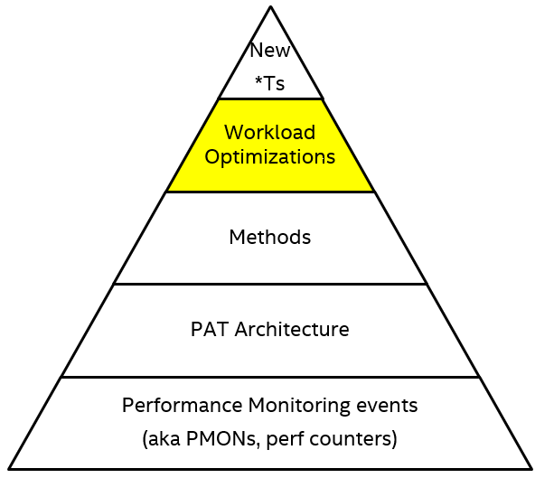
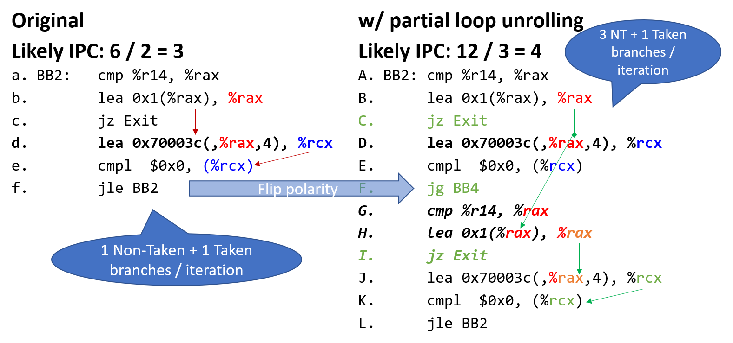
Opt#B: Tuning of Intel compiler for Alder Lake / SPR
Results on exchange2 component (1 of 10) of ISPEC17 1-copy:
  >10% speedup on Core/GLC, +4.6% on Atom/GRT
Root cause: tight-loops challenge wider-issue cores
Solution: compiler to unroll tight loops
How? TMA (Top-down Analysis) flags Frontend Bound and low Instructions per Taken Branch. Use LBR to scale.
Notes:
3

Slide 29
SW Optimizations summary [May 2022]
Motivation
# | issue | optimization | Status (ICX compiler version) | uarch’s | Applies to SPEC17
Opt#A | DSB hit after miss | JMP on fall-thru to loop | Deployed (2022.0) | Core | ♥♥
Opt#B | Tight Loops (much frequent takens) | (Partial) loop unrolling | Deployed (2022.1). [>10% exchange2. now xalancbmk] | All: Intel (Core, Atom), AMD | ♥, #2
Opt#C | DSB contended hit | Eliminate jump to mid-loop |  | Core
Opt#D | Underutilizing AVX vectors | exploit wider vectors in library/compiler | Optimized in Blender [+12% for ADL] | 256-bit: all 512-bit: Xeon | n/a
Opt#E | Mispredicted indirect jumps | De-virtualize it to a conditional | To come in Blender [+2% for ADL]. Now WordPress | Core, Atom | Base: n/a Peak: yes

